Slide 1
Ecology 8310
Population (and Community) Ecology
Coexistence in a competitive guild
  Hutchinson
  Resource heterogeneity
  Patch dynamics / IDH
  Predation
  Resource fluctuations
  Neutral Theory
  Interference competition
  Chesson: stabilizing and equalizing mechanisms

Slide 2
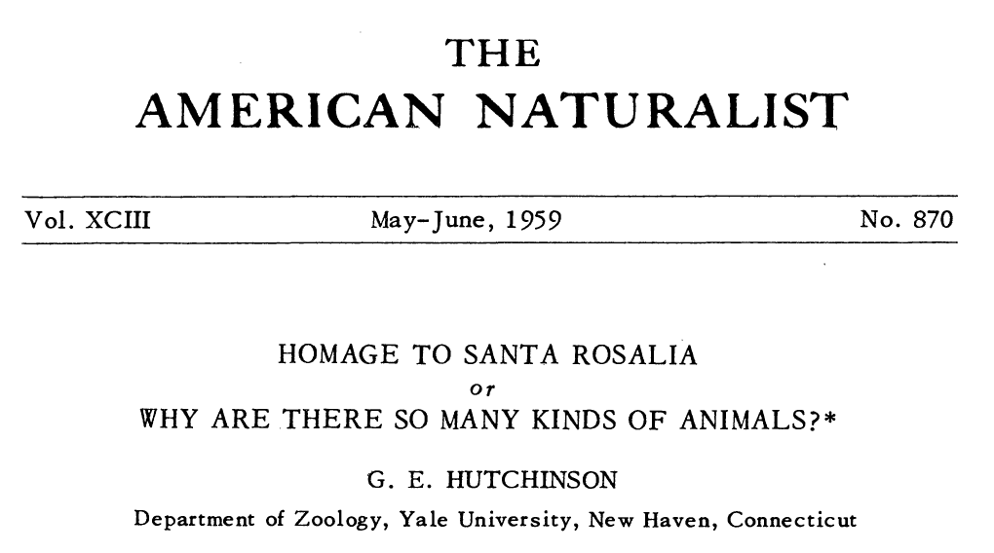

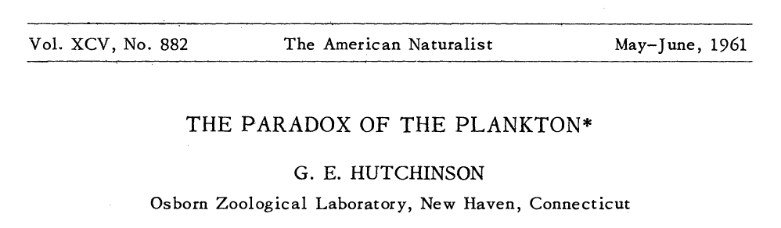

Slide 3
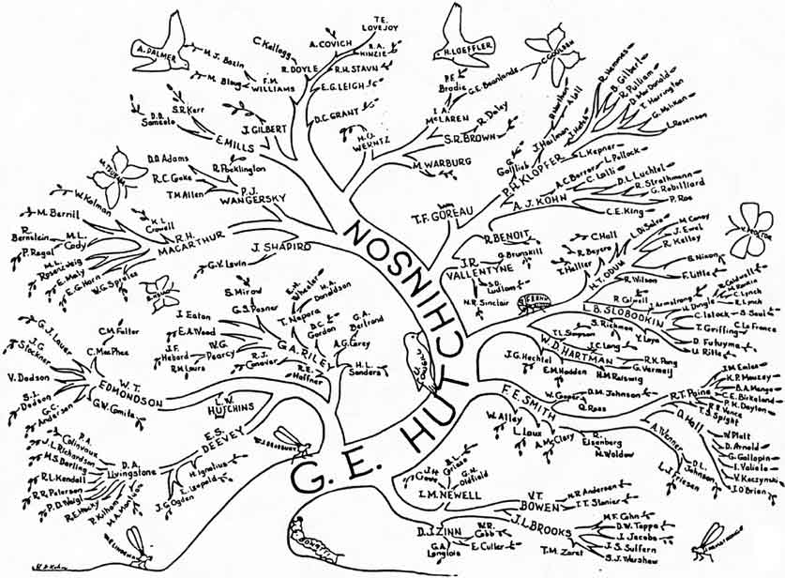

Slide 4
"Vast numbers of Corixide were living in the water …. These ideas finally prompted the very general question as to why there are such an enormous number of animal species."

Slide 5
Let's explore a few of those issues for a guild of competitors…

Slide 6
Resource partitioning (niche divergence): "intra>inter"
Environmental heterogeneity
Disturbance
Interference competition

Slide 7
Many competitors:
Assuming the dynamics of these 6 species is described fully by the R* framework…what will the outcome be?
R₂
R₁

Slide 8
How can we modify this picture to facilitate coexistence?

Slide 9
Many competitors:
Assume a trade-off in R*
How many species could co-exist now?
R₂
R₁

Slide 10
We need to specify consumption (and supply)

Slide 11
Three competitors:
What is the outcome in each region?
Add in consumption…
R₂
R₁

Slide 12
Three competitors:
Blue
Blue
Blue
Blue & Green
Green
Red & Green
R₂
Green
Red
Red
R₁

Slide 13
Trade-off in R*s
Correlation between R*s and consumption
(i.e., better competitor for a resource, consumes relatively less of that resource)
But, still only get (at most) 2 coexisting consumers

Slide 14
Many competitors:
Blue & Orange
Orange & Green
Green & Sky
Sky & Red
R₂
Red & Purple
R₁

Slide 15
What if a region is heterogeneous in S?

Slide 16
Many competitors:
Blue & Orange
Orange & Green
Green & Sky
Sky & Red
R₂
Red & Purple
R₁

Slide 17
What if patches don’t come to a competitive equilibrium?

Slide 18

Paradox:
1 limiting resource (Nitrogen)
Many species of plants (persisting together)
How is this possible?

Slide 19
Patch dynamics:
Disturbances open up space.
Good colonizers arrive first.
Competition occurs as others colonize.
One species wins (within that patch).
“Losers” persist by colonizing recently disturbed sites.
→Trade-off b/w ‘R*’ and colonizing ability

Slide 20
With-in Patch:
Let’s look at one patch in detail:
A
B
C
D
E
Resource
Species diversity
Abundance
Time
Note: Richness increases then decreases with time

Slide 21
Among- Patch:
Now look at a collection of patches (and vary disturbances) → mosaic:
Intermediate Disturbance Hypothesis
Resources
Species Richness
Good
competitors
Good colonizers
Frequent, large, intense
Rare, small, mild
Disturbances

Slide 22
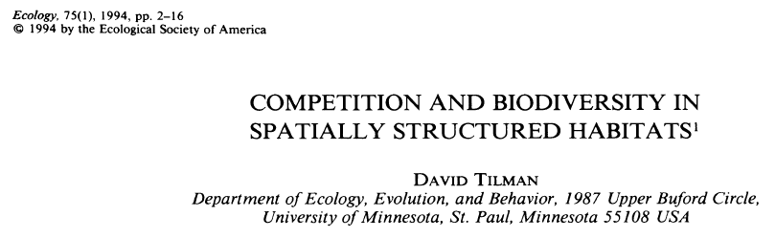
Let's review Tilman's classic paper:

Slide 23
Successional patterns:

Slide 24
Trade-off:

Slide 25
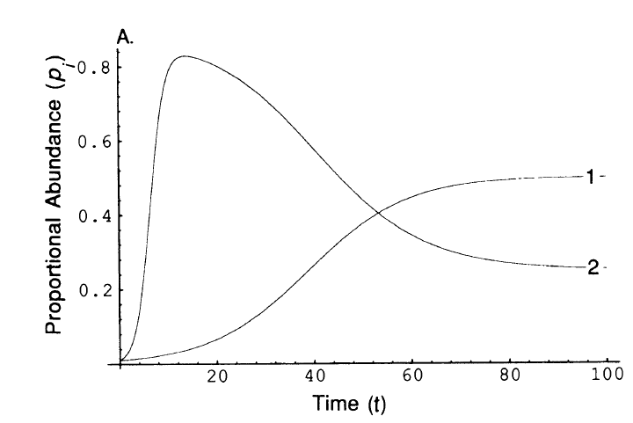
Trade-off:
Two species can persist…on one resource, even when one species is best competitor (if disturbances create heterogeneity)

Slide 26
Trade-off:
Many species can persist…on one resource (so long as the poorest competitor is the best colonizer):

Slide 27
Trade-offs
Possible trade-offs with competitive ability (that promote persistence of competitors):
Colonizing ability
Vulnerability to disturbance
Vulnerability to predators

Slide 28
Predators

Slide 29
Diamond food web:
Coexistence possible if better competitor is preferred by predator
Predator
Prey 1
Prey 2
Thus one prey is more limited by predation and the other by resource (a form of "partitioning")
Resource

Slide 30
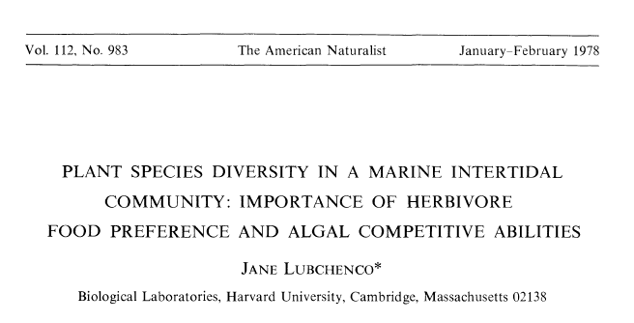


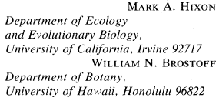


Slide 31
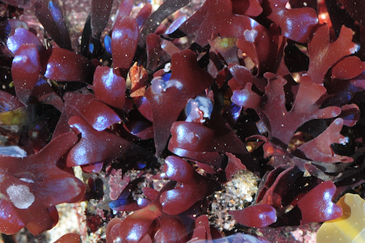
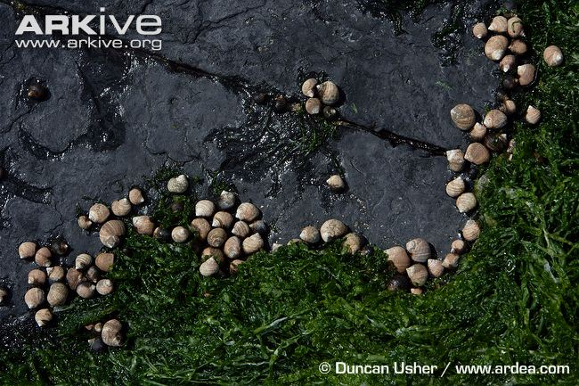
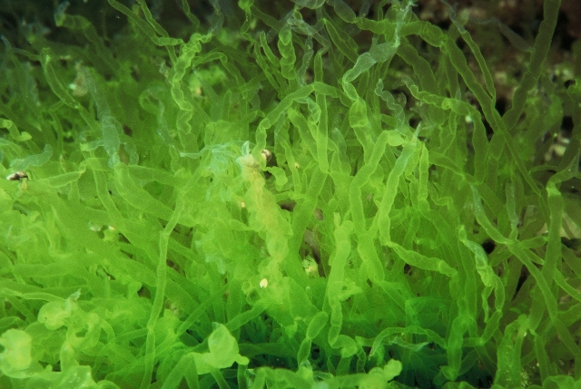
Avoided:
Chondrus
The grazer:
Littorina littorea
Preferred: Enteromorpha

Slide 32
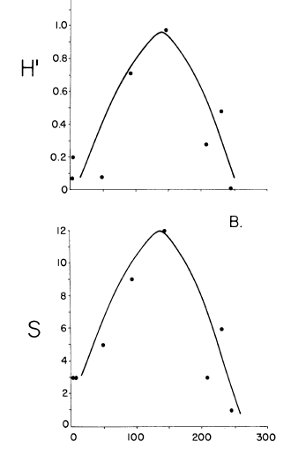
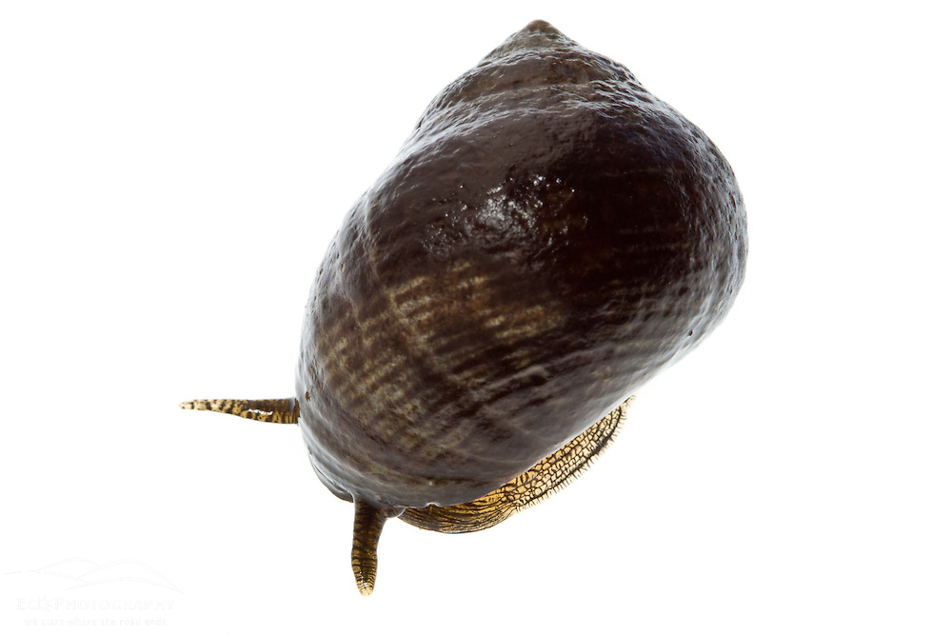

Inedible species dominates (Chondrus)
Competitive dominant wins (Enteromorpha)

Slide 33
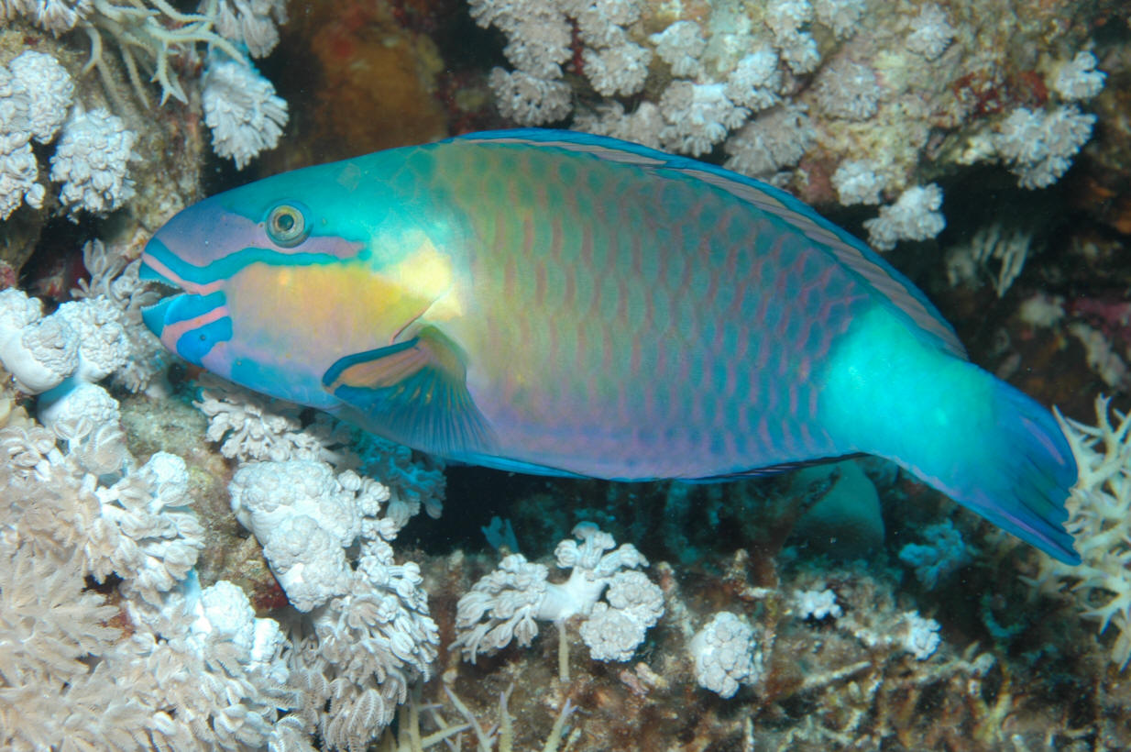
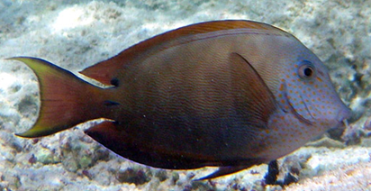
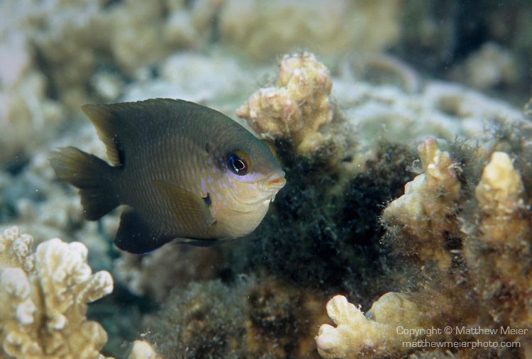

Slide 34
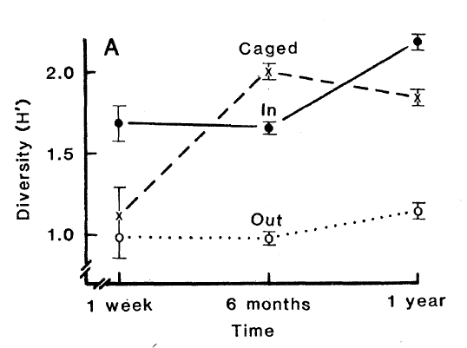
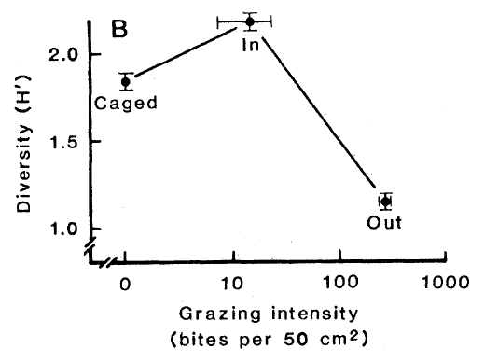
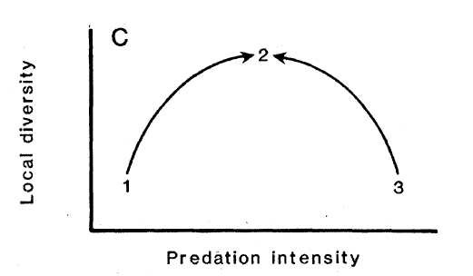

Slide 35
Resource fluctuations

Slide 36
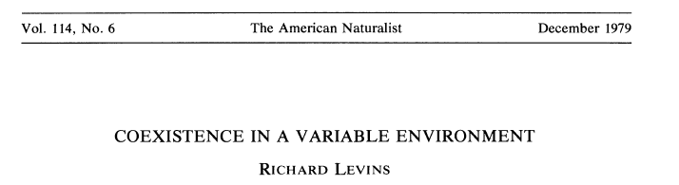
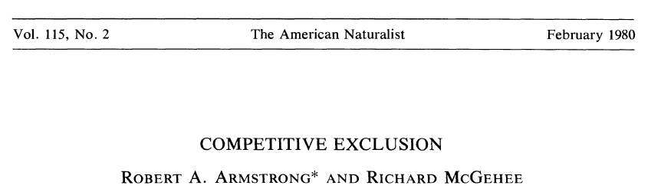
Exogenous:
Mean vs. variance specialists
Endogenous:
Limit cycles

Slide 37
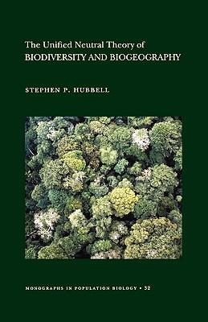
Hubbell's Neutral theory:
A different perspective (analogous to Kimura's model neutral theory in evolution):
  Species are identical: cf. niche theory
  Systems are saturated
  Random walk to extinction
  Extinction balanced by speciation
  Can achieve persistence of diverse communities (dynamic, no “winner”)

Slide 38
What if competitors compete via exploitation AND interference?

Slide 39
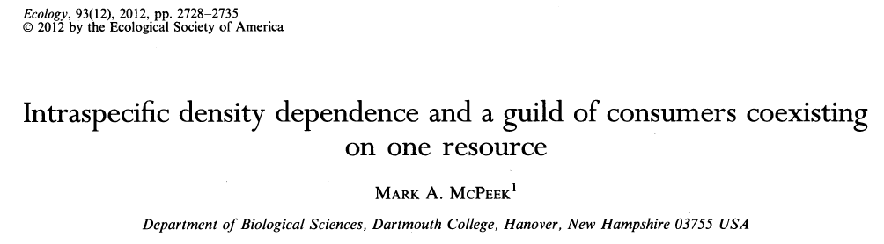

Slide 40
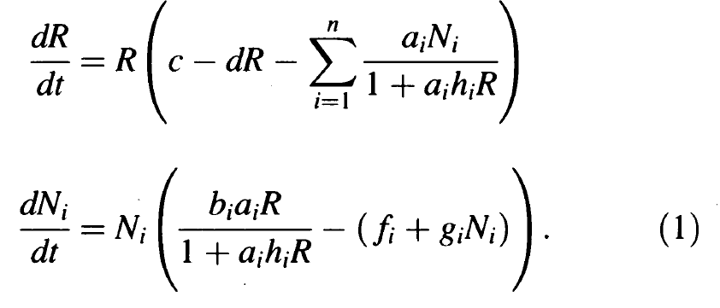
Type II functional responses
Logistic growth
Resource
Consumer
Interference-mediated mortality
Mortality

Slide 41
How does this change our basic 2-consumer model?

Slide 42
Consumer-resource phase plane:
Without interference (g=0) or handling costs (h=0)
dN₁/dt=0
dN₂/dt=0
N
dR/dt=0
R
Who will "win"?

Slide 43
Our picture isn't sufficient – we really need a 3-d phase plane…

Slide 44
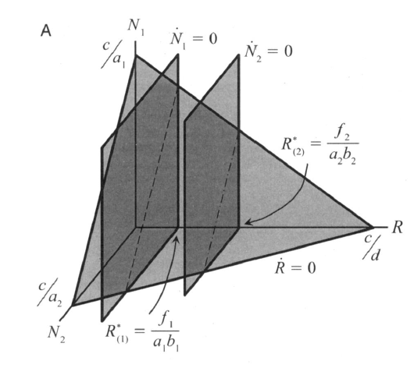

Slide 45
Now let there be INTRAspecific interference…

Slide 46
Consumer-resource phase plane:
With interference (g>0) but still no handling costs (h=0).
dN₁/dt=0
N
dR/dt=0
f₁/a ₁b₁ R*₁
Let sp. 1 have the lowest f/ab (i.e., invasion threshold):
How can another consumer invade?
R

Slide 47
Consumer-resource phase plane:
For species 2 to invade: f₂/a₂b₂ < R*₁
dN₁/dt=0
N
dR/dt=0
f₁/a ₁b₁ R*₁
R

Slide 48
Let's look at this in 3-d…

Slide 49
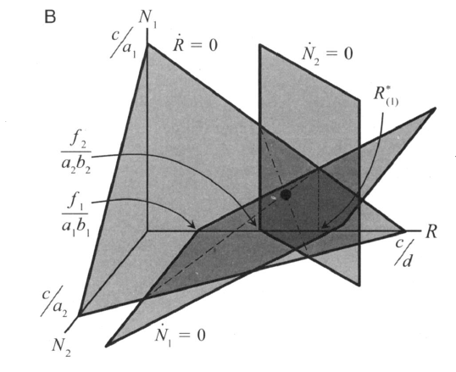
Three species equilibria where the isoplanes intersect:

Slide 50
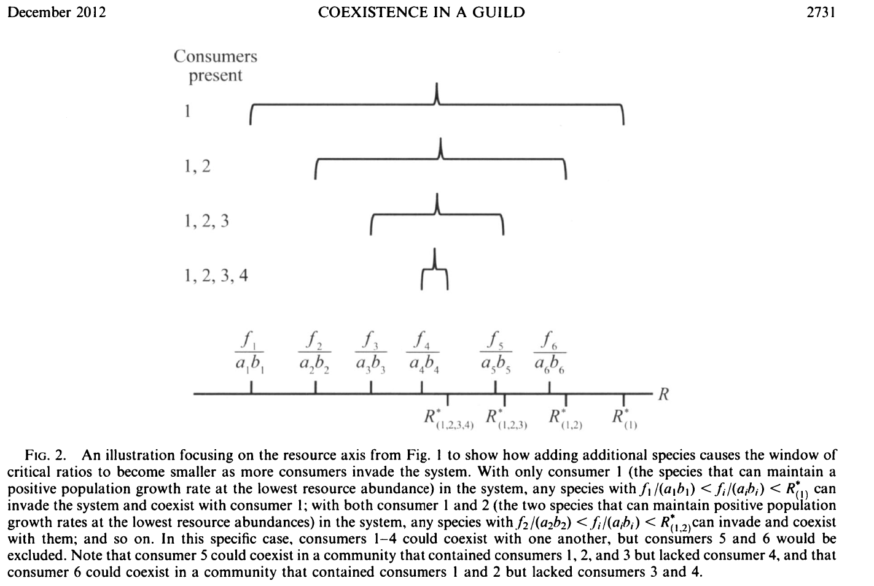

Slide 51
Therefore, interference enables multiple consumers to coexist on a single resource
(creates "intra>inter"; analogous to each species having it's own unique resource (partitioning) or specialized predator (apparent competition))

