Slide 1
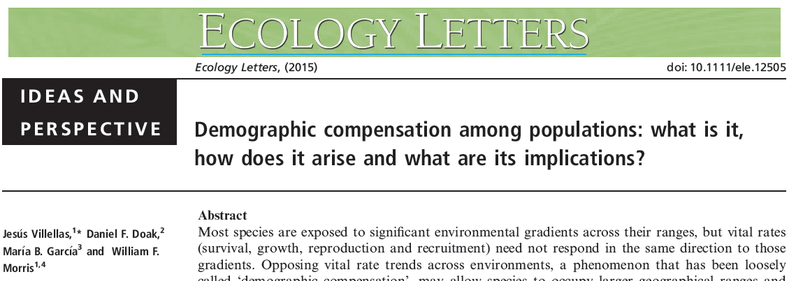
Ecology 8310 Population (and Community) Ecology
Notes:
Foraging theory had it's hay-day in 1970's and early 80's. Not common today, but the basis of the theory remains with us; engrained in how we model systems and think about consumer-resource interactions and spatial dynamics.

Slide 2
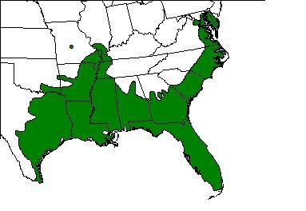
Context
Notes:
Green treefrog (GA state frog)
Space // time

Slide 3
Context
What accounts for the distributional limit?
dispersal (perhaps with Allee effects)
biotic and abiotic factors
If environmental factors, then:
λ(N≈0) > 1 within distribution
λ(N≈0) < 1 outside of distribution

Slide 4
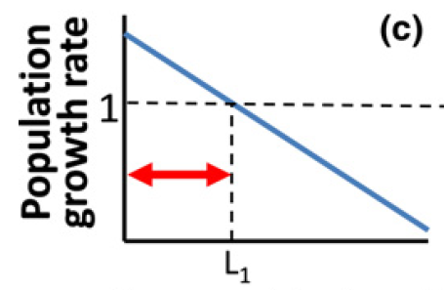
Context
Notes:
At low N.

Slide 5
Context
Environmental change:
Many species have shifted their ranges in recent decades…
"¼ - ½ of species show no net range shift" (Doak & Morris 2010)
Why?

Slide 6
Context
λ is a complex "trait"
Determined by vital rates:
Birth (or recruitment) rate
Death (or survival) rate
Growth rate (progression to next stage)
These rates may not change concordantly across environmental gradients

Slide 7
Demographic Compensation
Various meanings in the literature:
Most commonly: beneficial responses in a vital rate following a deleterious external event (e.g., birth rates increase after a hurricane).
Usually due to reduction in density-dependence.
Villellas et al: "we mean changes in opposite directions in mean vital rates across populations"

Slide 8
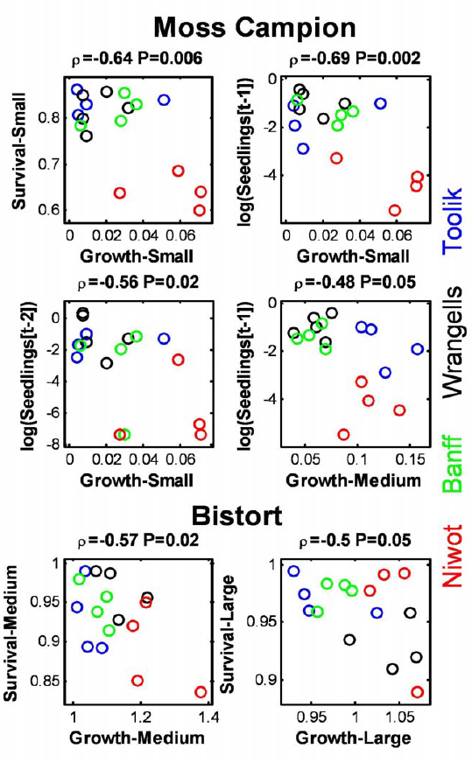
Other studies suggest negative (spatial and/or temporal) correlations between vital rates
[although I think the evidence in these citations is weak…to the left is one of the most compelling data]
Doak, D.F. & Morris, W.F. (2010). Demographic compensation and tipping points in climate-induced range shifts. Nature, 467, 959–962.

Slide 9
1. Is it present?
2. What is the pattern?
3. What causes it?

Slide 10
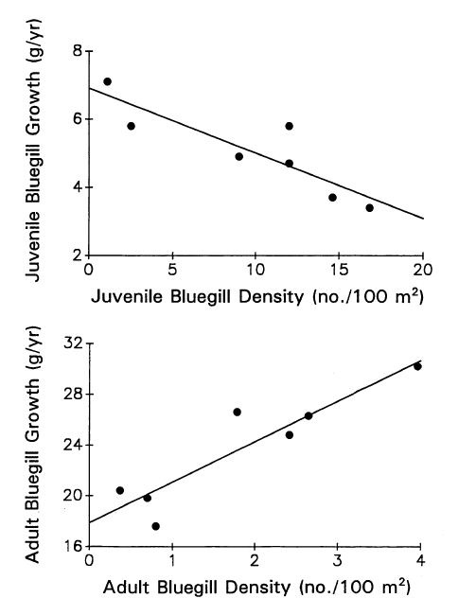
Demographic Compensation
Density – mediated (e.g., sunfish)
Small Bluegill
Large Bluegill
Littoral Invertebrates
Zooplankton

Slide 11
Demographic Compensation
Other drivers of negative correlations:
Genetic architecture
Biochemical processes
Energetic constraints

Slide 12
Let's consider two traits (very simplistically)…

Slide 13
Fitness landscapes
High fitness
Trait 2 (Z₂)
X
Low fitness
Trait 1 (Z₁)

Slide 14
Common empirical pattern:
Trait 2 (Z₂)
Trait 1 (Z₁)
Notes:
E.g., if our traits now are vital rates, such as fecundity and survival…..Does this expectation make sense? No, b/c of trade-offs.

Slide 15
But what about trade-offs
(and the factors driving the variation in traits)

Slide 16
Egg number vs. size
Daniel D. Heath et al. Science 2003;299:1738-1740

Slide 17
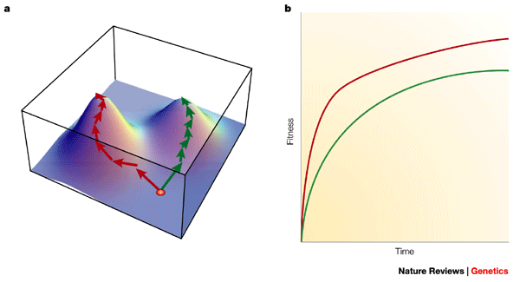
Fitness landscapes

Slide 18
What if there is a trade-off between Z₁ and Z₂ (i.e., you can't easily evolve in both directions)?

Slide 19
Fitness landscapes & trade-offs
High fitness
X
Trait 2 (Z₂)
Low fitness
Trait 1 (Z₁)

Slide 20
Fitness landscapes & trade-offs
Low fitness
High fitness
X
Trait 2 (Z₂)
Trait 1 (Z₁)

Slide 21
What if there are different environments (genotypes)? (in which total allocation to Z₁ and Z₂ is greater or lesser?)
Notes:
E.g., because of greater resource availability?

Slide 22
Fitness landscapes & trade-offs
Trait 2 (Z₂)
High resource acquisition
Low resources
Trait 1 (Z₁)

Slide 23
Alternative interpretation:
Trait 2 (Z₂)
Trait 1 (Z₁)

Slide 24
Alternative interpretation:
Trait 2 (Z₂)
Trade-off hidden by variation in resource acquisition
Trait 1 (Z₁)

Slide 25
So, if the environment changes, what would we expect in terms of the response of Z₁ and Z₂?

Slide 26
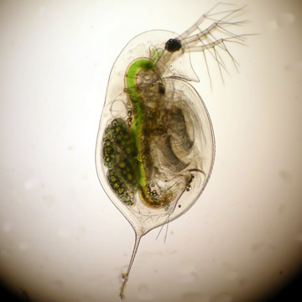
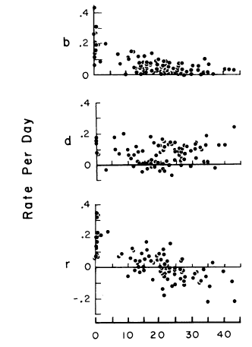
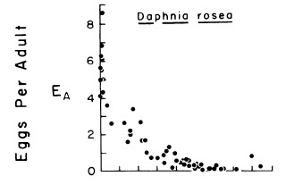
From Kerfoot et al. (1985)
Notes:
In a deteriorating environment (hi N; low food), Daphnia forego repro, but "protect" survival. Suggesting energy that was once allocated to both maintenance and repro, now only gets used to support maintenance.

Slide 27
Demographic Compensation
= "Trade-off" (between vital rates)
i.e., deleterious environmental change is expected to reduce vital rates (thus reducing population growth). Demographic Compensation can buffer this response (at the extreme, another vital rate will increase).

Slide 28
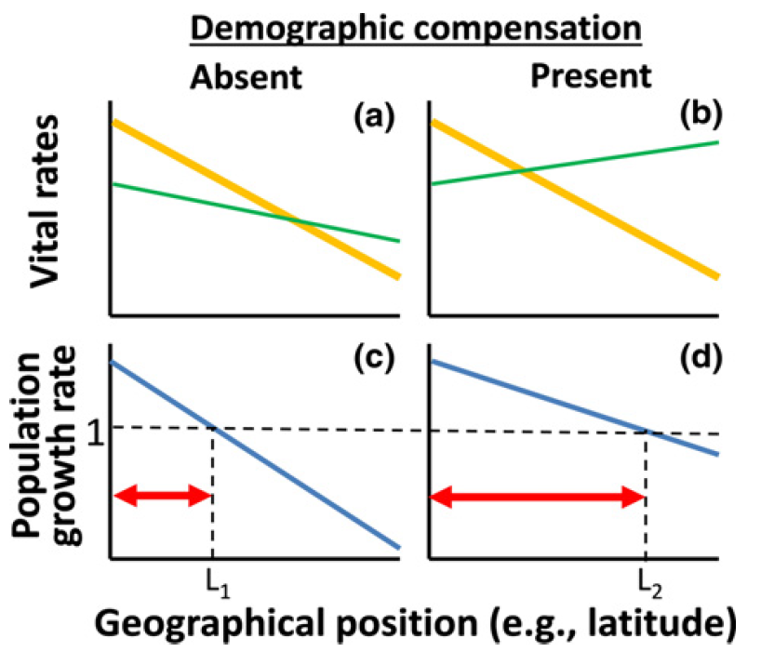
Their perspective:
Notes:
Frankly, this presentation was opaque to me or obvious. If you keep the yellow line fixed and change the green on, of course, the range will increase.

Slide 29
Context
My view:
1) DC doesn't require negative correlation across space
2) But, at most, an inverse response to change
3) Which buffers response to the change

Slide 30
Approach by Villellas et al
Obtain vital rates for many populations
Contribution of vital rate to λ
Assess correlations among rates
For 26 species with >6 pops.

Slide 31
Two analytic challenges
Estimation of vital rates (from matrix)
Contributions of vital rates to λ (via LTRE)
Notes:
LTRE = "life table response experiment"

Slide 32
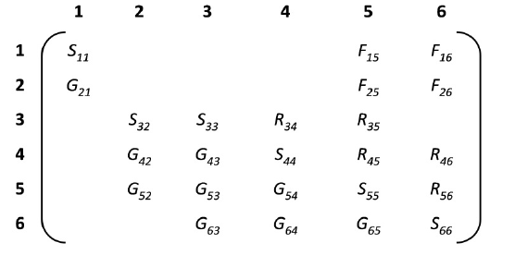
Projection matrix→ vital rates
Seedbank
Seedlings
Small juveniles
Large juveniles
Small adults
Large adults
Why isn't there a S₂₂ term?
Why are there fecundity terms in the second row?

Slide 33
Projection matrix→ vital rates
Sums to s₄
s = Pr(survival)
g = Pr(growth|survival) (by any amount)
r = Pr (revert|survival) (by any amount)
k (or h) = Pr (growth (or shinkage) by >1 step | survival and growth)
l = Pr (growth by >2 steps | survival, grow by >1 step)
f = fecundity (includes some survival)
z = Pr (germination from seedbank); sz = "recruitment"
Notes:
So now. We need to take these matrix elements and come up with GROWTH, SURVIVAL, FECUNDITY, GERMINATION, SHRINKAGE, as well as K and H (i.e., growth or shrinkage by >1 step)

Slide 34
Life Table Response Experiment
Convert vital rate to "contribution to growth, C"
Originally proposed to compare two treatments in an experiment (Caswell 2001 – classic book)
Here, "reference" is the mean across all populations:
Notes:
i.e., it's an esimate of "limitation" sensu are old discussions: it takes an infinitesimal change (S) and translates it (linearly) into a total change based on the perturbation applied (via the observed difference in vital rates).

Slide 35
A result
24/ 26 studies
had significantly more POSITIVE correlations than expected by chance
What does this mean?

Slide 36
A result
11 / 26 studies
had significantly more NEGATIVE correlations than expected by chance
What does this mean?

Slide 37
A result
The 4 experimental studies did NOT show demographic compensation.
Why?

Slide 38
A result
Demographic compensation more likely, if: a) monitored longer; and b) monitored more populations
Why?

Slide 39
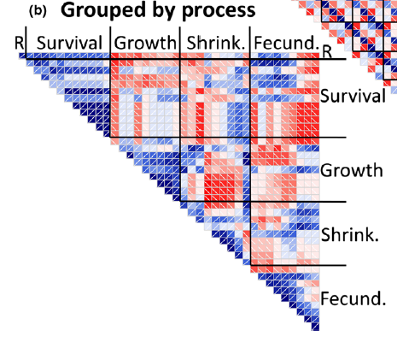
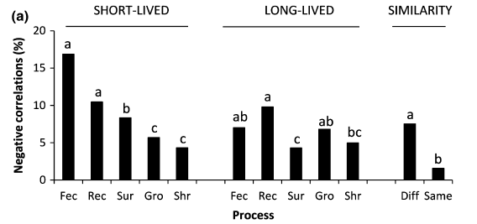
Other results
What might this tell us about life history trade-offs?

Slide 40
How do you expect vital rates to co-vary across space?
Notes:
Does demographic compensation require negative correlations?

Slide 41
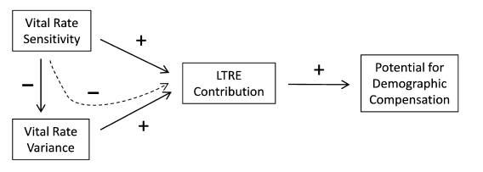
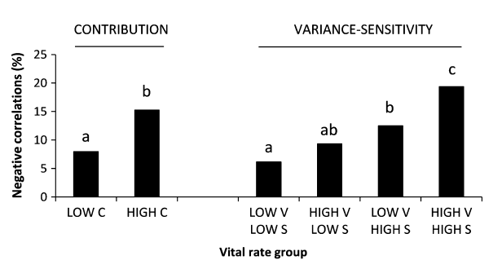
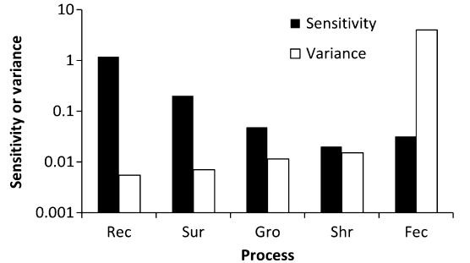
Notes:
Why does sensitivity decrease variance? Note that they observe this inverse relationship (see bottom figure). They argue that this is due to a form of selection, in which more sensitive parameters should show reduced variance – this is confusing to me, but I think analogous to the argument that trait traits that are most closely related to fitness should show small variances I'm just not sure how that variance is "acted upon" – what takes a sensitive rate and makes it less variable?

Slide 42
Why is this an interesting questions?
Why is var(λ) an "inverse proxy" for potential range size?

Slide 43
What if you examined these patterns at low N vs. near equilibrium?
Notes:
Give Mittelbach and Chesson and Osenberg scenario… Juvenile production vs. Adults…. And Adult production vs. juveniles…. At equilibrium it must be true that Fec and Surv are inversely related…

Slide 44
Timescale issues
Compare an experiment (short-term change in environment) with a comparative study (in which the populations have existed for many generations)
What do you expect in terms of demographic compensation?

Slide 46
Do these patterns arise from underlying genetic differences or plasticity? (does it matter?)

Slide 47
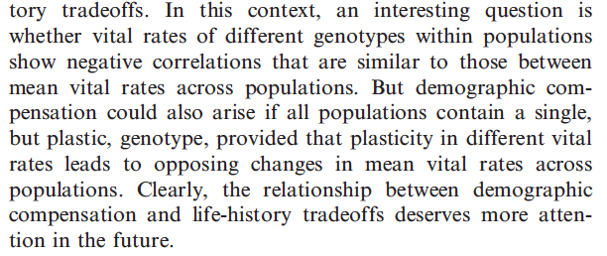

Slide 48
Bottomline:

Slide 49
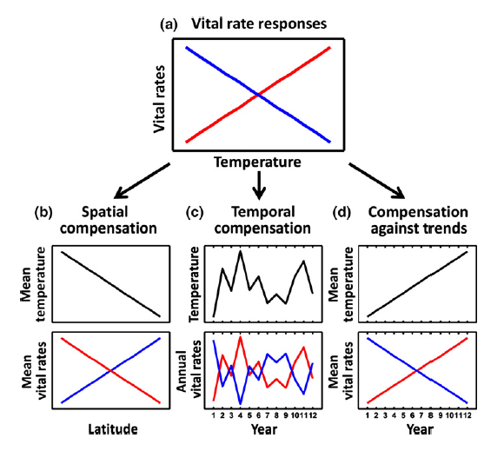

Slide 50
