Slide 1
Ecology 8310 Population (and Community) Ecology
Metapopulations
Levins' model
Mainland-island model
Within-patch dynamics
Source – sink dynamics

Slide 2
Closed population
Open population
Regional dynamics
Births,
deaths
N (focal population)
Emigration
Immigration
Notes:
Up until now…closed population, in which N is driven only by internal births and deaths.
If there were others populations in the regional system (click), they had no effect on the dynamics of our focal system.
But what if there was movement of individuals across these geographic barriers, creating additional gains and losses from our focal system?
And what patterns might emerge if we consider the entire collection of populations?

Slide 3
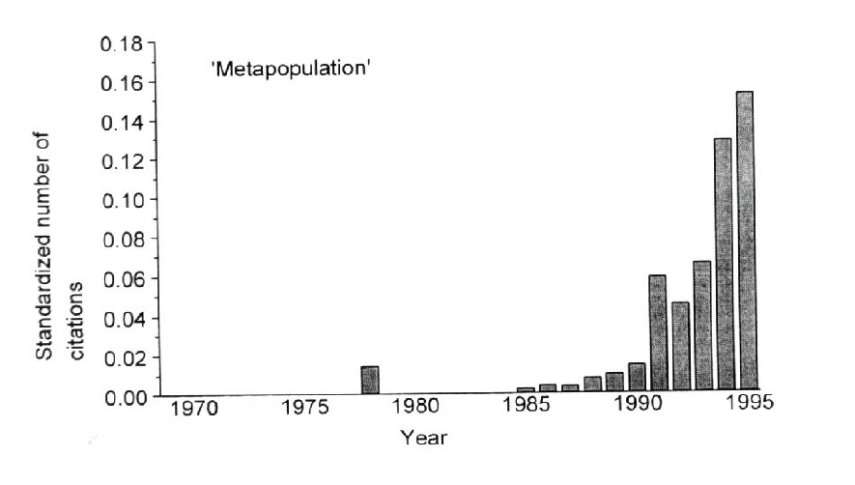
Attribution: Richard Levins (and later, Ilkka Hanski)

Slide 4
Levins model (aka internal colonization)
Notes:
i.e.how to take this information, target your actions, and get the best increase in pop growth. Management action should affect one or more elements in the matrix, but the response of lambda won't be the same. So, to inform our decision, we'd like i..,e how senstive is lambda to changes in the elements of A.

Slide 5
Levins' model :
Many identical patches in system (each patch can support a population); intervening matrix is unsuitable
Spatially implicit
Ignores internal dynamics (each patch is either occupied or unoccupied)
Thus, two processes: extinction and colonization

Slide 6
Levins' model:
n = number of patches (assumed very large)
P = proportion of patches occupied
1-P = proportion of unoccupied patches
m = rate of extinction (given occupied) [for example, if you shut down colonization, then p_{t}=p₀e^{-mt}]: e.g., like death rate (not a probability, but related to it).
c = rate of colonization (given unoccupied): e.g., birth rate
m, c are constant and identical among patches
dP/dt = change via colonization - extinction
dP/dt = cP(1-P) - mP

Slide 7
Levins' model:
Populations wink in and out.
occupied → unoccupied → occupied→…
In absence of other patches, a patch is empty (extinction is forever…)
Recolonization can lead to regional persistence
So, let's look at long-term behavior (P*)

Slide 8
Graphical approach, then mathematical
Notes:
i.e.how to take this information, target your actions, and get the best increase in pop growth. Management action should affect one or more elements in the matrix, but the response of lambda won't be the same. So, to inform our decision, we'd like i..,e how senstive is lambda to changes in the elements of A.

Slide 9
Levins' model:
dP/dt = cP(1-P) - mP
Rate, cP(1-P) or mP
P*
Proportion occupied, P

Slide 10
Levins' model:
Note that Levins' model is similar to logistic:
Recall:
dN/dt = rN – aN²
= rN(1 – N/K)
dP/dt = cP(1-P) – mP = (c-m)P – cP²
= (c-m) P (1 – P/(1-m/c))
So, c-m~r; (1-m/c) ~ K

Slide 11
Levins' model:
Given this similarity, many insights we already have are still relevant (but in which patches are "individuals"):
equilbrium
stability
"demographic" stochasticity

Slide 12
Vary the extinction rate
Notes:
i.e.how to take this information, target your actions, and get the best increase in pop growth. Management action should affect one or more elements in the matrix, but the response of lambda won't be the same. So, to inform our decision, we'd like i..,e how senstive is lambda to changes in the elements of A.

Slide 13
Levins' model:
dP/dt = cP(1-P) - mP
Rate, cP(1-P) or mP
Proportion occupied, P

Slide 14
Do some math…
Notes:
i.e.how to take this information, target your actions, and get the best increase in pop growth. Management action should affect one or more elements in the matrix, but the response of lambda won't be the same. So, to inform our decision, we'd like i..,e how senstive is lambda to changes in the elements of A.

Slide 15
Levins' model:
E.g., equilibrium:
dP/dt = 0
cP(1-P) = mP
P* = 1 – m/c (if c>m)
else
P* = 0 (if m>c)
[Agrees with our graphical approach]

Slide 16
Levins' model:
Implications:
1) Interpretation of local extinctions
2) Conservation biology

Slide 17
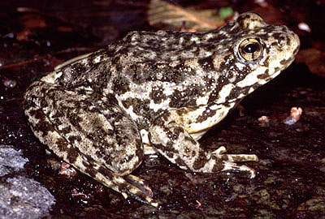
Discussion:
1) Amphibian declines
Established populations are declining

Slide 18
Discussion:
Assume:
Developers are environmentally aware
Target non-occupied sites (to avoid impacts)
What will be the implications (if these sites are part of a meta-population network)?

Slide 19
Levins' model:
E.g., equilibrium:
dP/dt = cP(1-D-P) - mP
D = the proportion of patches removed
Then
P* = 1 – m/c – D

Slide 20
Levins' model:
P* = 1 – m/c - D
Removing unoccupied patches reduces the number of occupied patches by the same amount!
The population goes extinct when:
D = 1 – m/c = P*_{without development}
E.g., if 1/3 of patches are occupied, and you destroy half of the empty patches…extinction.

Slide 21
Can we express this graphically?
Notes:
i.e.how to take this information, target your actions, and get the best increase in pop growth. Management action should affect one or more elements in the matrix, but the response of lambda won't be the same. So, to inform our decision, we'd like i..,e how senstive is lambda to changes in the elements of A.

Slide 22
Levins' model:
dP/dt = cP(1-P-D) - mP
dP/dt = cP(1-P) - mP
D=0
Rate, cP(1-P) or mP
D>0
D>1 – m/c
P*
P*
P*
Proportion occupied, P

Slide 23
= "metapopulation meltdown"
Unoccupied sites are essential to the persistence of a metapopulation!
Notes:
Imagine that you remove a small fraction of the empty sites every year….. Eventually the metapop is extinct; even though you never destroyed habitat that was "used" by the species.

Slide 24
Can we compensate for these effects?

Slide 25
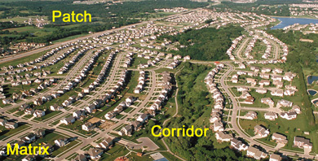
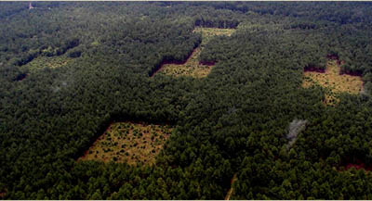
Corridors (increase colonization)
Savannah River Site (DOE): Haddad, Tewskbury, Levey

Slide 26
Corridors?
dP/dt = cP(1-P) - mP
Large c
Rate, cP(1-P) or mP
Small c
P*
P*
P*
Proportion occupied, P

Slide 27
Island – Mainland model

Slide 28
Island-Mainland model
Same as Levins', except:
Mainland fixed
No internal colonization

Slide 29
Island-Mainland model:
dP/dt = c(1-P) – mP (vs. cP(1-P) in Levins')
dP/dt = 0
P* = c / (c + m)
Note: islands always persist if c>0 (so long as the mainland exists)

Slide 30
What would this model look like graphically?

Slide 31
Island-Mainland:
dP/dt = cP(1-P) - mP
Rate
dP/dt = c(1-P) - mP
P*
P
Rate, c(1-P) or mP
P*
Proportion occupied, P
Notes:
Ie., islands persist with P*> so long as the mainland sends out more than 0 colonists.

Slide 32
Discussion
Rescue Effect?
Allee Effect?
Patch size?
Distance (isolation)?
Notes:
Rescue: Let m decline as more patches are occupied (e.g., because more propagules means that you don't get pushed to low local density as often due to demo stochasticity).
Address this by letting m become a decreasing function of P (so mP decelerates) (i.e., m declines as P increases)
Allee: colonizations may not be successful unless there are sufficient number of colonists arriving to an empty patch. In Internal colonization model, this means that c increases with P.
Can we put together a graphical model with Rescue or Allee?

Slide 33
What about within patch dynamics?

Slide 34
Notes:
Discuss Reeves and role of synchrony…
Next time: source-sink

Slide 35
Simulation study:
10 patches
Each patch follows Ricker dynamics, plus local noise, global noise, and migration
Migration: either distance-independent or distance-dependent
Increase r (r<2 is stable, r>2.56 chaos)
Quantify local and global extinctions
Notes:
Discuss Reeves and role of synchrony…
Next time: source-sink

Slide 36
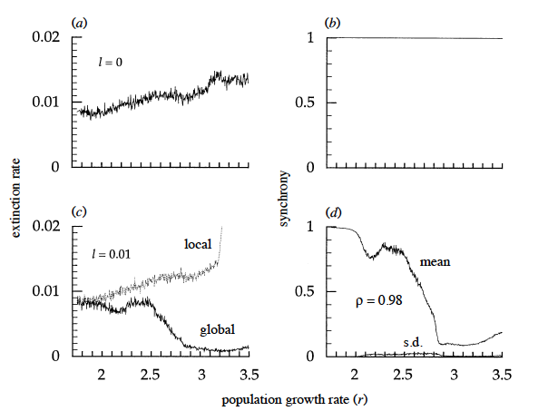
Simulation study: distance-INDEP migration
Local noise absent
Local noise present
From Heino et al. 2015 (Proc Roy Soc B)
Notes:
Without local noise and with migrants raining out of the sky (no distance-based migration), all patches come into synchrony. Yes, there are initial transients, but eventually, all patches show THE SAME temporal dynamics. Extinction rises with r due to stochastic extinction. Local extinction rate = global (bc all patches the same). (u is local noise; z is global noise)
L is a measure of local noise Uniform from –L to +L (with mean 0). So L is a measure of local environmental variance.
WITH Local noise (u): Now patches exhibit different dynamics; Initially, synchrony is high, but as we enter chaos, synchrony declines and extinction rate DECREASES!

Slide 37
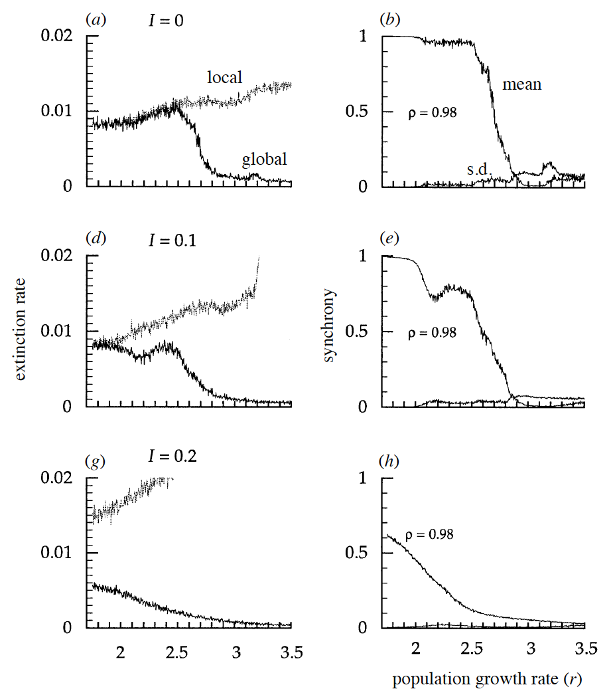
Simulation study:
Distance-DEP
migration
Synchrony decreases persistence
Asynchrony arises from endogenous variation (chaos), local noise, distance-dep dispersal (decouples distant patches).
From Heino et al. 2015 (Proc Roy Soc B)
Notes:
In the

Slide 38
Discussion
Why does asynchrony stabilize the system?

Slide 39
Discussion
What about variation in patch "quality"?

Slide 40
Discussion
Let there be two patches,
each with logistic growth (K₁>K₂>0)…
What will be N₁* and N₂*?
(if: emigration rate is constant and immigrants come from the other patch)
Notes:
(see Holt 1985 TPB). It's hard to say. But we can assert that K1<N1*<N2*<K2.
Assume that emigration gets very large (goes to infinity)…then what? Because it's a well-mixed system, the N's will converge. And w N1=N2, we also know that the migration into and out of a patch are in balance. Thus, we can seek a graphical solution....draw the basics of Holt 1985 – see figure hidden on next slide. can graphically compare the pre capita growth rates.
…From Holt 1985. Curves give dN/Ndt for the two patches. DOT gives the mean of the K's. X gives the density (recall N1=N2) at which the overall growth is 0 (one patch produces at rate Z and the other loses at rate Z) – the dashed line is just the average dN/Ndt (when N1=N2). Thus X gives the average density in the system, which can be either <aveK or >aveK. This depends on the strength of density-dependence. Bottomline: the aveK is biased towards the patch with the stronger den-dep.

Slide 41
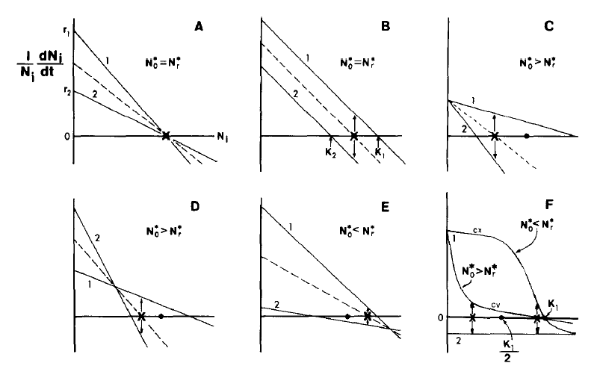
Notes:
From Holt 1985. Curves give dN/Ndt for the two patches. DOT gives the mean of the K's. X gives the density (recall N1=N2) at which the overall growth is 0 (one patch produces at rate Z and the other loses at rate Z) – the dashed line is just the average dN/Ndt (when N1=N2). Thus X gives the average density in the system, which can be either <aveK or >aveK. This depends on the strength of density-dependence. Bottomline: the aveK is biased towards the patch with the stronger den-dep.

Slide 42
Discussion
What if K₁>0, but K₂=0 (i.e., r₂<0) ?
What will be N₁* and N₂* ?
(if: emigration rate is constant and immigrants come from the other patch)
Notes:
Go thru a logistic case following Holt 1985 graphicall approach in which r<0. What is N1* and N2*.
Of course, movement will be more limited and thus we won't have a well mixed system. In this case, the solution is more challenging, but similar qualitative reasoning can apply.

Slide 43
Sources and Sinks
Notes:
What is a source? What is a sink?

Slide 44
Discussion
What is a source?
What is a sink?
What happens to a source (or sink) if you shut off migration?
How can you infer source vs. sink observationally?
E.g., you establish a reserve based on sites where you find the most critters…
Notes:
Lambda><1

Slide 45
Go over HW3

