Slide 1
Ecology 8310
Population (and Community) Ecology
Indirect Effects
  A terminological milieu
  "Classic" indirect effects
  Higher order interactions

Slide 2
Indirect effect
Trait-mediated indirect effect
Trait-mediated indirect interaction
Trait-mediated interaction
Interaction modification
Non-lethal effects
Non-consumptive effects
Trait-modified indirect effect
Density-mediated indirect effect
Behavioral indirect effect
Higher order interaction

Slide 3
Indirect effect
Higher order interaction

Slide 4
Indirect Effect
Indirect effect: An effect of one species on another, mediated by a change in the density of an “intermediate” species
(a series of >2 direct effects)
Notes:
The enemy of my enemy is my friend…

Slide 5
+
P
P₁
P₂
+
+
-
-
-
+
+
P
-
-
-
N₁
N₂
N₁
-
N₂
+
Keystone predation
Indirect mutualism
N₂
-
-
P₁
P₂
P
-
-
-
-
-
+
+
+
+
R
-
Trophic
cascade
N₁
-
N₂
N
Exploitation competition
Apparent competition

Slide 6
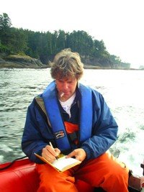
Classic experimental study:
Wootton (1994)

Slide 7
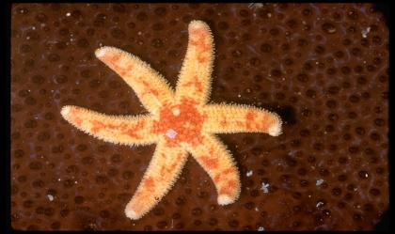
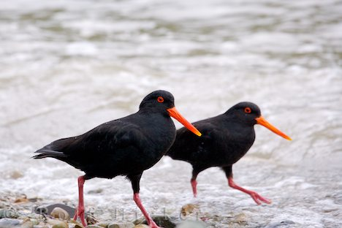
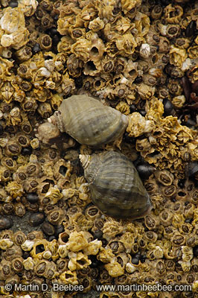
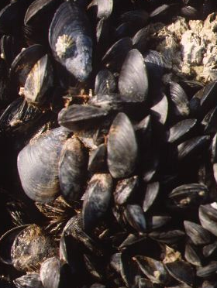
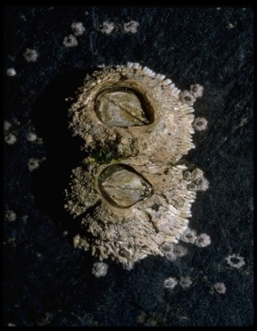
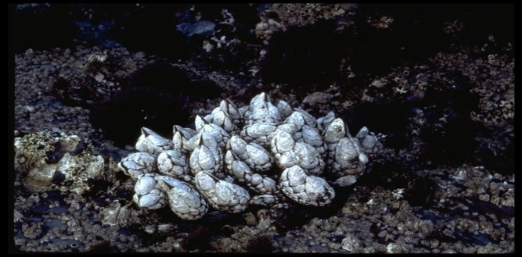
Intertidal food web
₊
Birds
GW Robinson
₋
₊
Starfish
₋
₊
₋
Snail
₊
₊
₋
₋
₊
₋
₊
₋
₊
₋
₋
₋
Goose Barn.
Acorn Barn.
₋
₋
Mussels
₋
G&B Corsi
Gerald and Buff Corsi

Slide 8
Data: Response to Bird Exclusion
Birds
Starfish
(no data)
Snail
Goose Barn.
Acorn Barn.
Mussels
What hypotheses might explain these patterns?

Slide 9
How can we explain the data?
Hypothesis 1
Another option?
₊
Birds
₋
Starfish
₊
₋
₋
₊
Snail
₊
₊
₋
₋
₊
₋
₊
₋
₋
₊
Acorn Barn.
₋
Goose Barn.
₋
₋
₋
Mussels
₋

Slide 10
Hypothesis 2
₊
Birds
₋
Starfish
₊
₋
₋
₊
Snail
₊
₊
₋
₋
₊
₋
₊
₋
₋
₊
₋
Goose Barn.
₋
Acorn Barn.
₋
Mussels
₋
₋

Slide 11
Hypothesis 3
₊
Birds
₋
Starfish
₊
₋
₋
₊
Snail
₊
₊
₋
₋
₊
₋
₊
₋
₋
₊
₋
Goose Barn.
₋
Acorn Barn.
₋
Mussels
₋
₋

Slide 12
Can we come up with a test of these hypotheses?
Hypothesis 1
Hypothesis 2
Hypothesis 3
Birds
Birds
Birds
Starfish
Starfish
Goose Barn.
Mussels
Snail
Acorn Barn.
+
Acorn Barn.
Snail
Goose Barn.
+
Goose Barn.
Snail
Acorn Barn.
Mussels
Mussels

Slide 13
Two approaches
Manipulate intermediate species directly (and look at effects)
Remove intermediate species: does indirect effect of birds disappear?

Slide 14
It the absence of snails: what will happen to the other species, if we then manipulate birds?

Slide 15
Hypothesis 1
Hypothesis 2
Hypothesis 3
Birds
Birds
Birds
Starfish
Starfish
Goose Barn.
Mussels
Snail
Acorn Barn.
Acorn Barn.
Snail
Goose Barn.
Goose Barn.
Snail
Acorn Barn.
Mussels
Mussels
Notes:
Note position of snails in the chain of effects and the downstream effects. Removal of snails will prevent effect of birds on all downstream components.
Emphasize multiple hypotheses constructed to explain the same data. (BLUE = intermediate species; RED = downstream effects)

Slide 16
Response thru snails (Nucella):
Weak effects of snail manipulation
Bird effects do not depend on presence of snails
Supports Hypothesis 1
Other focal taxa…

Slide 17
Hypothesis 1
Hypothesis 2
Hypothesis 3
Birds
Birds
Birds
Starfish
Starfish
Goose Barn.
Mussels
Snail
Acorn Barn.
Acorn Barn.
Snail
Goose Barn.
Goose Barn.
Snail
Acorn Barn.
Mussels
Mussels

Slide 18
Effects thru gooseneck barnacles (Pollicipes):
Large effects of Pollicipes (reduced acorn barn, mussels, snails)
Bird effects depend on presence of Pollicipes (key result)
Supports Hypothesis 1 (not 2 & 3)

Slide 19
Creative experimental approach based on clear definition of "indirect effect"

Slide 20
Higher order interaction
the direct effect of one species on another depends on the density of a third (i.e., a_{ij} is a function of N_{k}): e.g.,
Predator (j)
a_{ij}
A third species (k)
Prey (i)
a_{ij} is a function of N_{k}

Slide 21
Higher order interaction == a direct effect (but influenced by another species)
Indirect effect == a result of a series of direct effects

Slide 22
Higher Order Interactions:
Non-linearities (e.g., a type II functional response with >2 prey)
"Trait-moderated" indirect effects:
    Habitat shifts (e.g., predator-induced; aka “behavioral indirect effects”)
    Morphology (tadpole tails, barnacle lips, Daphnia helmets)
    Physiology (activity, stress)
    Life history (e.g., early reproduction)

Slide 23
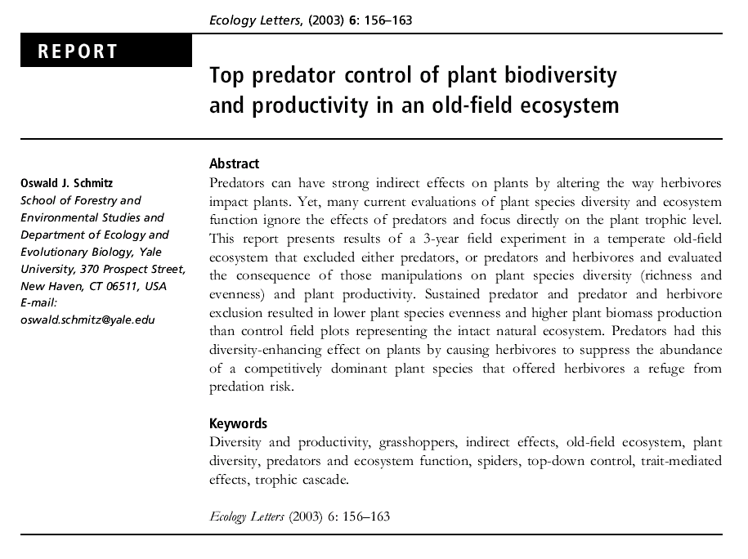

Slide 24
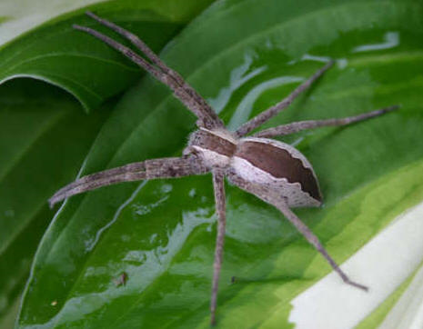
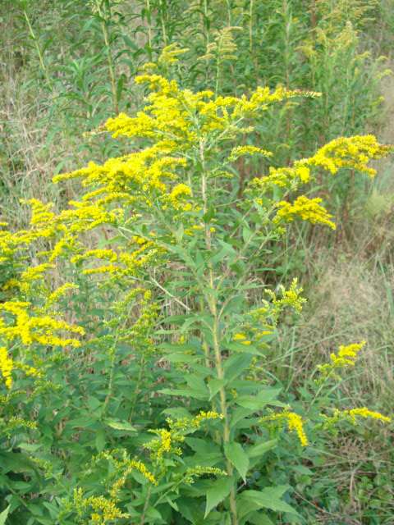
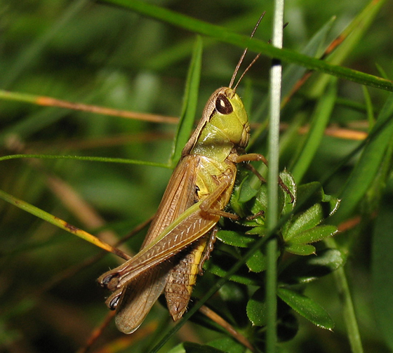
The key players:
Predator
Prey
Resource

Slide 25
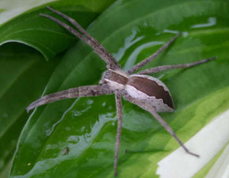


Three treatments (3 years):
Predictions?
--plant abundance
--plant diversity

Slide 26



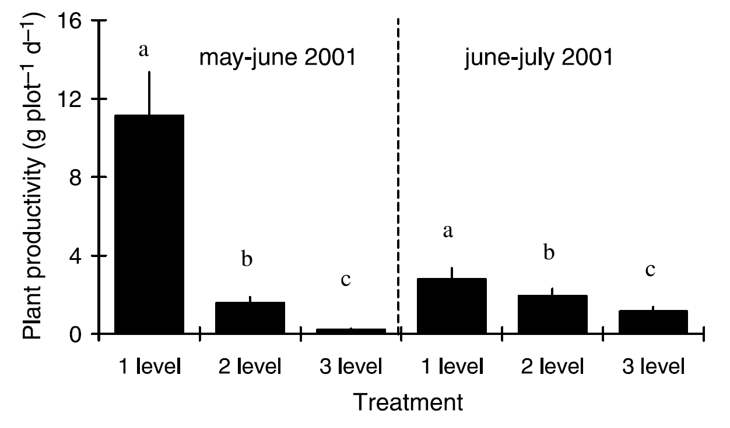
Notes:
Notice: addition of predator does NOT release the plant from herbivory – it actually exacerbates it.

Slide 27
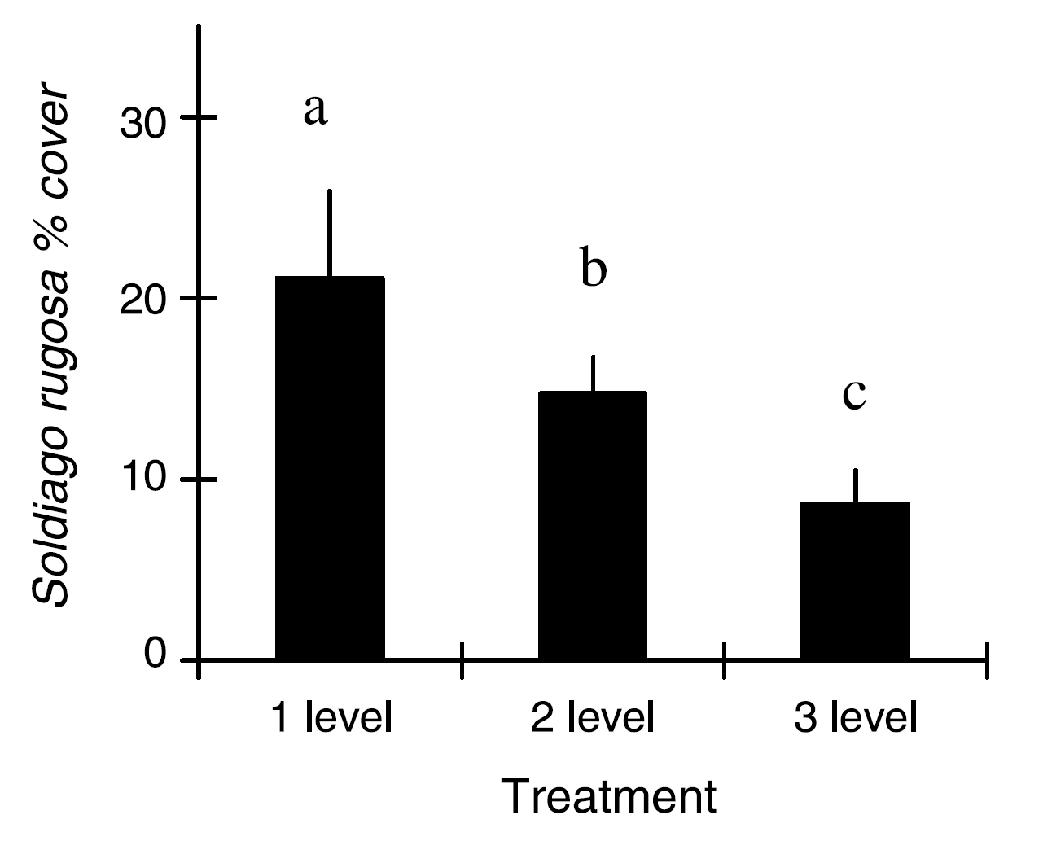

Slide 28
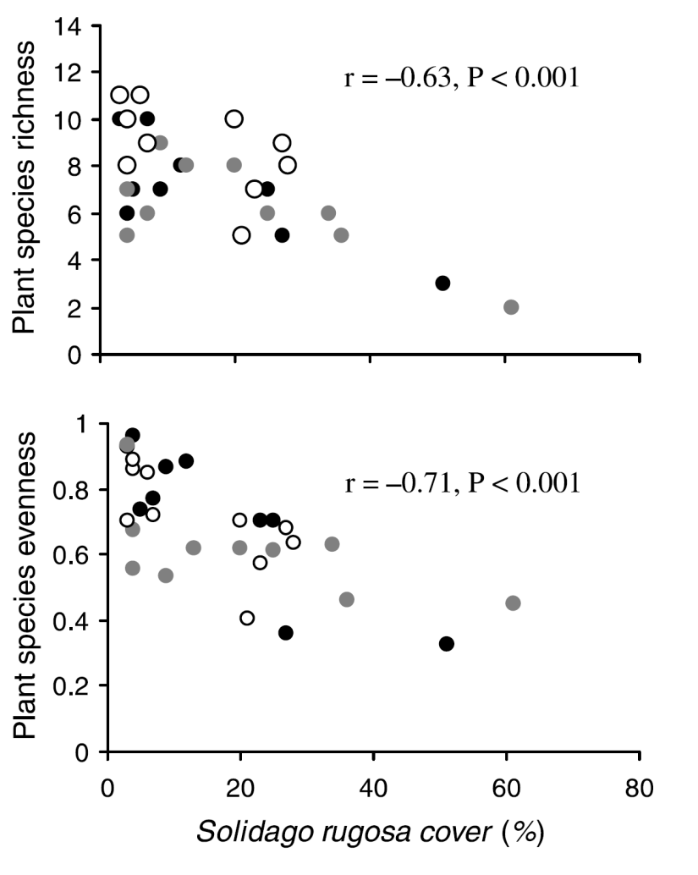
Symbols are different years
Richness: No. species
Evenness: a measure of equitability (1=equal abundances; 0=one dominant)
Notes:
Circles with different shading represent three different years.

Slide 29
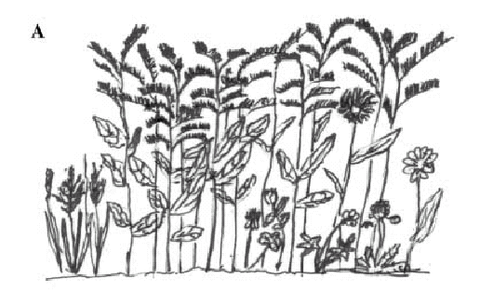
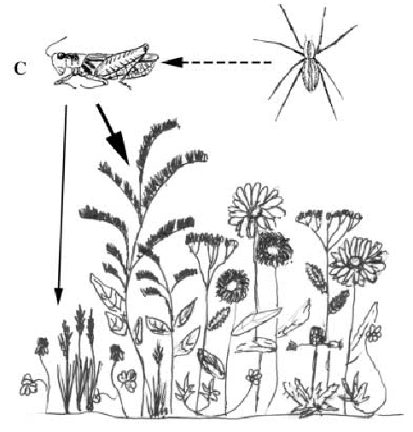
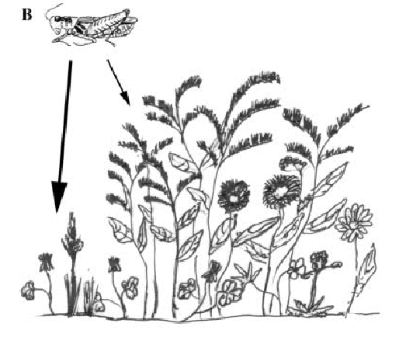
Solidago rugosa
Notes:
Spiders seek Solidago as a refuge from spiders (they don’t get eaten, but shift microhabitat).

Slide 30
Non-lethal effects of predator on prey can influence prey's resource assemblage

Slide 31
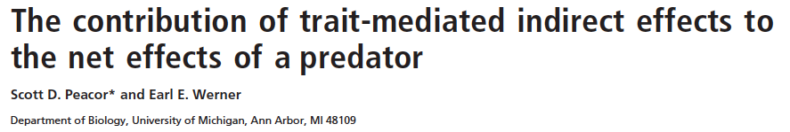

Slide 32
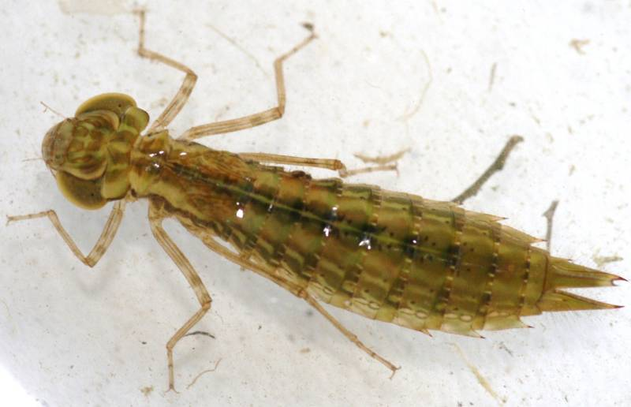
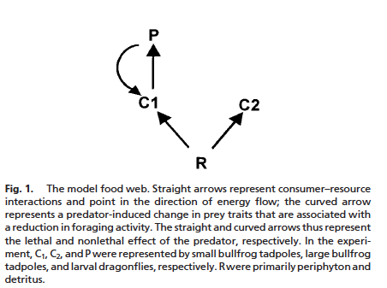
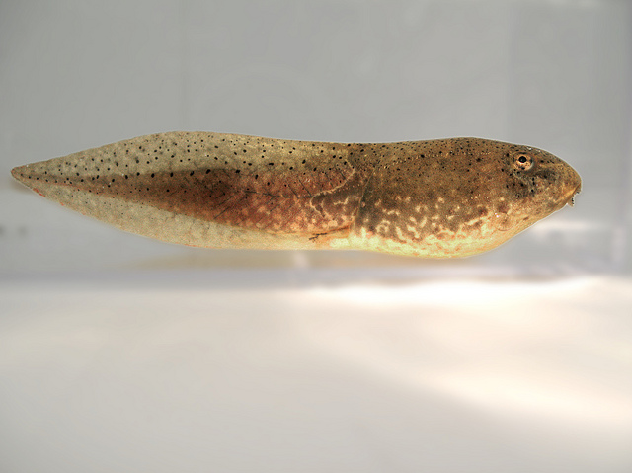
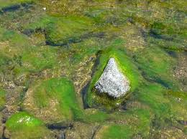

Slide 33
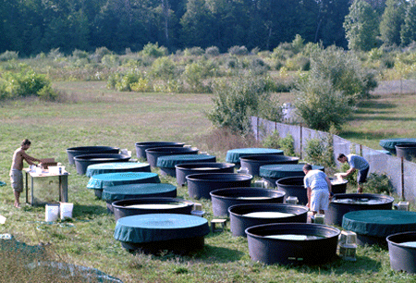
3 mortality levels (removed 9, 4, 25% per 2.5 d)
X
4 non-lethal levels (0, 1, 2, 4 caged Anax)
Effect of 2 lethal Anax

Slide 34
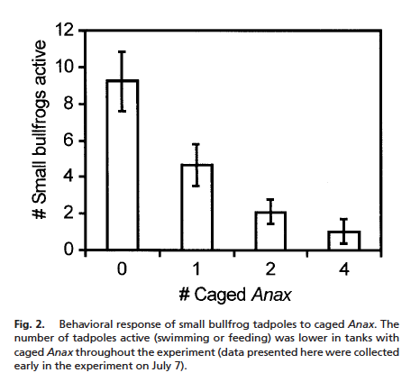
Notes:
Large bullfrogs don't respond (much)

Slide 35
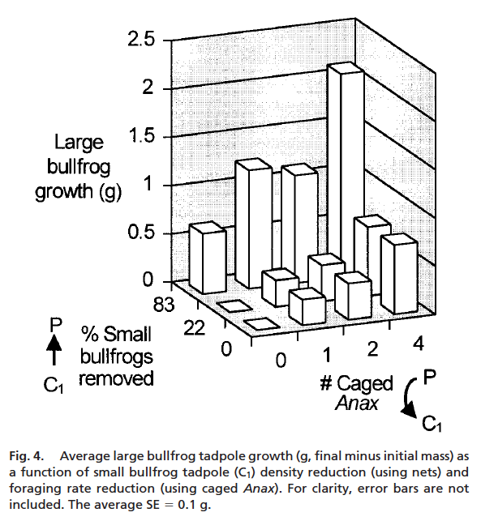

Slide 36
Use these data to partition lethal and non-lethal effects

Slide 37
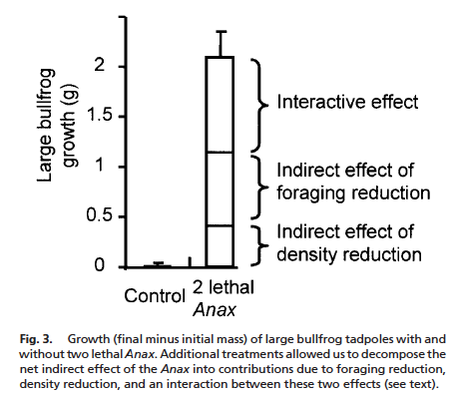

Slide 38
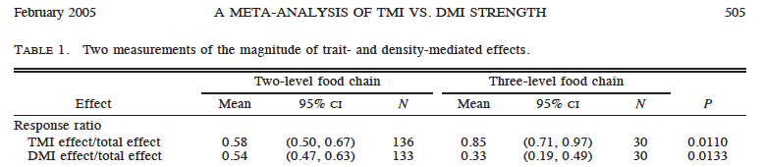
Subsequent reviews have shown non-consumptive effects can be very large relative to consumptive effects.
Preisser et al. 2005

