Slide 1
Ecology 8310 Population (and Community) Ecology
Disease ecology
Examples (e.g., measles)
SIR models
Epidemics
Vaccinations
Persistence (endemics)
Thanks to Drew Kramer

Slide 2
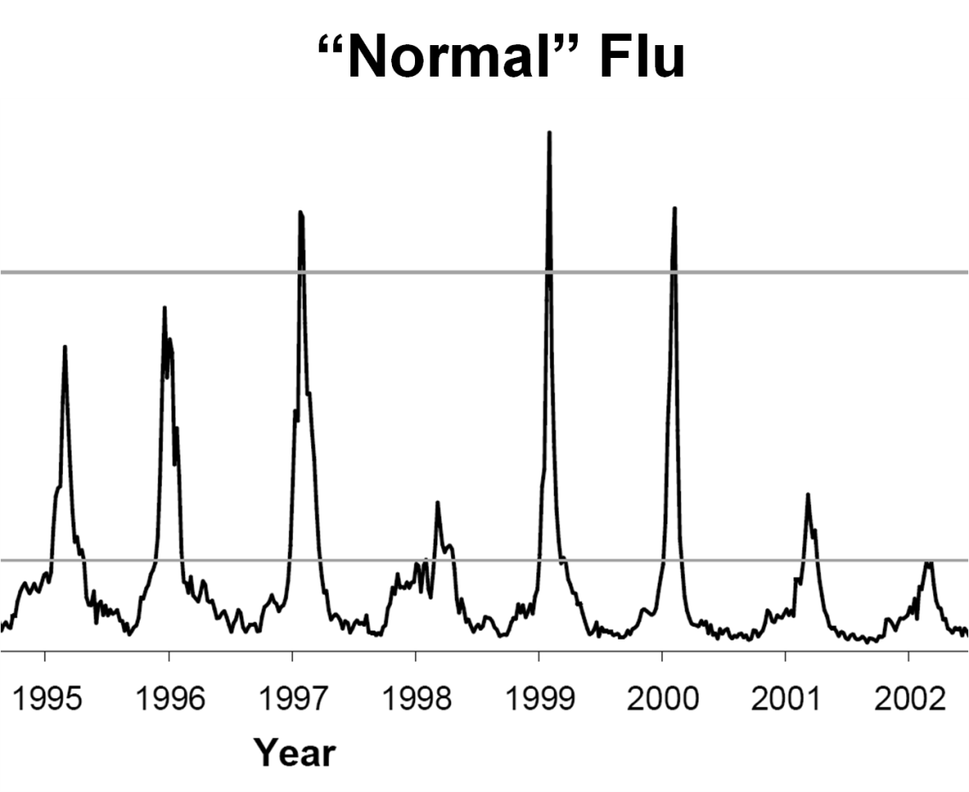
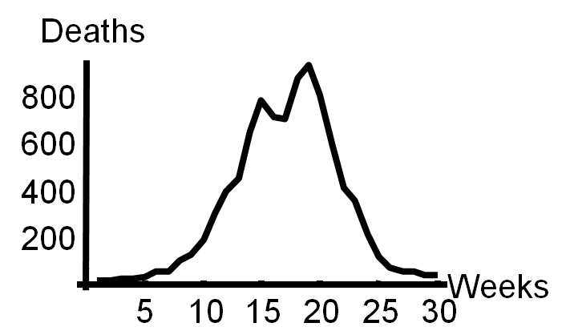
Why study host-parasite interactions?
Interesting dynamics (e.g., cycles)
Plague: Weekly deaths in Bombay (1906):

Slide 3
Measles dynamics (pre-vaccination): 1944-1966
Large city (London)
Medium
Small
Finkenstadt, Bjornstat & Grenfell (2002)
Notes:
Peaks in most years in ~january, with every 2nd or 3rd very large (pre-vaccine). 6-9d from exposure to infective. 6-7 day infections; recov is permanent immunity; vaccine introduced in 1960’s; mass vaccinatin in 1966. direct, aerosol xmission. Single stranded RNA virus (little strain variation).
Fig. 1. Time series plots of reported cases corrected for temporal under-reporting for (a) London (3.3 million
inhabitants), (b) Plymouth (210 000 inhabitants), (c) Teignmouth (10 000 inhabitants) during the pre-vaccination time
from 1944 to 1966. The population sizes stated in brackets are the approximate median yearly sizes for this time
period.

Slide 4
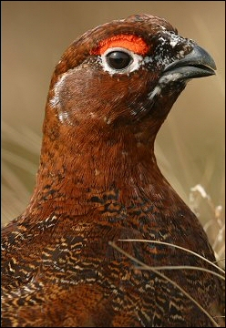
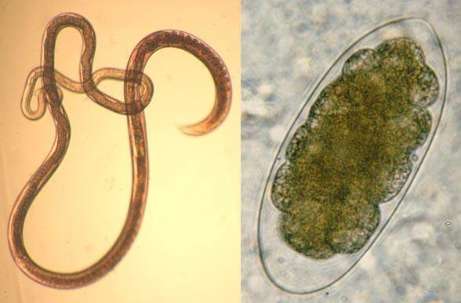
Why study host-parasite interactions?
Major regulator of wildlife population dynamics
Red Grouse
(Lagopus lagopus scoticus)
Trichostrongylus tenuis

Slide 5
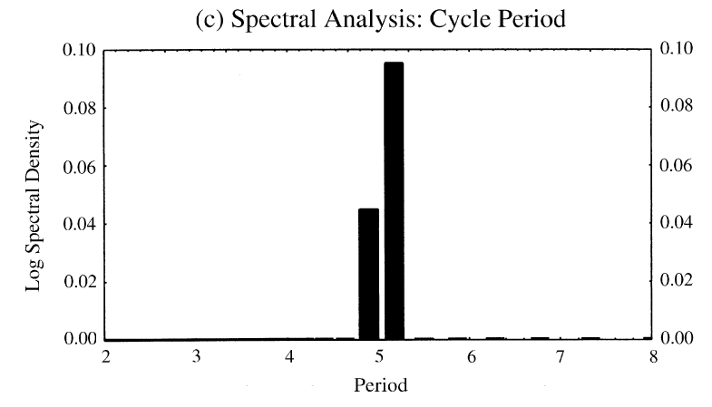
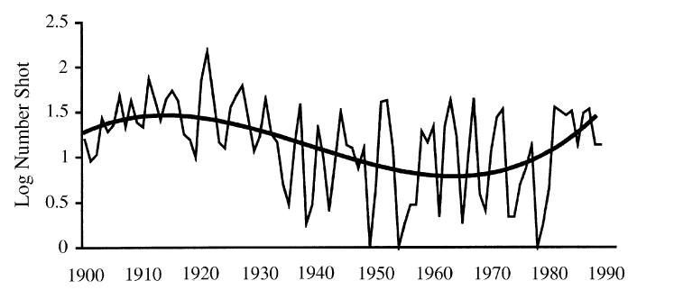
Red grouse dynamics:

Slide 6
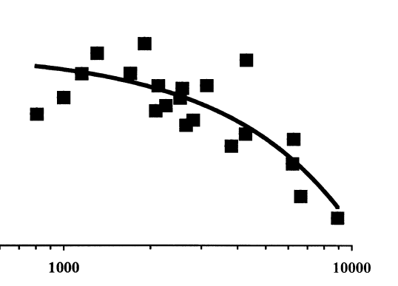
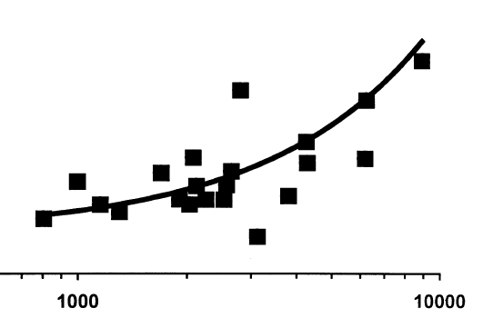

Slide 7
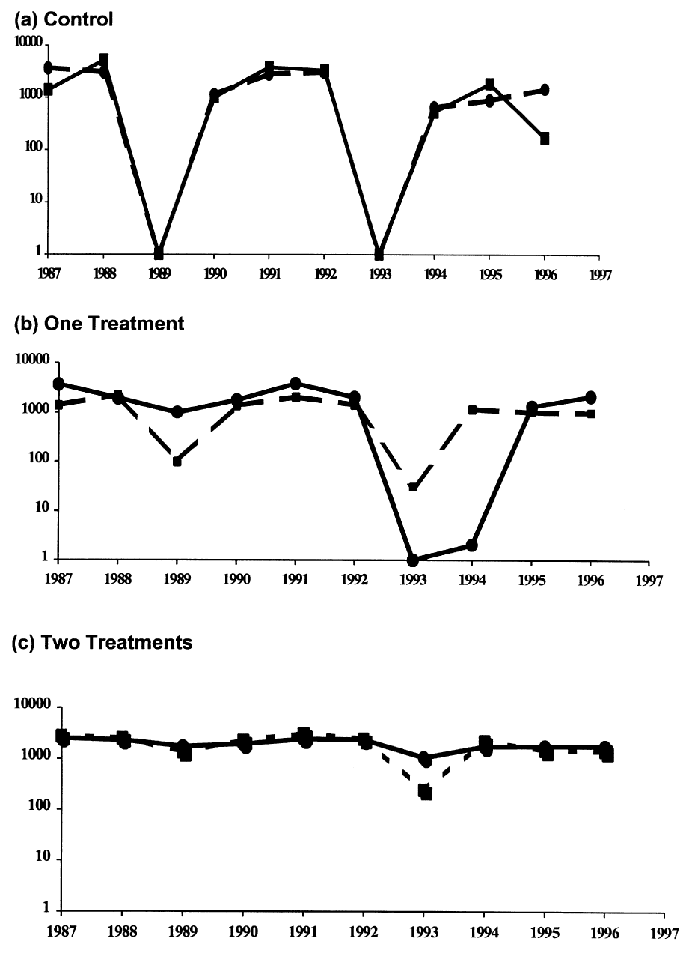
Field experiment (n=2):
Remove parasites in ~20% of grouse
Number shot + 1
+antihelmintic

Slide 8
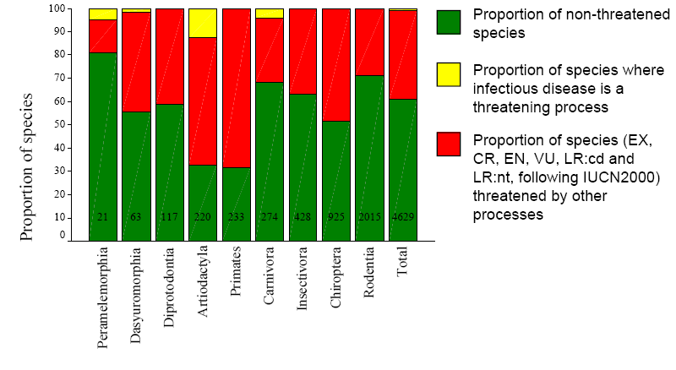
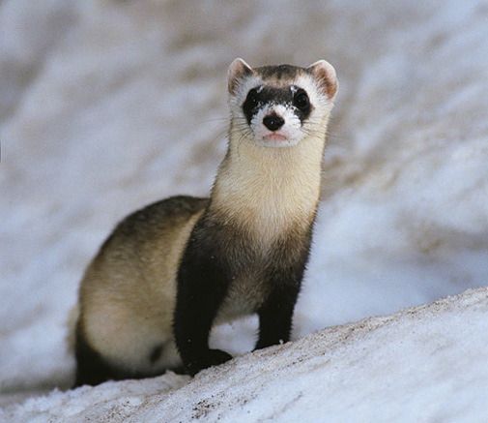
Why do ecologists study host-parasite interactions?
Cause of decline for threatened and endangered species
Mustela nigripes
Omnivorous marsupials
Even-toed ungulates

Slide 9
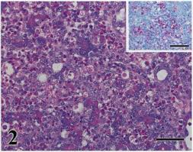
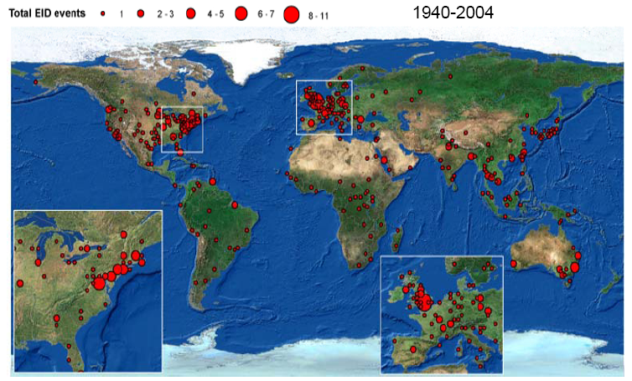
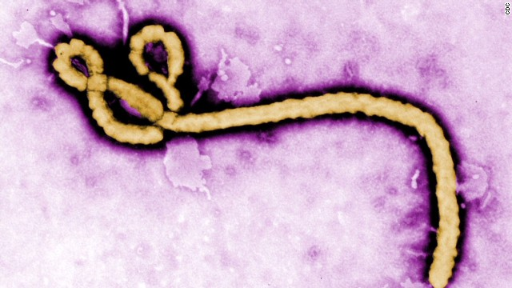
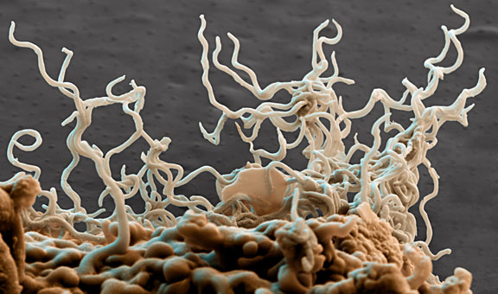
Why do ecologists study host-parasite interactions?
Zoonoses are the main source of emerging infectious diseases in humans
Jones et al. 2008

Slide 10
Issues:
What determines if there will be an epidemic?
Why does it die out?
Why does it recur?
Let’s start by building a model…

Slide 11
SIR model:
Three states of host:
Susceptible (S)
Infected (I)
Removed (R): dead or immune
[N = S+I+R]
S
I
R
No host demography (no births or deaths)
All hosts start as “S”

Slide 12
SIR model:
Need to specify:
Conversion of S to I
Removal (I to R):
S
I
R
is “transmission rate”: set by contact rate and infection probability (“random encounter”)
is removal rate
is mean time an individual remains infective

Slide 13
SIR model:
S
I
R

Slide 14
Is there an epidemic?
does an Infected infect a Susceptible before s/he Recovers (or dies)?

Slide 15
SIR model:
An epidemic requires:
dI/dt > 0
i.e.,
i.e.,
recall is duration of infection so is the number of new infections per infection
S
I
R
Notes:
At start, all individuals are un
infected.

Slide 16
Basic Reproductive Number:
Notes:
The expected number of new infections that arise from an infected host.

Slide 17
SIR model:
Is there an epidemic?
At start, all individuals are susceptible:
N=S, so is
S
I
R
Notes:
At start, all individuals are infected. Three terms are important: Beta, N and gamma.

Slide 18
SIR model:
Epidemic more likely if:
N is large (more contact with susc.)
is large (more contacts; more likely to transmit given contact)
is small (stay infectious longer)
Notes:
At start, all individuals are infected.

Slide 19
Critical community size:

Slide 20
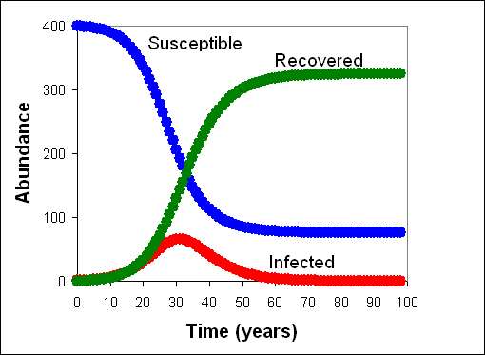
SIR model:
What do the dynamics look like?
Why doesn’t everyone get the disease?

Slide 21
SIR model:
What fraction of population gets infected?
1
Notes:
At start, all individuals are infected.

Slide 22
Sequential epidemics? (cycles)

Slide 23
Endemics:
Why does pathogen persist?
Birth of new hosts
Immigration of new hosts
Loss of immunity
Evolution of pathogen
Reintroduction of pathogen
Notes:
In the case of measles in the UK,the birth of new hosts along, leads to persistence, but NOT cycles.. the cycles require a combination of births and seasonality of transmission (driven by kids in school), and spatial heteerogeneity (introductions of infecteds from elsewhere).

Slide 24
Vaccinations

Slide 25
Vaccines:
Vaccines convert S to R
S
I
R
protects immunized person
reduces Pr(epidemic): herd immunity
What proportion, p, of population do we need to immunize to prevent epidemic if infected individual enters our community?

Slide 26
Vaccines:
Prior to vaccine:
After vaccine:
So to prevent epidemic:
Notes:
Humans (N may be higher or lower, but beta is certainly higher and gamma is much lower b/c we keep people alive, unless we quanantine them; opportunity for more virulent diseases.
Sex: does doubling in N give rise to a double in number of partners? STDs persist even at v. low densities.

Slide 27
Measles
Vaccines:
Rubella
Smallpox
eradication
epidemics
Notes:
Smallpox eradicated; measles: very few cases in US (<100/yr); 30 million cases worldwide! Note high p (.91 vs. .5 for smallpox)
Rubella = “german measles”

Slide 28
Adding in host demography

Slide 29
S
I
R

Slide 30
Epidemic criterion:

Slide 31
STDs?

Slide 32
Transmission?

Slide 33
Transmission (per infected): βSI/I = βS
Contact: cN
Pr(contact is with susceptible): S/N
Pr(infection|contact with S): a
Thus, transmission = acS,
and
β = ca

Slide 34
Contact rate (cN)
(e.g., how many people do you bump into on a sidewalk?)

Slide 35
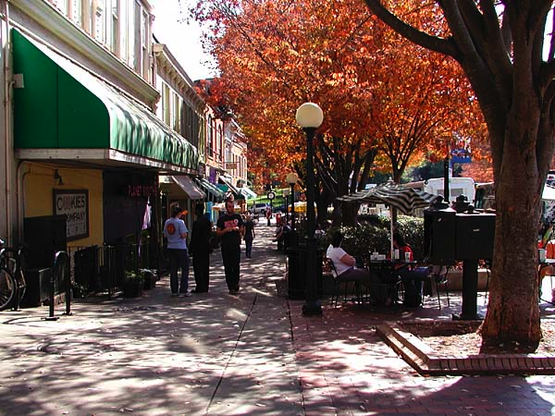
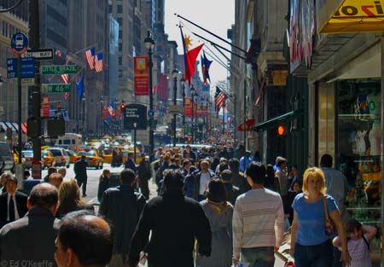
Contact rate
Slope = c
Athens
Atlanta
NYC
Population size, N
Is this a good model for all pathogens (e.g., STDs)?

Slide 36
An alternative?

Slide 37
Density-dependent transmission
Frequency-dependent transmission
e.g., STD
Contact rate
e.g., cold, flu
Host population size, N

Slide 38
Density-dependent transmission
Frequency-dependent transmission
R₀
e.g., STD
e.g., cold, flu
Host population size, N

Slide 39
Thus, the existence of threshold populations depends on the type of transmission
With frequency-dependent transmission there is no threshold population size!

Slide 40
Density-dependent transmission
Frequency-dependent transmission
e.g., STD
Mean age at infection
e.g., cold, flu
Host population size, N

Slide 41
R₀ & age at infection
It is possible to derive that if R₀>1 and there is a supply of susceptibles, then the equilibrium proportion of susceptibles is S/N=1/R₀
Suppose the average age at infection is A
Individuals < A are susceptible
Individuals > A are immune
For simplicity assume a rectangular age distribution up to life expectancy L
Then the proportion susceptible = A/L
This means R₀=L/A
R₀ is inversely proportional to mean age at infection
This is also true when using more complicated models (e.g. not assuming rectangular age distribution)

Slide 42
Predictions based on transmission
Density- and frequency-dependent transmission
Mean age at infection
N

Slide 43
More surprises

Slide 44
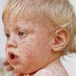
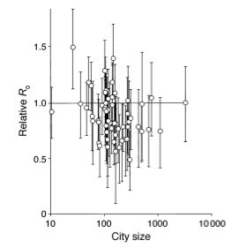
Measles in UK
suggests frequency-dependent transmission
why?
Bjørnstad et al. 2002, Ecol. Monographs
Notes:
Bjornstad argues that transmission occurs at school; school's are a fixed size, so the size of the city isn't relevant. It's the school.

Slide 45
But isn't there a critical community size?

Slide 46
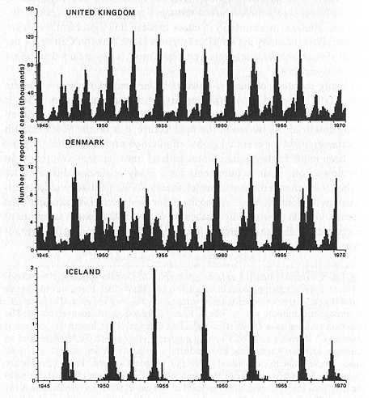
UK ~ 60M people
Epidemic fade-outs
e.g. Measles
Denmark ~ 5M people
Iceland ~ 0.3M people
Cliff et al. 1981
Note how measles is non-endemic in Iceland

Slide 47
Persistence vs population size
Measles in England and Wales
0.7
0.6
Recurrent
Epidemics
Endemic
0.5
0.4
Proportion of time extinct
0.3
Critical Community Size
~300-500k
0.2
0.1
0
10 000
100 000
1 000 000
10 000 000
population size
Notes:
Here, the CCS is determined by the pathogen remaining endemic. Births build up fast enough in a big city that the disease persists. This isn't about CCS and an EPIdemic in our simplest SIR model (whtout host demography); it's about endemic persistence.

Slide 48
Issues we haven't addressed:
SEIR models (exposed/latent period)
Vector-borne diseases
Age structure
Spatial structure

