Slide 1
Ecology 8310 Population (and Community) Ecology
Alternate stable states and phase shifts
Equilibria
Shifts in equilibria across gradients
Multiple equilibria
Resilience (resistance and other terms)
Tipping points
Examples (scattered throughout)

Slide 2
Equilibria
Stable Equilibrium
Unstable Equilibrium

Slide 3
Change the environment

Slide 4
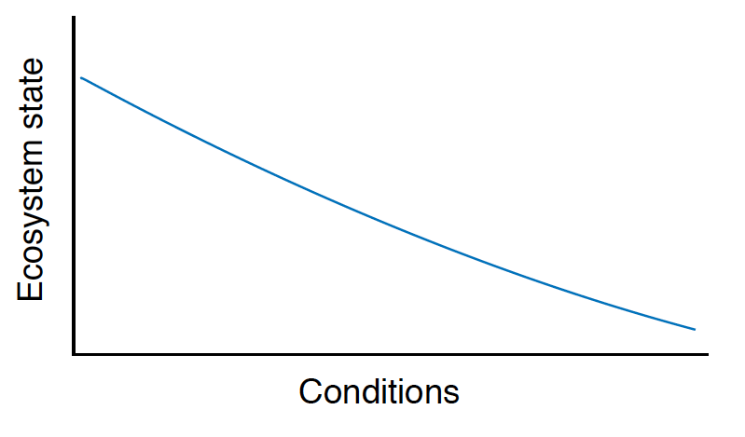

Slide 5
Perhaps the transitions are more abrupt…

Slide 6
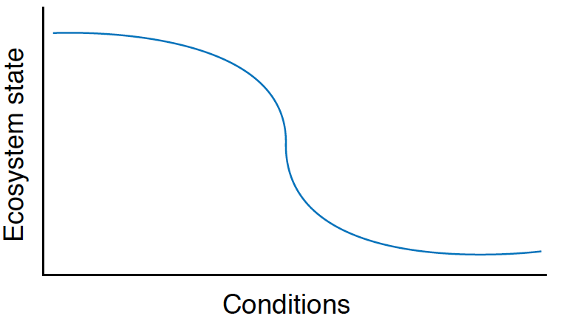

Slide 7
Perhaps the dynamics are more complex…

Slide 8
Bistability – 2 locally stable equilibria and an unstable intermediate

Slide 9
How might this landscape change as the environment shifts?
Ecosystem "state"

Slide 10
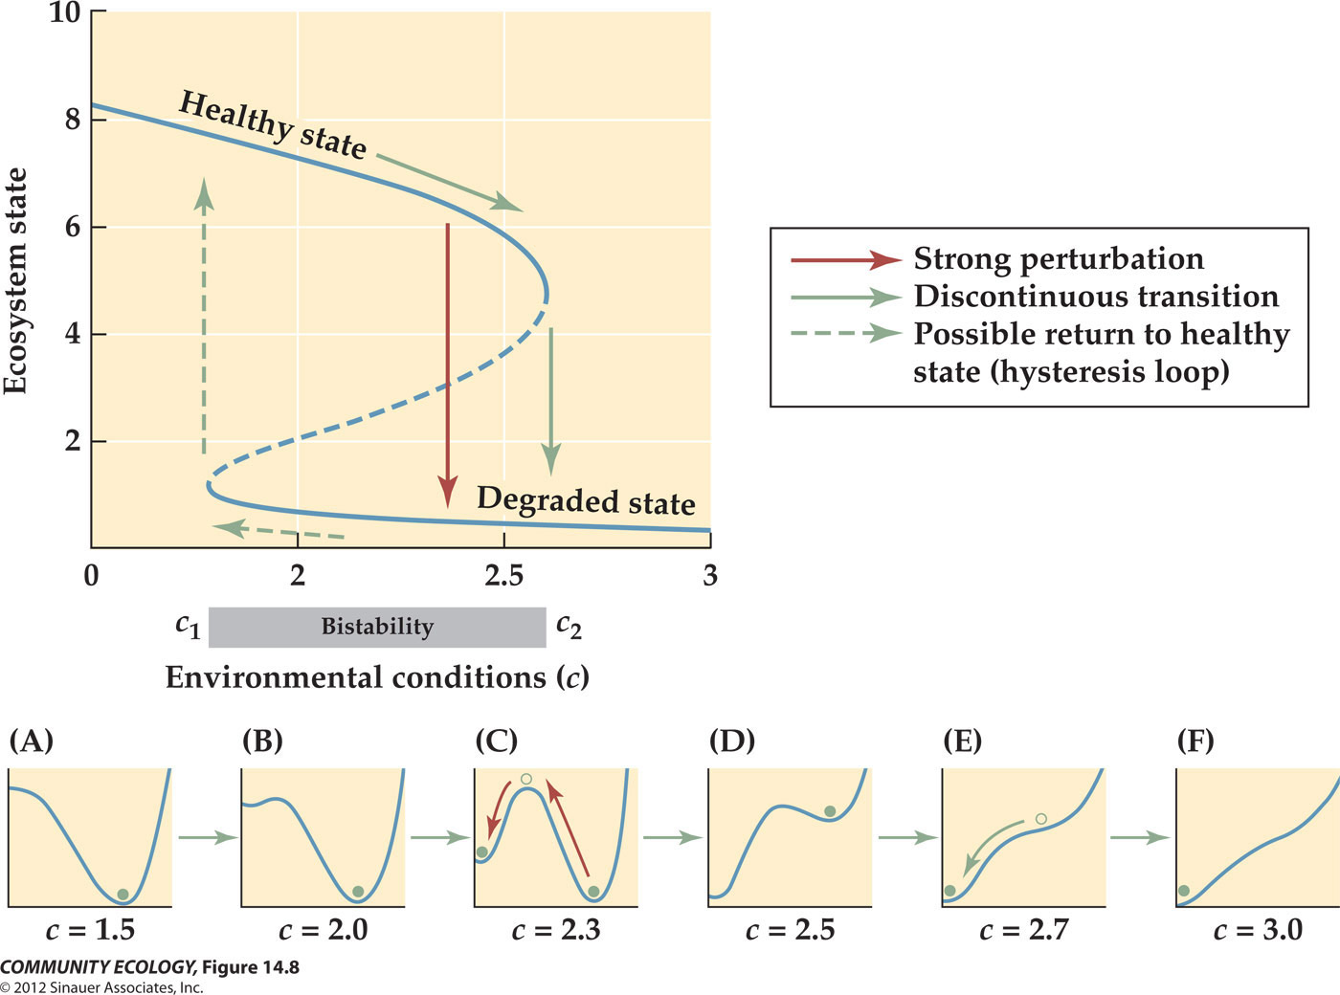

Slide 11
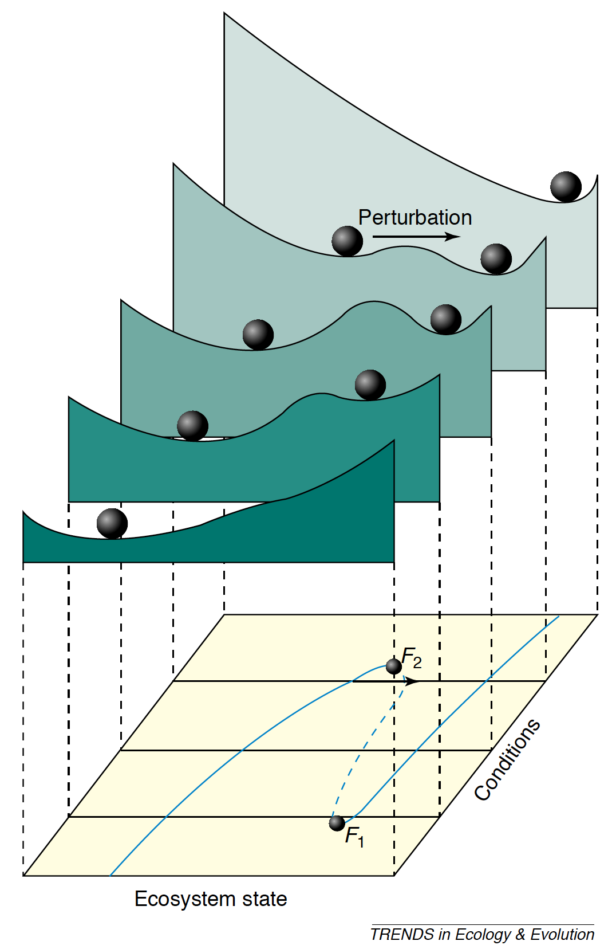
Scheffer and Carpenter (2003)

Slide 12
Can we use phase planes to represent this?

Slide 13
dN₂/N₂dt=0
Env 1
Intermediate environments?
N₂
dN₁/N₁dt=0
N₂
N₁
N₁
N₂
Env 2
N₁
N₂
N₂
Hysteresis
N₁
N₁

Slide 14
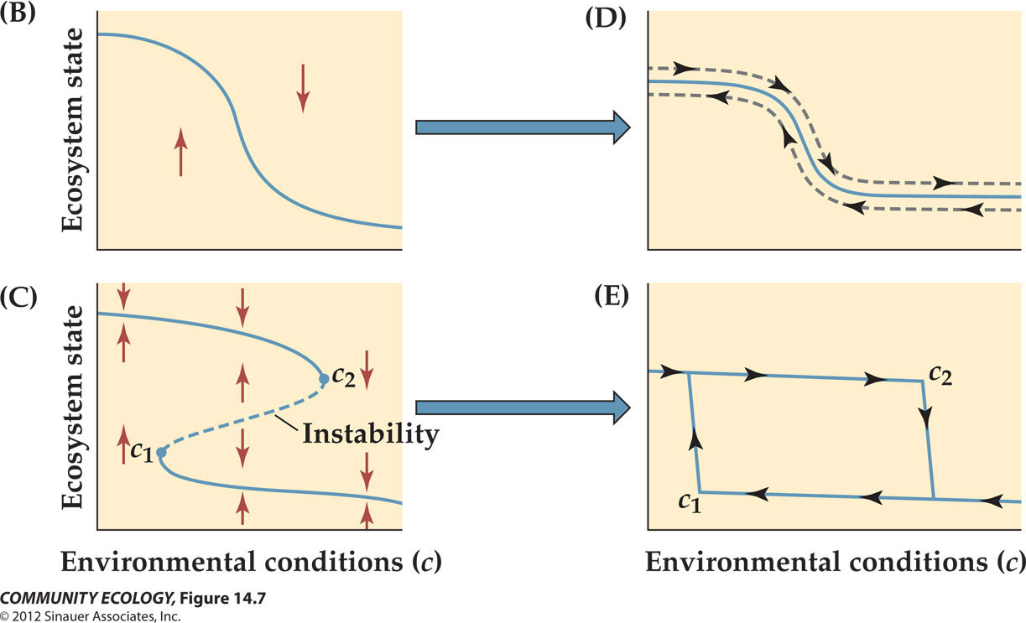
Hysteresis

Slide 15
Evidence?

Slide 16
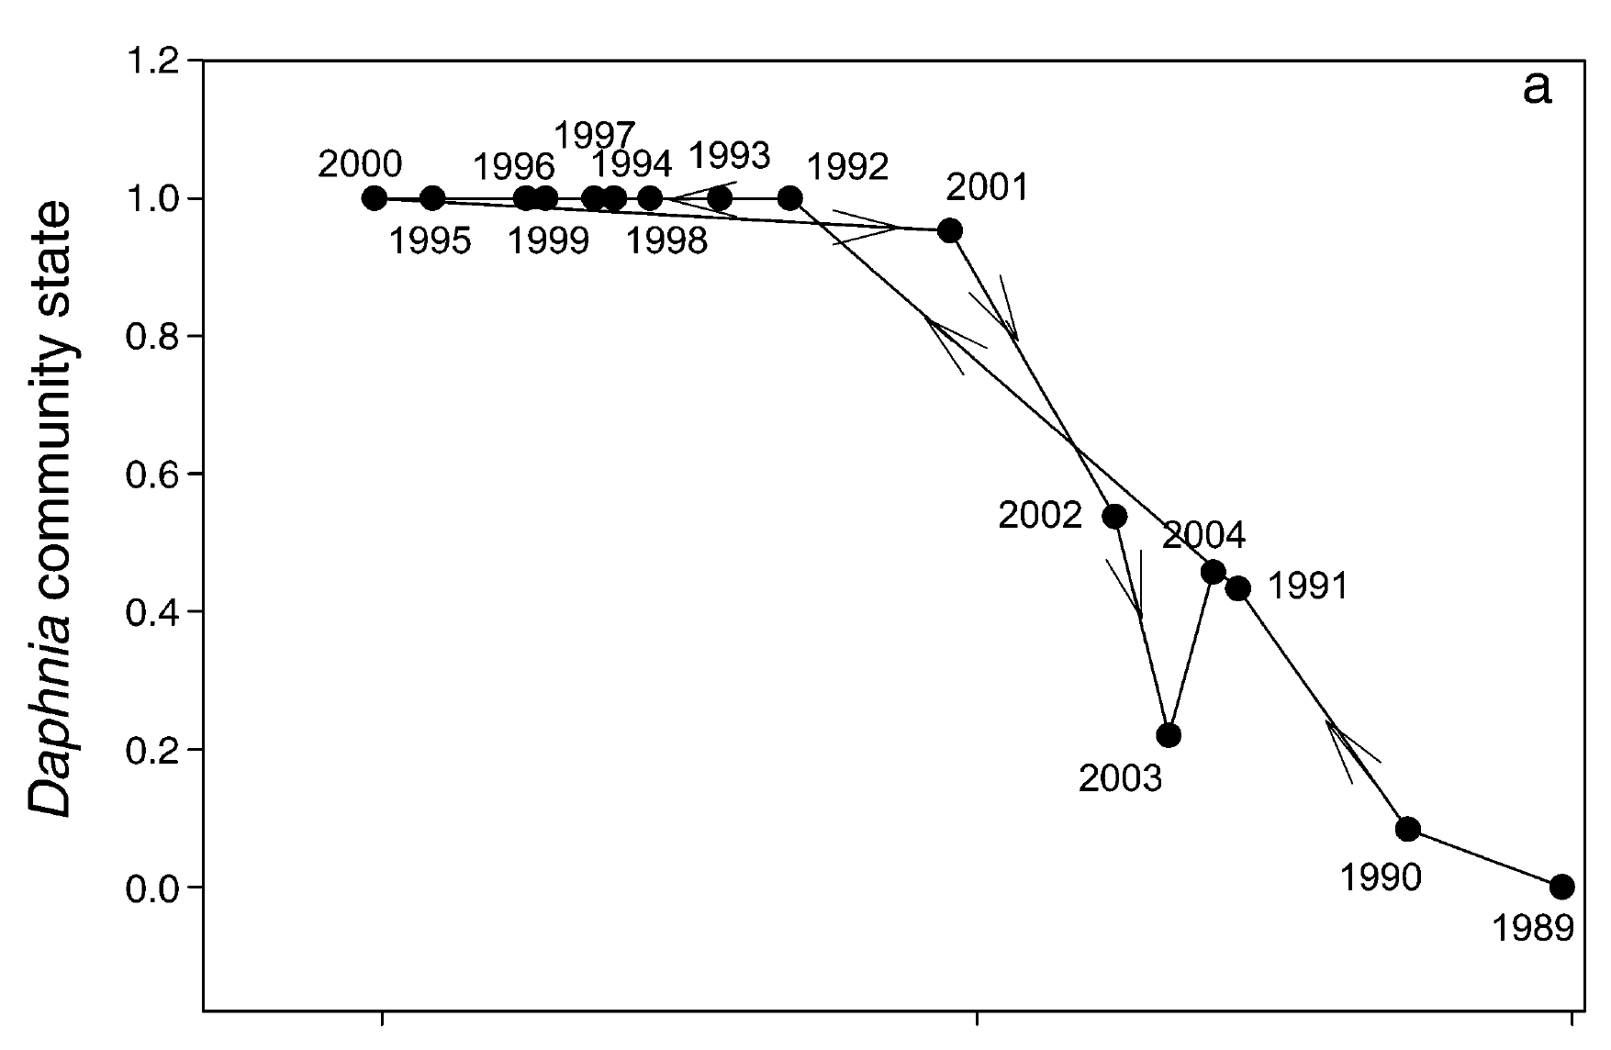
From Mittelbach et al. 2006
No hysteresis

Slide 17
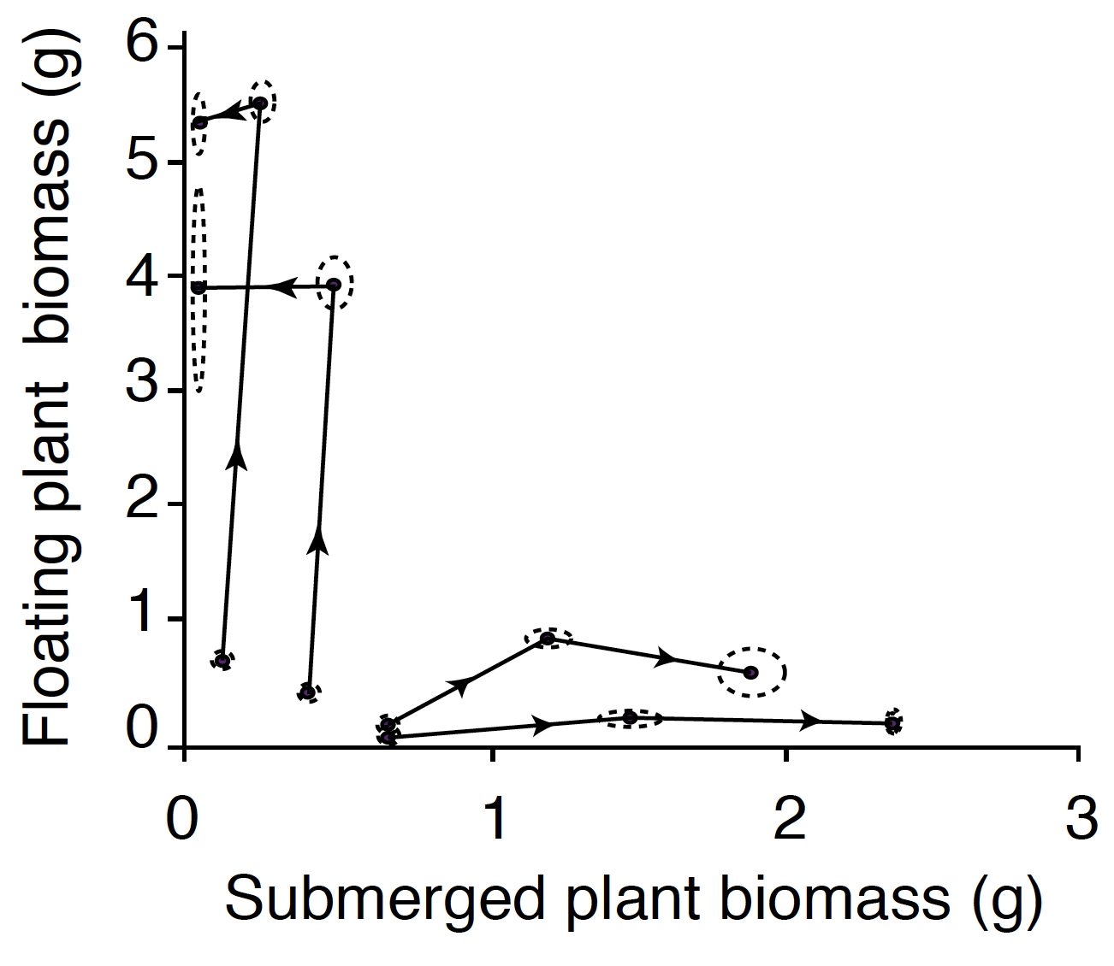
Experimental data from Scheffer et al. 2003 (PNAS):
Same environment; different starting conditions;
Data from days 1, 23 and 57;
Circles are SDs of reps.
Alternate Stable States

Slide 18
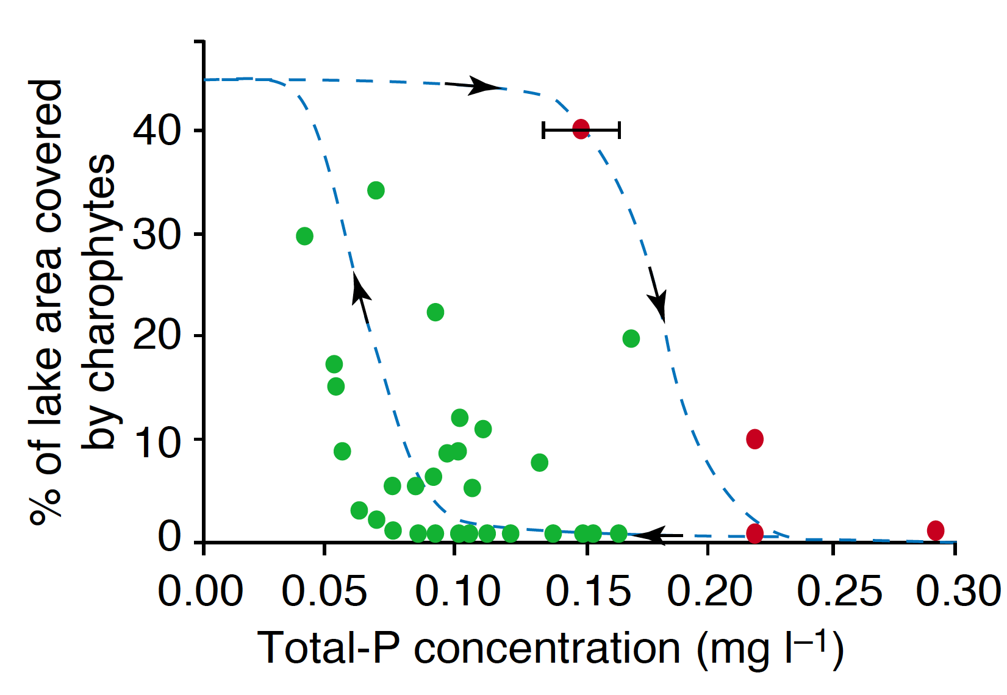

Slide 19
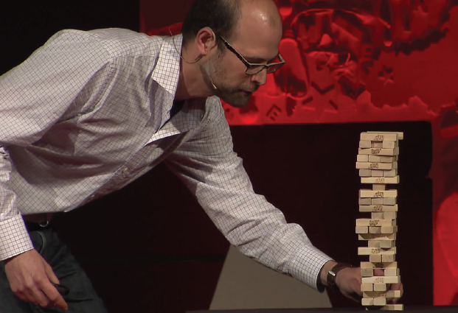
Resilience, critical transitions/slowing down, early warning

Slide 20
Resilience?
1. Resistance – tendency to change little in response to a an environmental perturbation (how big of a perturbation is required to elicit change)
2. "Resilience" – tendency to return to original state quickly following a perturbation (time it takes to recover from disturbance)
Notes:
Both components are generally lumped under the umbrella of "resilience"

Slide 21
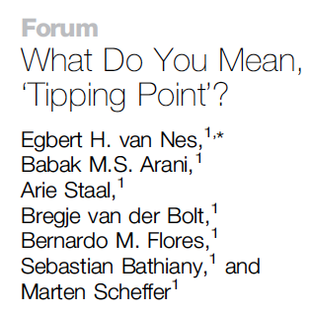
Tipping points …
Notes:
Argue that "tipping point" has been used two ways. Both result in a sudden change in state arising from strong positive feedbacks (so that small change is amplified to create large changes).
--one arises from a perturbation that pushes a system to an unstable "peak"; from which is heads off towards another attractor. Hence the system properties themselves weren't changed, but rather the state of the system was shifted by an external perturbation.
--the other is more complex – the dynamics of the system change, which changes the "landscape", its stability and state states.

Slide 22
Perturbation (change in state)…
Notes:
The state changes – system gets perturbed to a configuration that is unstable; and then the system 'runs' off to a new state (equilbrium).

Slide 23
Change in conditions…
What happens to the temporal variance as we approach the tipping point?
Notes:
So the current state becomes unstable.

Slide 24
How do we effect a large change in system?

Slide 25
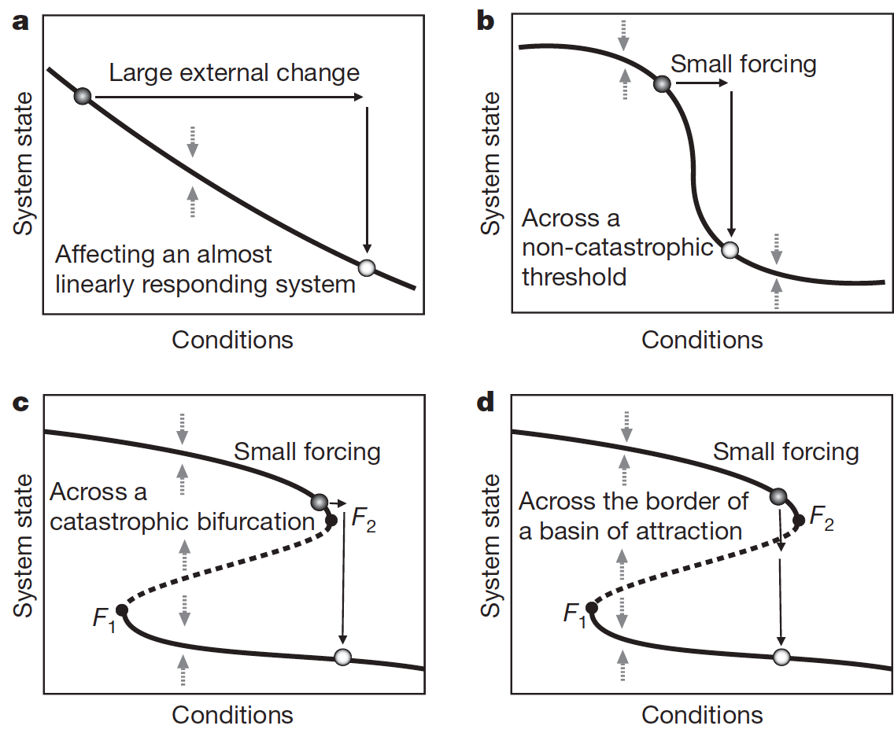
Notes:
1) large perturbation (but a continuous response)
2) small perturbation, across a treshold (no bifurcation)
3) a small change across a bifurcation – passing a critical point.
4) a small perturbation that takes you from one basin or attraction and into another.

Slide 26
Early warning/indicators
Notes:
Both components are generally lumped under the umbrella of "resilience"

Slide 27
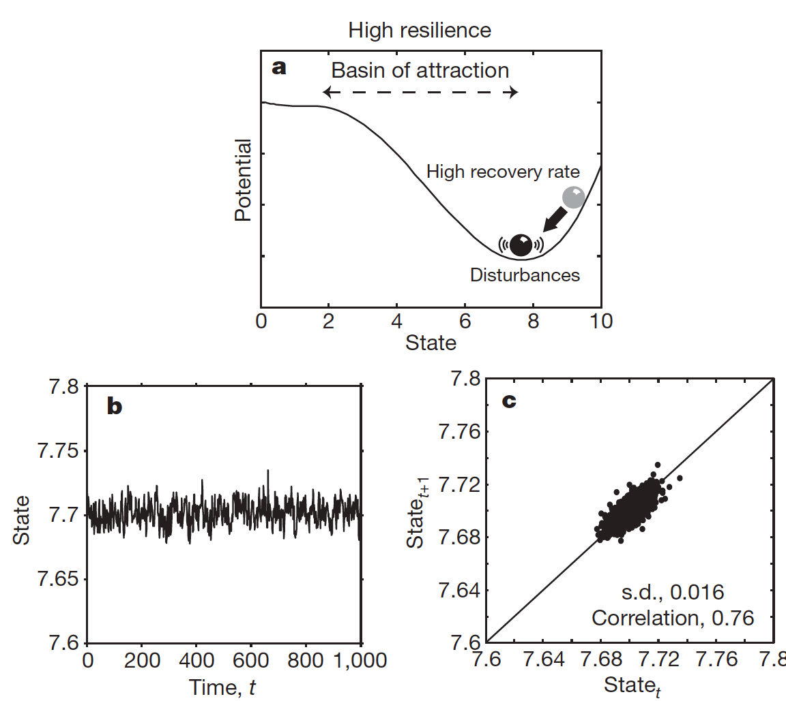
From Scheffer et al. 2009 (Nature)

Slide 28
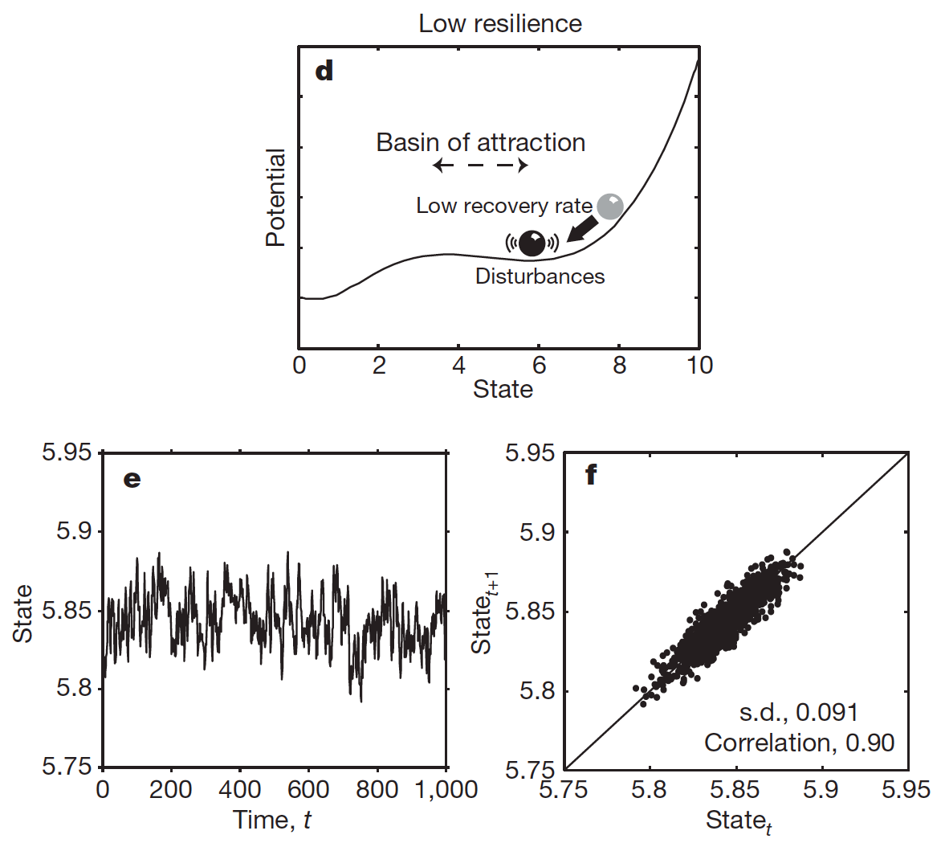
From Scheffer et al. 2009 (Nature)

Slide 29
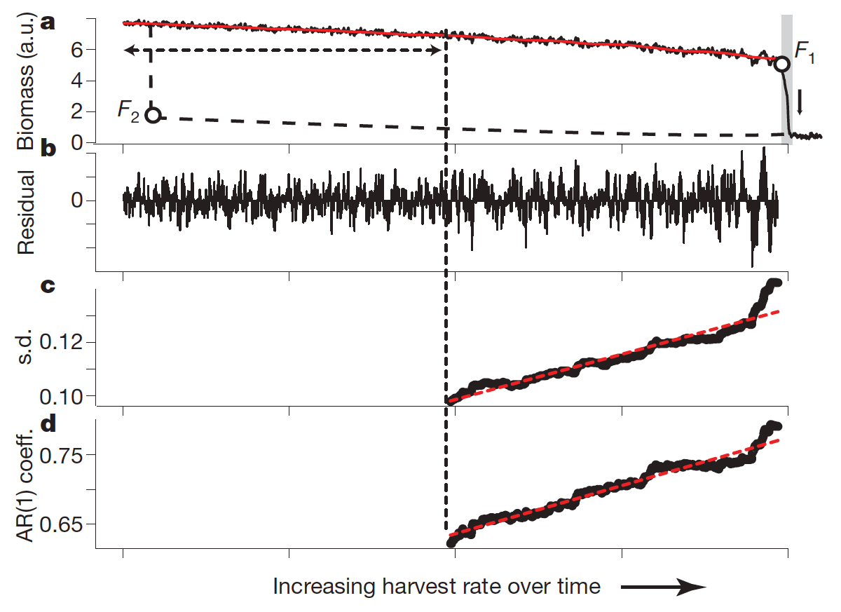
From Scheffer et al. 2009 (Nature)
Notes:
Model of harvesting. Note two transitions: F1 and F2. Strong hysteresis (not shown).
The catastrophic transition is preceded by: 1) increase in temporal variance; and 2) increase in autoregressive coefficient (adjacent points in time or more strongly correlated – slower to move back to equilibrium state).
The ideas have been applied widely: to interpret ecological, geological, economic, sociological data.

Slide 30
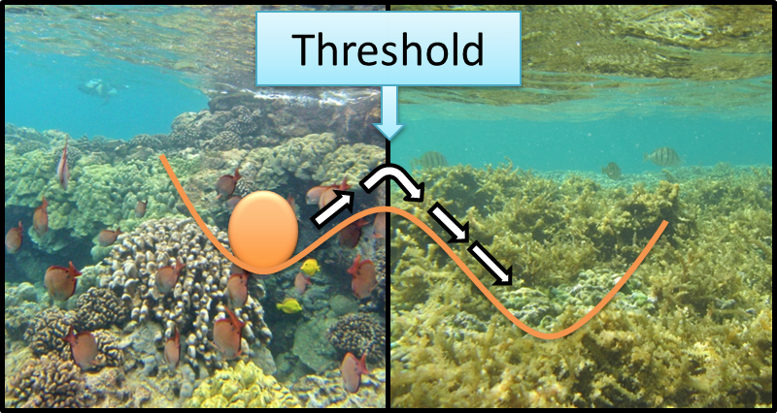
How do we explain coral-algae states?
Discussion
Phase (or regime) shifts
1. Transient (not a tipping point) ?
2. Continuous phase shift
3. Discontinuous phase shift
From http://oceantippingpoints.org
Notes:
What is a phase shift?
Let's distinguish three scenarios:
1) a Pulsed change in environment – causes a transient change in the system….but given ENOUGH time, it returns to previous state.
2) a permanent change in environment that shifts the equilibrium (at any condition, there is only 1 equilbrium): = "CONTINOUS" phase shift.
3) a tipping point was crossed, leading to a "DISCONTUOUS" phase shift – moved from one equil to another.
Continuous vs. Discontinuous phase shift --- why is the distinction important? (1 vs. >1 equilibria)
Hysteresis only occurs when you have ASS; thus if it's just a continuous phase shift, then if you modify the environment, the system will return.
Is it an alternate stable state is the environment is "different" – ala Connell and Sousa 1983 (set down rigid criteria to judge evidence).

Slide 31
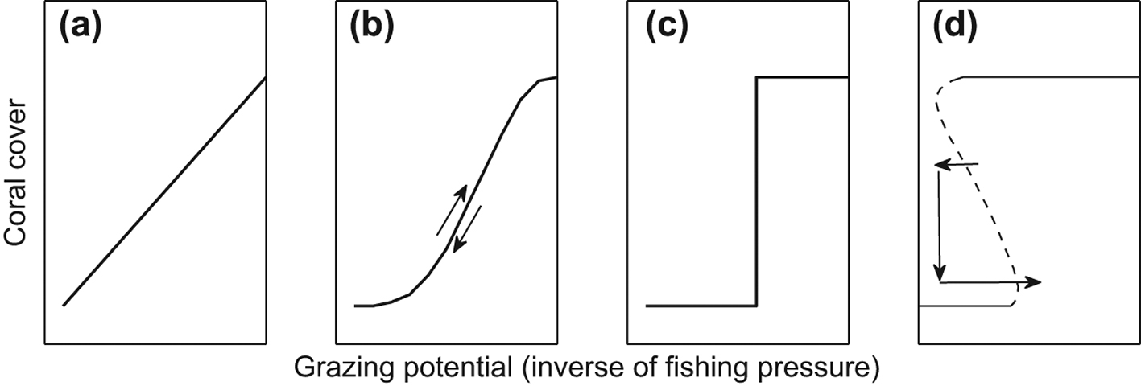
From Mumby et al. 2013 (Oikos)

Slide 32
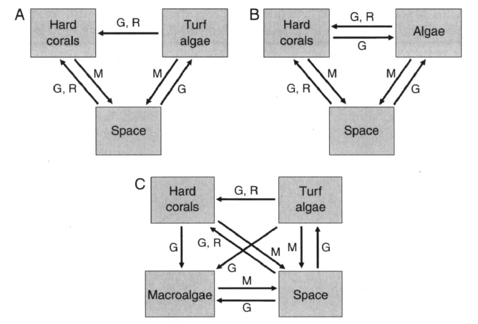
Arrows are transitions; not "effects"
G=growth
R=recruitment
M=mortality
From Fung et al. 2011 (Ecology)

Slide 33
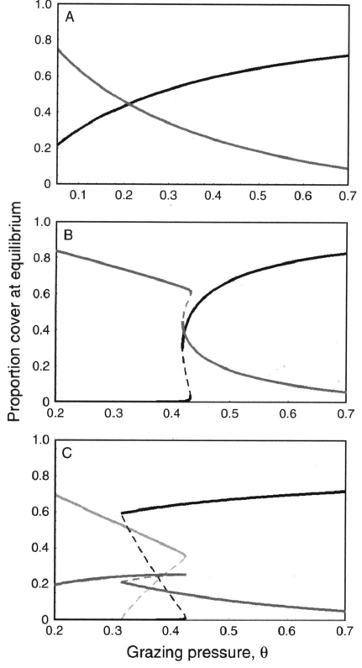
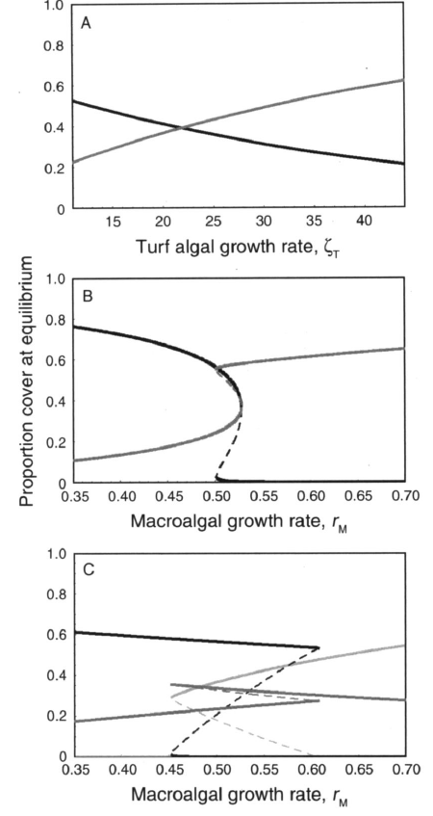
From Fung et al. 2011 (Ecology)
Coral
Macroalgae
Turf algae
Notes:
Feedack that is crucial involves the opening of bare space, and then strong effects of algae on coral dynamics. Turf algae effects on coral are too weak to generate the required feedback. Is also lacks the negative feedback of coral on algae

Slide 34
Conclusions of Fung et al:
Alternate Stable States only possible with macroalgae (not turf)
Parameters required are rare (at observed extremes)
Thus, phase shifts most likely from large changes in environment (probably from "continuous" changes)
Zychaluk et al. (20012) concur (data-model comparision) that ASS unlikely (also questions phase shift in general).

Slide 35
Evidence?
Notes:
What data are needed?

