Slide 1
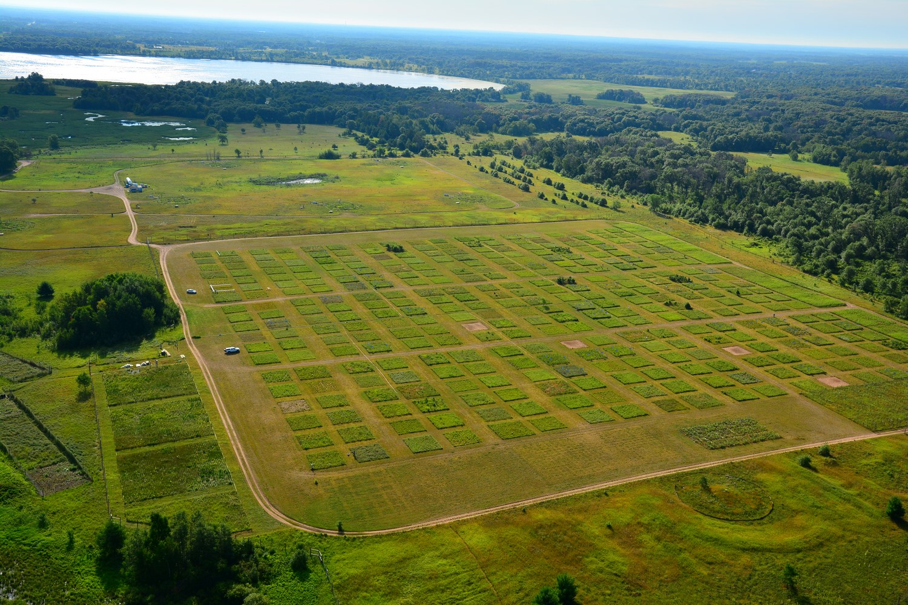
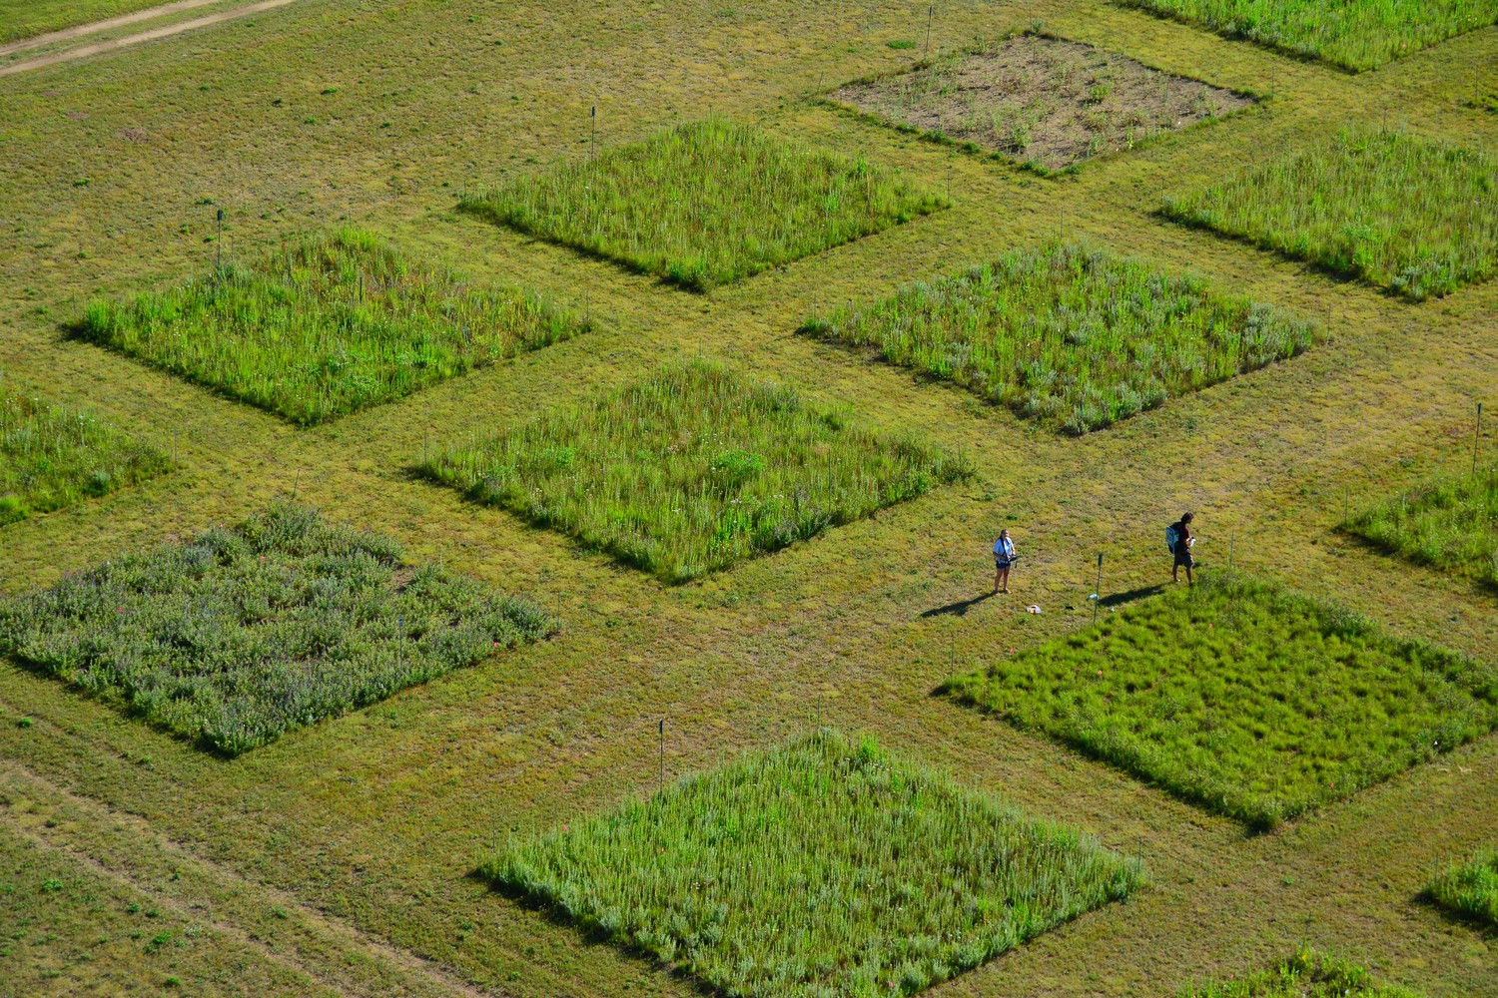
ECOL 8000
Biodiversity and Ecosystem Functioning (BEF) Module

Slide 2
Questions
What is biodiversity?
What is an ecosystem?
What are “ecosystem functions”?
How does biodiversity affect an ecosystem?

Slide 3
“Any unit that includes all of the organisms (i.e. the “community”) in a given area interacting with the physical environment so that a flow of energy leads to clearly defined trophic structure, biotic diversity, and material cycles (i.e. exchange of materials between living and nonliving parts) within the system is an ecological system or ecosystem”
– Odum 1971
“Ecosystem ecology addresses the interactions between organisms and their environment as an integrated system.”
– Chapin et al. 2011
“An ecosystem is the interacting system made up of all living and nonliving objects in a specified volume of space.”
– Weathers et al. 2013

Slide 4
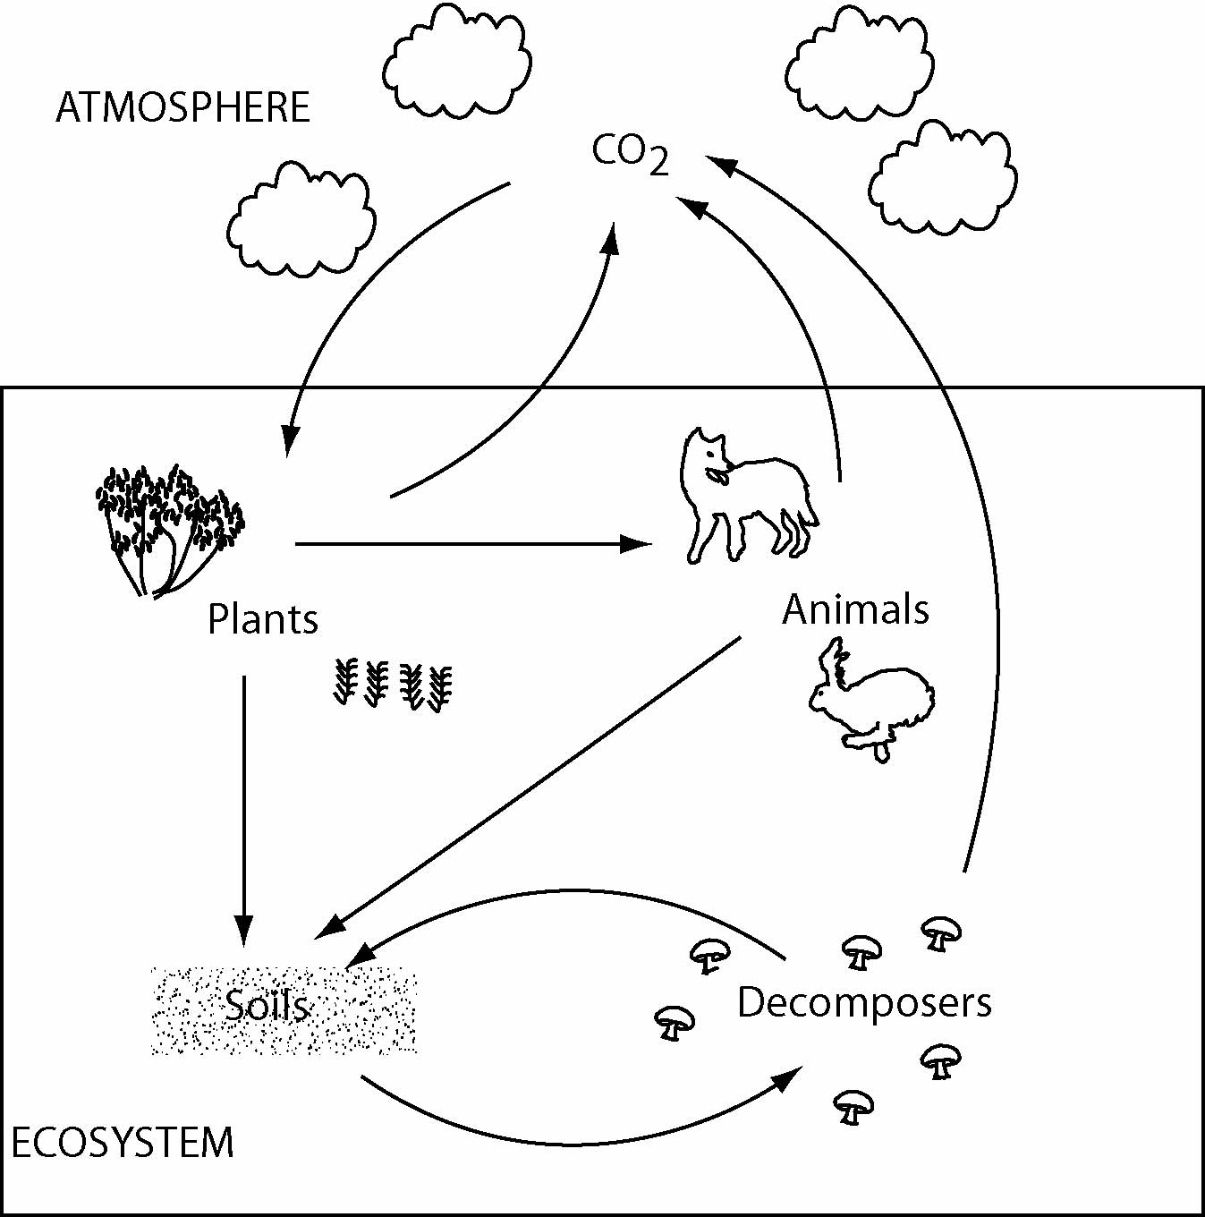
What is an ecosystem?
Components
Interactions
Inputs / Outputs
Controls
Boundaries

Slide 5
Ecosystem stability comes from feedbacks

Slide 6
Ecosystem stability comes from feedbacks
Add earthworms (and bioturbation)
  Indirect positive effects

Slide 7
Questions
What is biodiversity?
What is an ecosystem?
What are “ecosystem functions”?
How does biodiversity affect an ecosystem?

Slide 8
What are ecosystem functions?”

Slide 9
Questions
What is biodiversity?
What is an ecosystem?
What are “ecosystem functions”?
How does biodiversity affect an ecosystem?

Slide 10
Discussion of Tilman et al. 2014
Biodiversity and Ecosystem Functioning
We will consider:
The early experiments and their limitations
Origins of BEF theory
The 3 BEF theories
  What are they?
  What empirical support exists?
  What controversies surround them?

Slide 11
Group 1 – the first 3 experimental BEF studies
What was the significance?
What was the controversy?
Tilman et al. 2014 Figure 1abc

Slide 12
Group 2 – the development of theory
What do these graphs represent?
What role did theory play in the understanding of BEF?
Tilman et al. 2014 Figure 2abc

Slide 13
Group 3 – Diversity-productivity theory
What is diversity-productivity theory?
What empirical support exists?
Tilman et al. 2014 Figure 4abcdf

Slide 14
Group 4 – Diversity-stability theory
What is diversity-stability theory?
What empirical support exists?
Tilman et al. 2014 Figure 3
Notes:
Over time there was interannual variability in climate… where more diverse plots maintained greater stability in NPP. However, spp populations were less stable in the more diverse plots.

Slide 15
Group 5 – Diversity-invasion theory
What is diversity-invasion theory?
What empirical support exists?
Tilman et al. 2014 Figure 1d, 2f

Slide 16
Discussion
What is the most convincing experiment/theory providing support for BEF?
What weaknesses or open questions remain?
Why do you think BEF has always been so controversial?
What broader lessons about scientific inquiry can we learn from the history and development of BEF?

