Slide 1
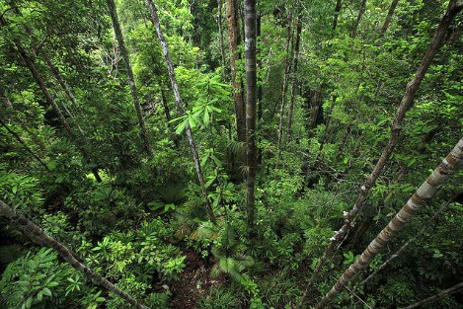
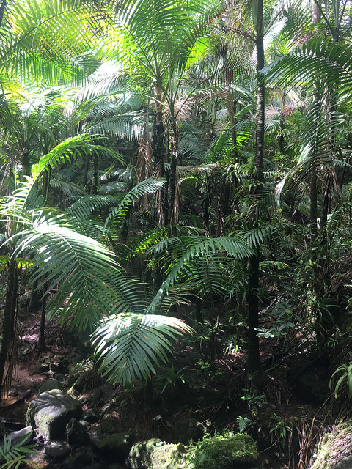
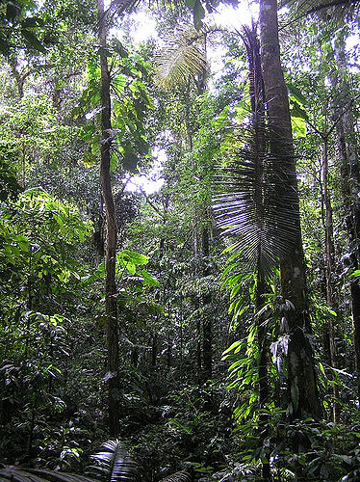
ECOL 8000- Module 2
Biodiversity and Ecosystem Functioning

Slide 2
Questions
What is biodiversity?
What is an ecosystem?
What are “ecosystem functions”?
How does (or how might) biodiversity affect an ecosystem?

Slide 3
“Any unit that includes all of the organisms (i.e. the “community”) in a given area interacting with the physical environment so that a flow of energy leads to clearly defined trophic structure, biotic diversity, and material cycles (i.e. exchange of materials between living and nonliving parts) within the system is an ecological system or ecosystem”
– Odum 1971
“Ecosystem ecology addresses the interactions between organisms and their environment as an integrated system.”
– Chapin et al. 2011
“An ecosystem is the interacting system made up of all living and nonliving objects in a specified volume of space.”
– Weathers et al. 2013

Slide 4
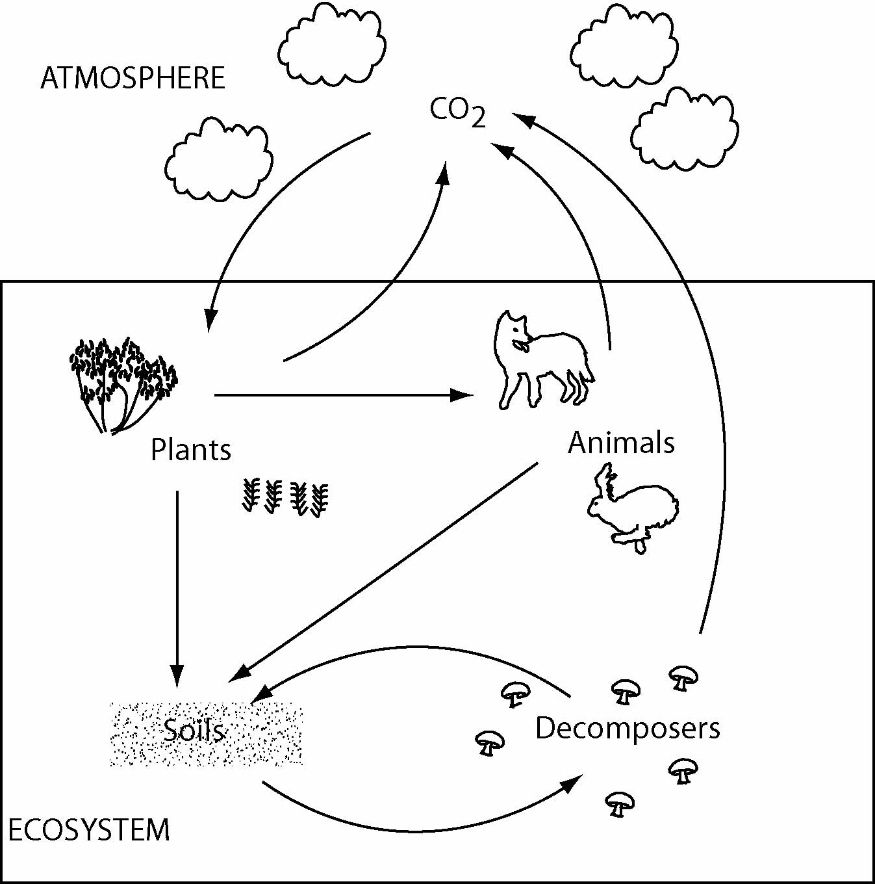
What is an ecosystem?
“Ingredients” of an ecosystem
Components
Interactions
Inputs / Outputs
Controls
Boundaries

Slide 5
Ecosystem stability comes from feedbacks

Slide 6
Ecosystem stability comes from feedbacks
Add earthworms (and bioturbation)
  Indirect positive effects

Slide 7
Questions
What is biodiversity?
What is an ecosystem?
What are “ecosystem functions”?
How does (or how might) biodiversity affect an ecosystem?

Slide 8
What are ecosystem functions?”

Slide 9
Consider the relationships between species richness and ecosystem processes
Each species is unique
Some species are ecologically similar
Remove a rare species
Remove a dominant species
Remove a compensating species
Remove a keystone species

