Slide 1
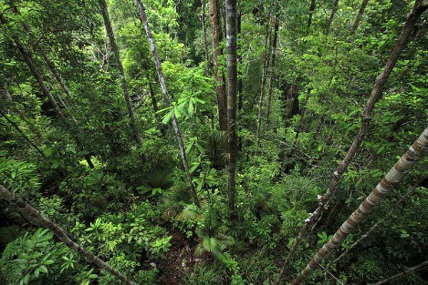
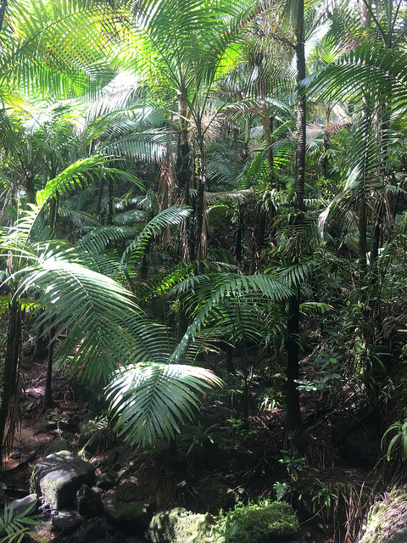
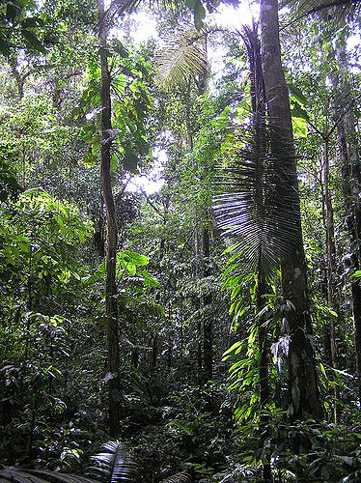
Assignment – Analyzing BEF relationship with a tropical forest dataset

Slide 2
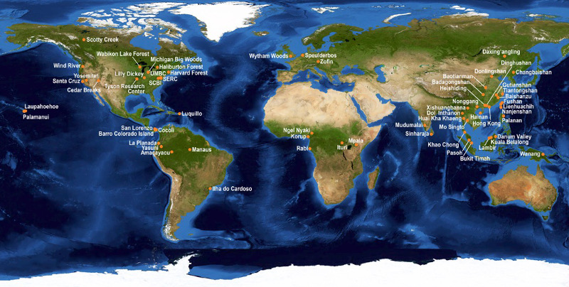
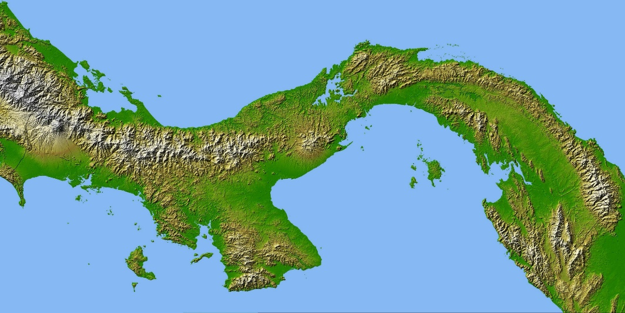
Module 3 Assignment – Tropical forest dataset
Tropical forest data compiled from Averill et al. 2014 and Center for Tropical Forest Science – Forest Global Earth Observatory (CTFS-ForestGEO) network (www.forestgeo.si.edu)
Total soil carbon and nitrogen, NPP, tree species richness

Slide 3
Metadata:
Site ID - defined by Averill et al. 2014
site.name- guessed, described by Nina
c50 – total soil carbon content 0-50 cm (kg C/m²)
n50 – total soil nitrogen content to 0-50 cm (kg N/m²)
sand50 – sand content of soil 0-50 cm (%)
silt50 – sand content of soil 0-50 cm (%)
clay50 – sand content of soil 0-50 cm (%)
latitude
longitude
c – total soil carbon content 0-1m (kg C/m²)
n – total soil nitrogen content 0-1m (kg N/m²)
ph – soil pH 0-1 m depth
sand – sand content 0-1m (%)
silt – silt content 0-1 m (%)
clay – clay content 0-1m (%)
em – mycorrhizal dominance of ecosystem (0 = arbuscular, 1 = ectomycorrhizal)
npp – estimate of net primary productivity (10 year average of MODIS NPP product) (kg C/m² yr)
mat – mean annual temperature (°C), estimated from WorldClim
map – mean annual precipitation (mm), estimated from WorldClim
tree.spp – species number for site or location
panama.plot.spp – tree species number measured in 1 ha plot across the Panamanian isthmus

Slide 4
Part 1.
In teams of two or three, you will explore the relationship between biodiversity and ecosystem function. There are many ways that you can achieve this goal, the approach and specifics are entirely up to you. However, you will:
state a question and hypothesis
define an analytical approach
analyze data
present your results in a figure or figures
interpret your findings

Slide 5
Part 2.
Many experiments are inspired by patterns (or the lack of pattern) from previous observations or experiments. Using your findings from part 1, design an experiment, observational study (or some kind of hybrid) to address your original question or address a new question that arose during the course of your study.
describe the knowledge gap or surprise (i.e. what your analysis did or did not show, or what the literature lacks)
state (or restate) your question and hypothesis
design and experiment or study to address this question
Add these components to Part 1 and turn in one final paper (~3 pages), and give one presentation (5 min) of your journey of discovery. Due on the Oct 3rd.

