Slide 1
Module 4: Community structure and assembly
Class | Topic | Reading(s)
Day 1 (Thu Nov 1) | Intro, definitions, some history. Messing around with a simple dataset in R.
Day 2 (Tue Nov 6) | Paper discussion 1: Niches across scales | Chase and Myers (2011)
Day 3 (Thu Nov 8) | Paper discussion 2: Can we begin to infer community assembly processes from patterns? | Leibold and Mikkelson (2002)
Day 4 (Tue Nov 13) | Paper discussion 3: do communities actually exist? | Half the class will read Ricklefs (2008) and half will read Brooker et al. (2009).
Day 5 (Thu Nov 15) | 5 datasets, 5 groups (TBD). ‘Elements of metacommunity Structure’ approach applied to datasets using R package metacom.
Day 6 (Tue Nov 27) | Brief group presentations and discussion. Is the world Clementsian/Gleasonian/neutral/other?

Slide 2
Themes of this module
How do we quantify diversity across scales?
What does it tell us about community assembly?

Slide 3
Learning objectives
Understand key foundational ecological concepts
Understand some of the key mechanisms driving community assembly and patterns of diversity across scales
Learn basic R tools for analyzing communities and metacommunities
What is the relationship between pattern and process, and what are limits to this relationship?

Slide 4
Some key concepts
The niche
Environmental filtering
Competition and competitive exclusion
Succession
Dispersal limitation
Community assembly
Metacommunity
Deterministic vs. stochastic processes
Niche vs. neutral processes

Slide 5
NICHES

Slide 6
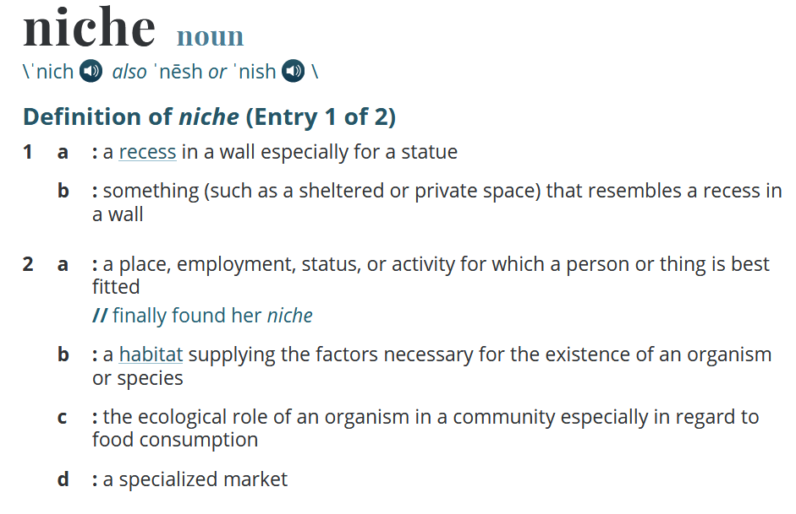

The niche concept
https://www.merriam-webster.com

Slide 7
The niche concept and competition
Grinnellian niche (Grinnell 1917)
Eltonian niche (Elton 1927)
Niche is “n-dimensional”, maps population dynamics onto environmental space (Hutchinson 1957)
Competitive exclusion principle (Hardin 1960)
MacArthur and Levins (1967): limiting similarity

Slide 8
Hutchinson (1957): fundamental niche concept
Red oak
Tradeoff axis
Species turnover occurs across this axis
Spring temperature
Beech
Precipitation
Modified from Clark et al. (2011)

Slide 9
Hutchinson (1957): fundamental niche concept
The two species can co-occur in this parameter space, and compete for resources
Red oak
Spring temperature
Beech
Precipitation
Modified from Clark et al. (2011)

Slide 10
Hutchinson (1957): fundamental niche concept
No turnover in this case; there is nestedness across space
Sp A
Sp B
Sp C
Why doesn’t Sp C occur here? Biotic interaction with Sp A or B or ‘environmental filtering?’
Spring temperature
Precipitation
Fundamental vs. realized niche

Slide 11
Species distributions form successive Gaussian envelopes along environmental gradients
A
B
C
D
Environmental gradient
Whittaker (1965, 1967)

Slide 12
COMPETITION

Slide 13
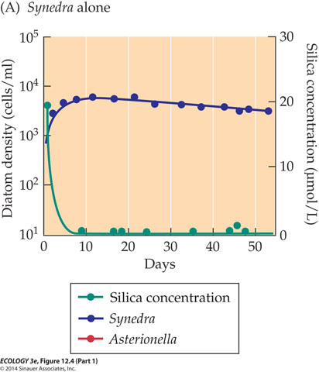
Resource consumption often leads to resource depletion – AND COMPETITION
  The ability of a species to maintain itself in a community is determined by the limiting resource level (R*) that results in zero net population growth (ZNPG).
  This depends on the supply and consumption rates of the resource and the reproduction and mortality rates of the consumer species.
Image/fig from Cain et al. (2014)
Tilman (1980); Tilman et al. (1981)

Slide 14
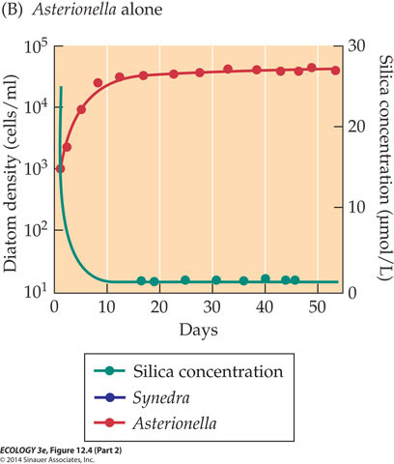
Two species may have different R* values corresponding to their respective ZNPG states
Image/fig from Cain et al. (2014)

Slide 15
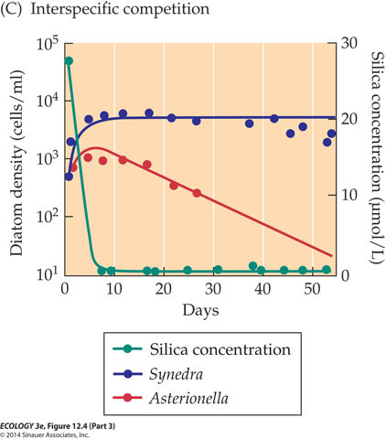
In competition, Synedra has a lower R*, and outcompetes Asterionella
R* represents the level of the resource that will allow a species to persist
If R* is low, the resource is being used efficiently
What can we say about the niches of each of these species?
Image/fig from Cain et al. (2014)

Slide 16
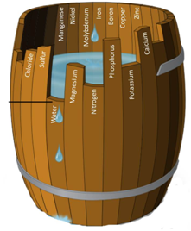
What happens when there are multiple resources?
von Liebig's Law of the Minimum: yield is proportional to the amount of the most limiting nutrient in the soil
A population will grow until one resource becomes limiting for further growth
Organisms need many resources – but von Liebig suggested that at any given time only one is limiting
http://corn.osu.edu/
Image/fig from Cain et al. (2014)

Slide 17
LOCAL COEXISTENCE

Slide 18
Tilman’s R* provides a mechanism for understanding competitive exclusion and coexistence in terms of population dynamics
Species A
m_{A}
Growth rate
Two species, one resource – who wins?
Species B
m_{B}
R*_{B}
R*_{A}
Resource R
What happens when there are two potentially limiting resources?

Slide 19
Two species, two resources
Consumption vectors
Species B
Species A
3
2
1
4
Resource 2
5
Species B
6
Species A
Resource 1
Only a resource supply in zone 4 will lead to the coexistence point, but this shows that conditions exist that allow coexistence

Slide 20
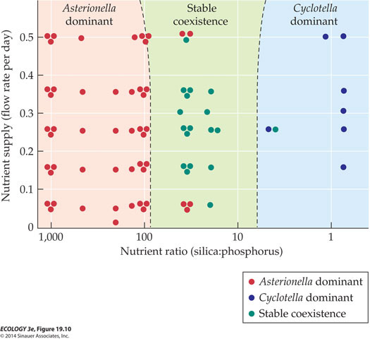
Tilman showed experimentally that certain combinations of resource ratios and nutrient supply rates allowed stable coexistence between two diatom species
Image/fig from Cain et al. (2014)

Slide 21
All plants need similar resources – how do so many species coexist?

Slide 22
At any given point in space, two species that don’t occupy the same niche can coexist when there are two limiting resources
It follows that if there are n limiting resources, n species can theoretically coexist
BUT – there are only so many resources…
Hutchinson (1961), in “The paradox of the plankton” asked, how do n+ species coexist on n resources?

Slide 23
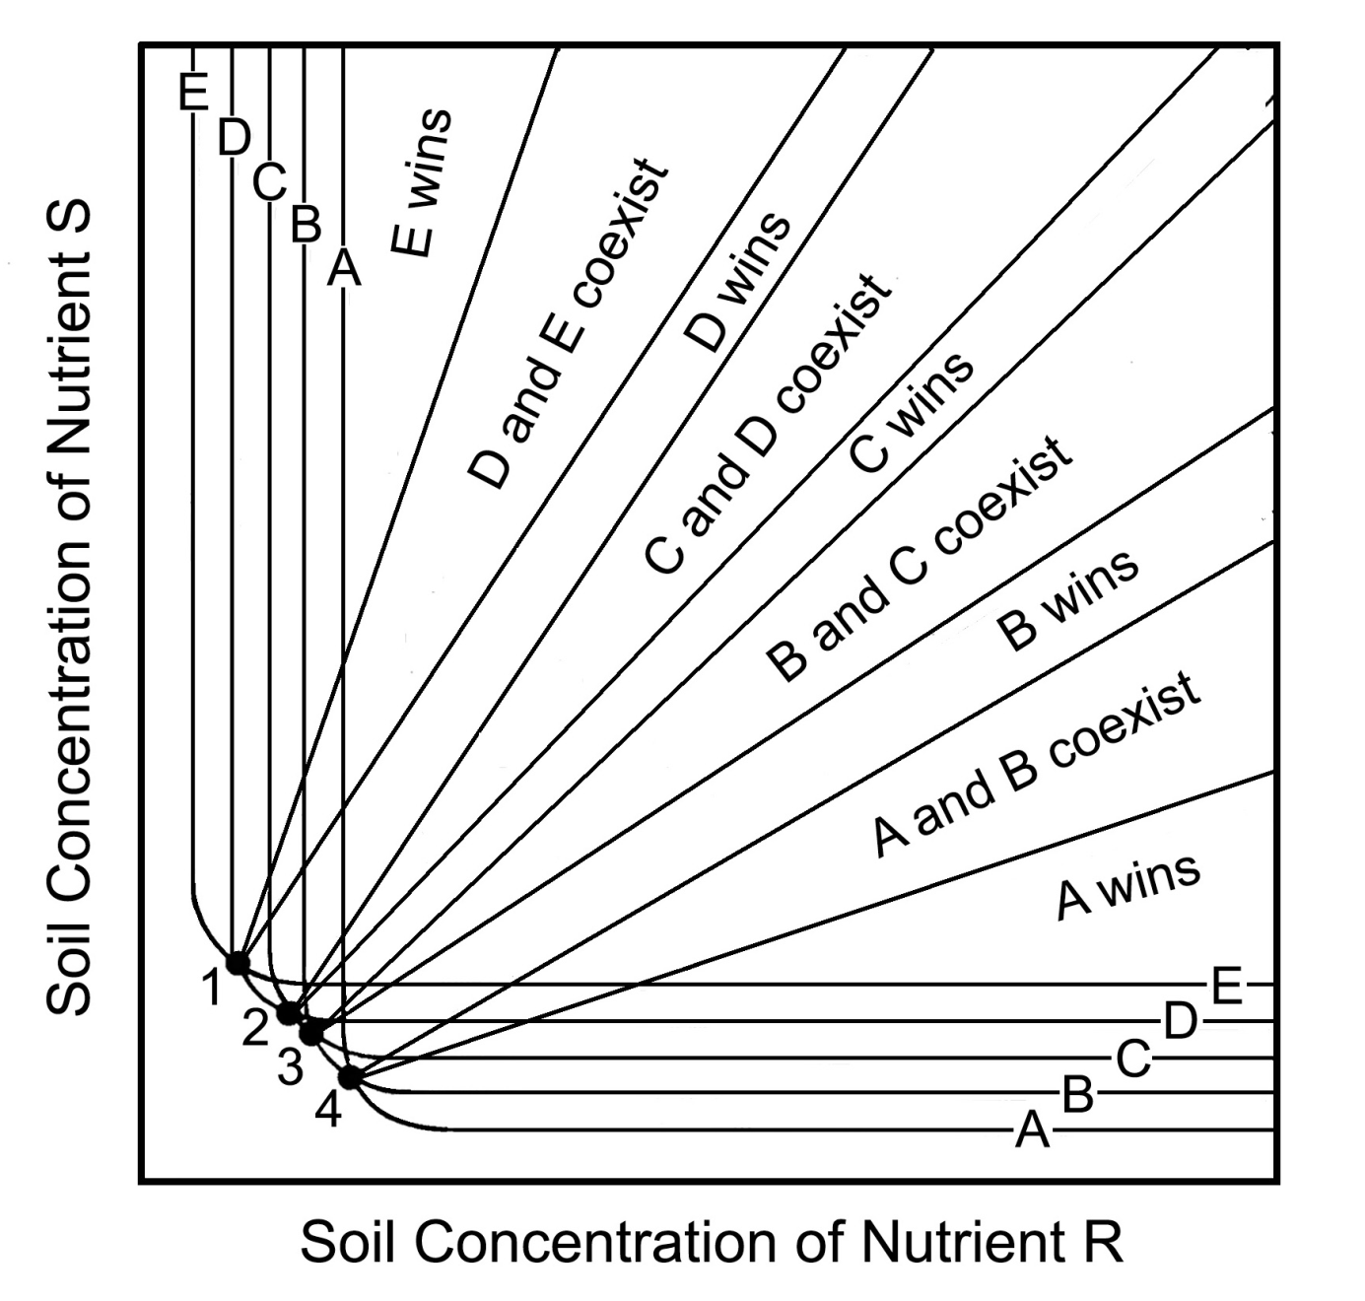
Tilman (1988) expanded the two-species case to incorporate many species

Slide 24

One way -> if there is spatial variation in resource supply rates
If the environment is homogeneous, we can think of the supply point as exactly that – a point, and only two species coexist
Tilman (1988)

Slide 25
But if we have substantial spatial heterogeneity in supply rates and resource ratios, many species can coexist
Tilman (1988)

Slide 26
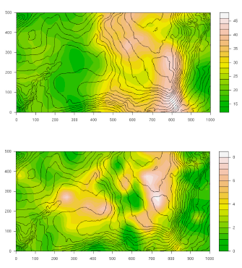
Another example: soil N and P in Barro Colorado Island (BCI), Panama
Soil N
Soil P
http://www.life.illinois.edu/

Slide 27
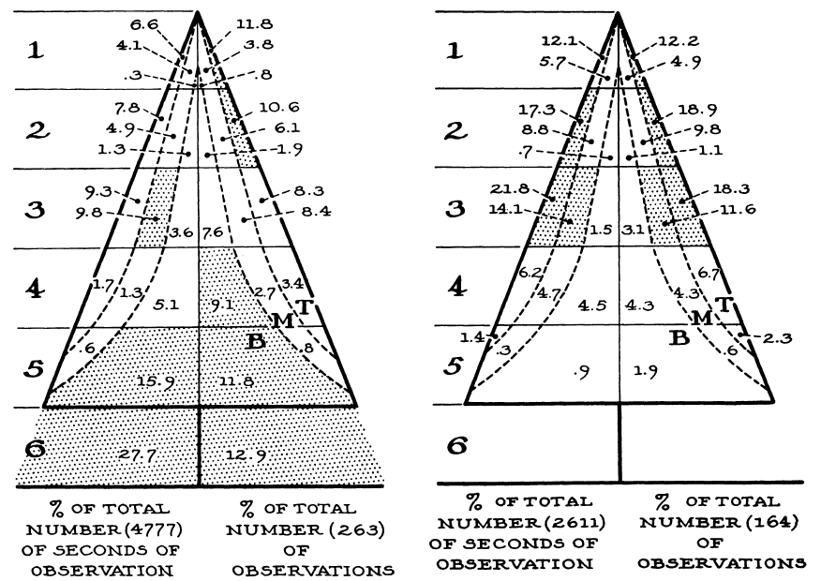
Macarthur’s warblers and niche partitioning
Myrtle warbler
Black-throated green warbler
MacArthur (1967)

Slide 28
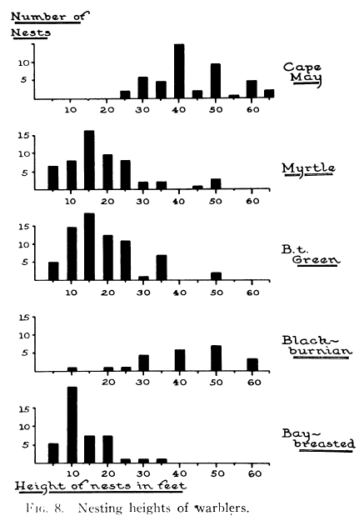
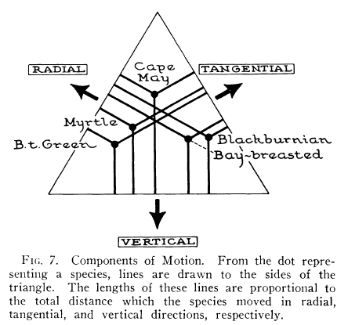

Slide 29
To sum up: some mechanisms that may explain local species richness:
Resource ratios
Hutchinson (1961): Non-equilibrium
Spatial heterogeneity in resource ratios
Niche partitioning
Others?

Slide 30
SUCCESSION

Slide 31
Clementsian vs. Gleasonian succession
Cowles (1899) -> succession in Lake Michigan dune communities
Clements (1916) -> communities as “super-organisms”, succession as analogous to development – climax state
Gleason (1926) -> “individualistic model”: species interact during succession, but not in an integrated fashion

Slide 32
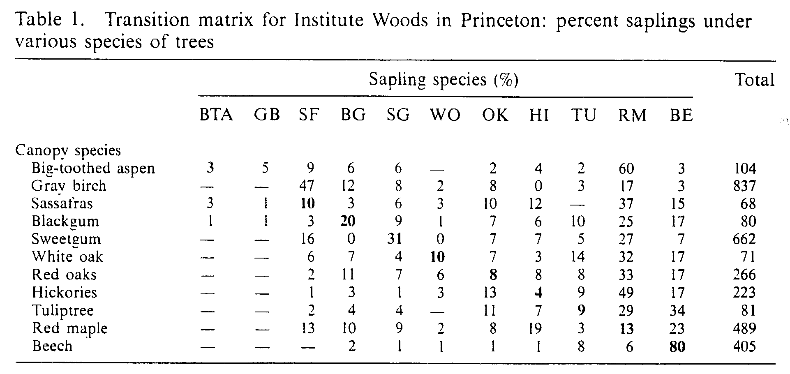
Horn (1975) and the Institute Woods
Horn (1975)

Slide 33





Horn’s table in cartoon form…
Sassafras
Red maple
Beech

Slide 34
A simulation of succession based on Horn’s overstory/understory data

Slide 35
Models of succession (Connel and Slatyer 1977)
Disturbance creates colonization opportunities
Tolerance: later species take time to disperse, grow, and establish. They grow despite the presence of early-successional species, and eventually out-compete them.
Facilitation: first species change conditions to allow later species to colonize. Implies high level of community integration.
Inhibition: early-successional species inhibit colonization by all others. Late successional species are those that are able to survive better.
Climax

Slide 36
Our focus so far:
LOCAL coexistence of things that are interacting with each other
Let’s shift to larger scales

Slide 37
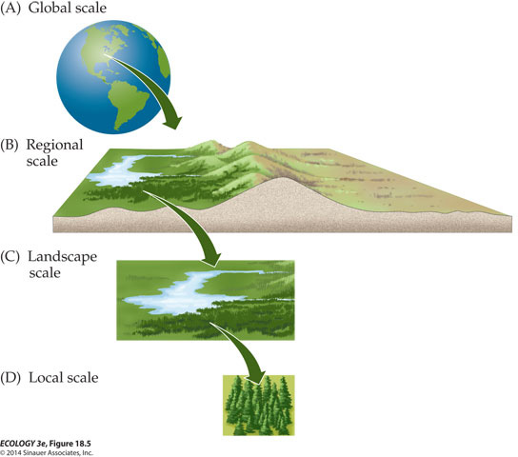
Diversity across scales
Regional scale
γ diversity
Spatial scale
Turnover
β diversity
Community scale
α diversity
Image/fig from Cain et al. (2014)

Slide 38
A cartoonish, non-quantitative example
Plot 1
Plot 2
B
D
C
A
A
D
B
Example 1
Low α, High β
B
C
C
B
A
A
D
D
B
D
C
B
A
C
B
C
B
A
B
A
A
C
Example 2
High α, Low β
B
D
D
A
B
D
A
C
D
C
C
D
Can we infer the mechanisms that gave rise to these patterns simply by analyzing the patterns themselves?

Slide 39
DISPERSAL LIMITATION

Slide 40
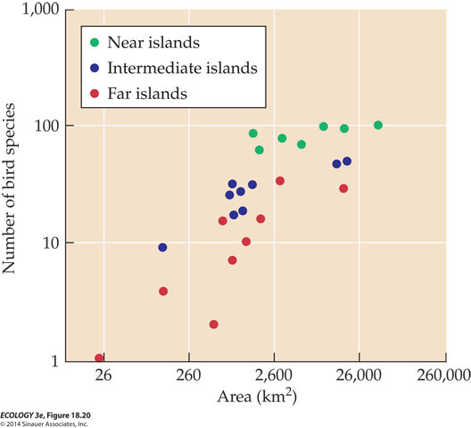
Theory of Island Biogeography (MacArthur and Wilson 1967)
Area and distance (≈ isolation) influence rates of immigration (recolonization) and extinction
Effect of area and distance on New Guinea bird species richness
Image/fig from Cain et al. (2014)

Slide 41
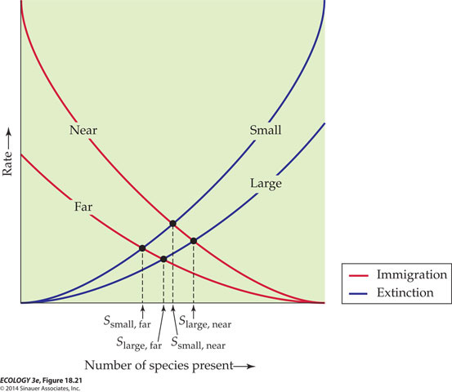
Area drives extinction rates and distance drives immigration rates
Where the two rates balance out, there is an equilibrium species richness
Image/fig from Cain et al. (2014)

Slide 42
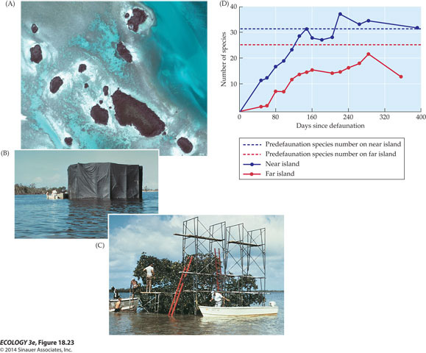
The theory was tested by Simberloff and Wilson (1969) on mangrove islands
Image/fig from Cain et al. (2014)

Slide 43
Enter Hubbell (1997 and 2001): A unified theory of biogeography and relative species abundance
Focuses on two scales: local community dynamics and regional metacommunity dynamics. Generalization of IB to include speciation
Local communities are ‘saturated’ and no births or immigration occurs until spaces are vacated by deaths
They can be recolonized by reproduction by the local species pool or by immigration from the regional pool
No need for niches – species are identical, wide range of species relative abundance distributions explained by this model, which only has 3 parameters θ, J and m
Dispersal limitation is the key
Dispersal is a random (neutral) process

Slide 44
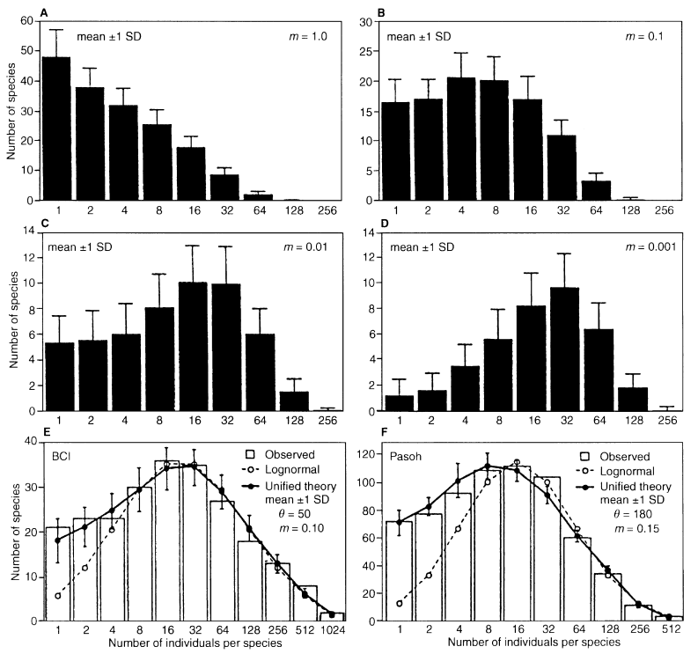
Hubbell (1997)

Slide 45
So how do niche principles “scale up”?
According to Hubbell, not very well
Neutral model can explain observed patterns very well – niches and competition not needed
Homogeneous environments can be occupied by diverse communities of effectively identical species (in terms of niches)
Hubbell acknowledges that species do have niches, but they don’t matter at large scales

Slide 46
Going forward
What do neutral and niche models have to say about α and β diversity?
What do patterns of α, β diversity tell us about the mechanisms of community assembly?
Is the world niche or neutral, or some of both?
If species differences matter, are communities Gleasonian or Clementsian?

