Slide 1
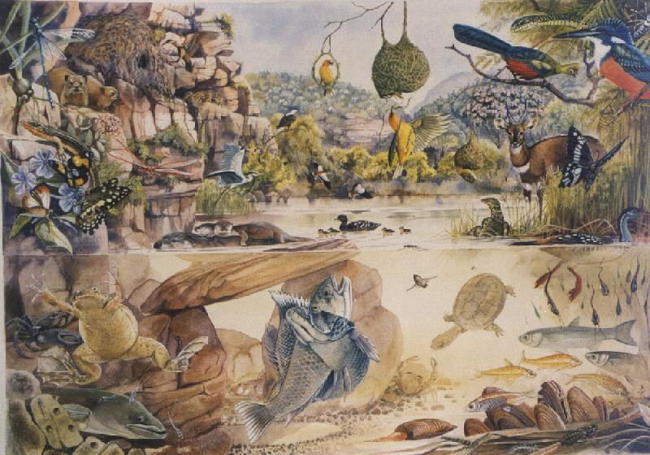
Changing biodiversity in space and time: Succession and latitudinal gradients
ECOL 4000/6000

Slide 2
Quiz
TO BEST ILLUSTRATE THE EVOLUTIONARY EXPLANATIONS FOR LATITUDINAL DIVERSITY GRADIENTS, WHICH (IF ANY) OF THE FOLLOWING SHOULD BE SWITCHED?
TITLES
AXES LABELS
LEGENDS
TIME FOR DIVERSIFICATION
DIVERSIFICATION RATE
LEGEND:
TROPICS
TEMPERATE
SPECIES RICHNESS
SPECIES RICHNESS
TIME
TIME

Slide 3
Succession:
Key concepts
Primary and secondary succession
Species abundance distribution
Climax community
Succession and diversity
Disturbance succession

Slide 4
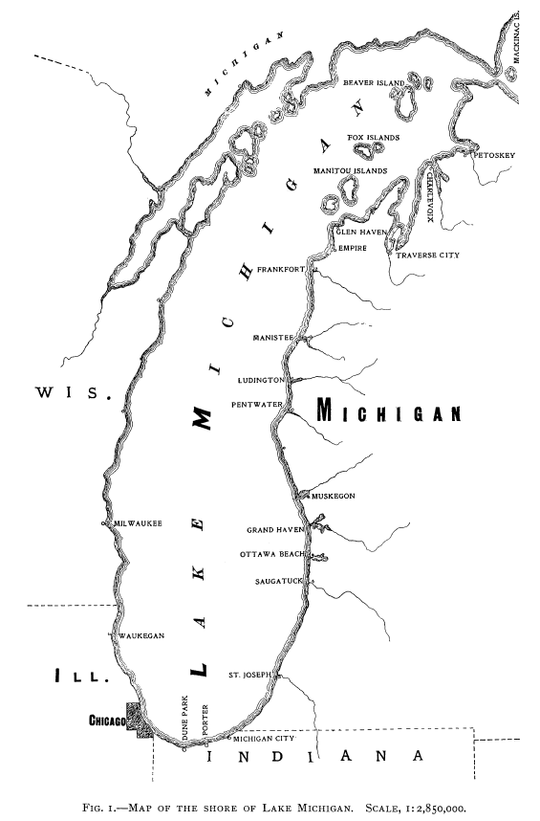
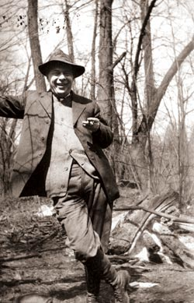
The origin of succession theory
Henry Chandler Cowles

Slide 5
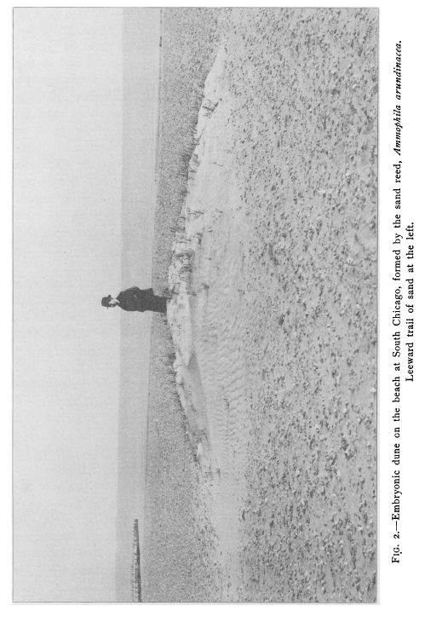
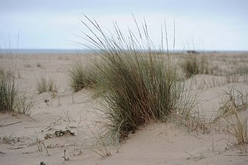
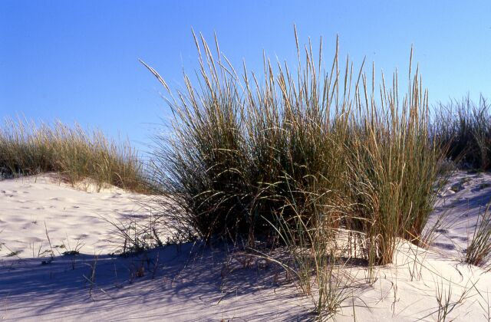
Primary succession by Ammophila breviligulata
Indiana Dunes, USA
Photo: Cowles (1899)

Slide 6
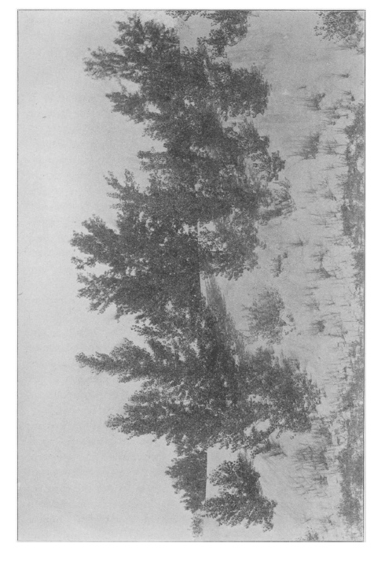
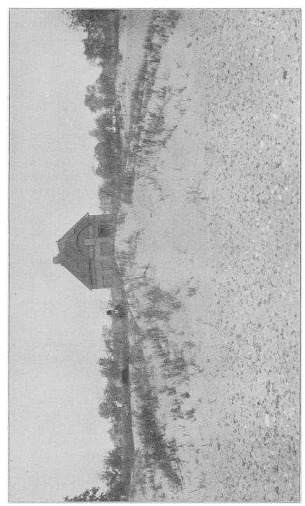
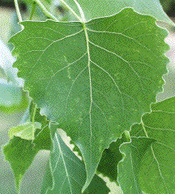

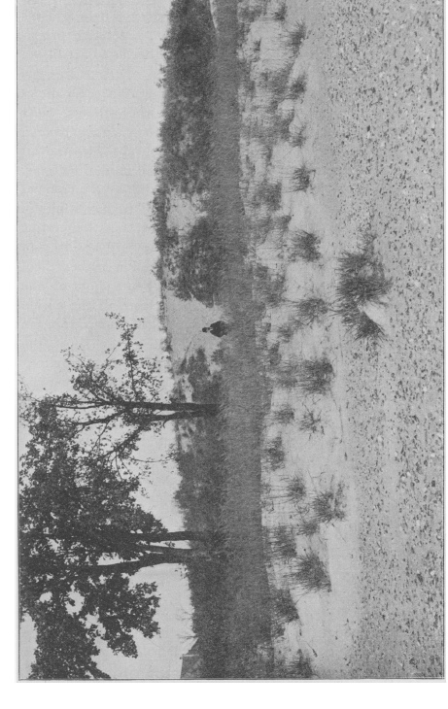
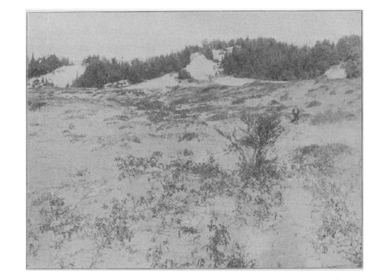
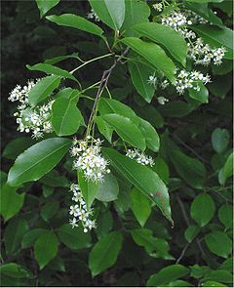
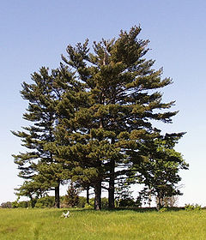
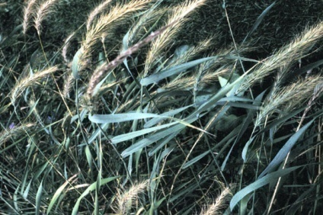
Cowles (1899)
Plate 5
Plate 3
Established Ammophila breviligulata
(Marram grass)
Populus (Cottonwood)
Plate 6
Coniferous trees
Plate 4
Pinus spp.
Elymus (Wildrye)
Prunus and Salix

Slide 7
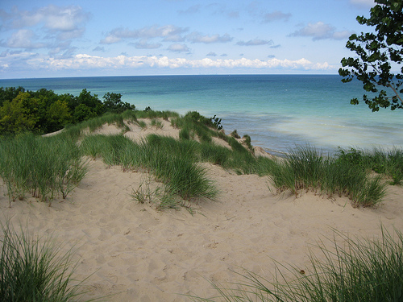
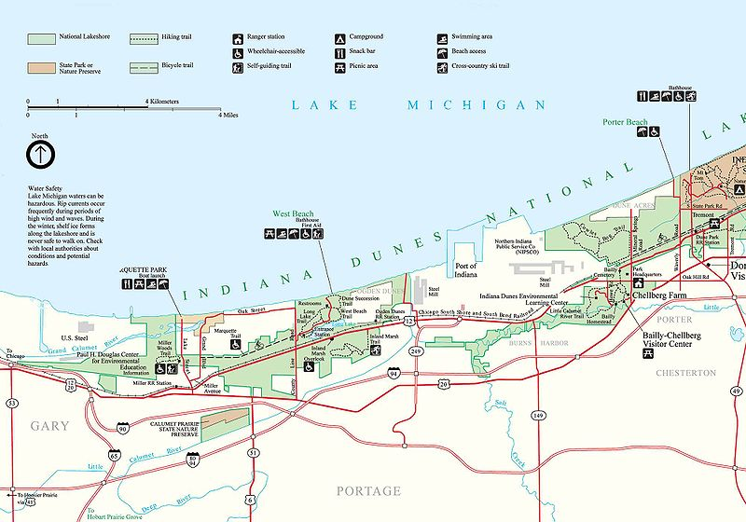
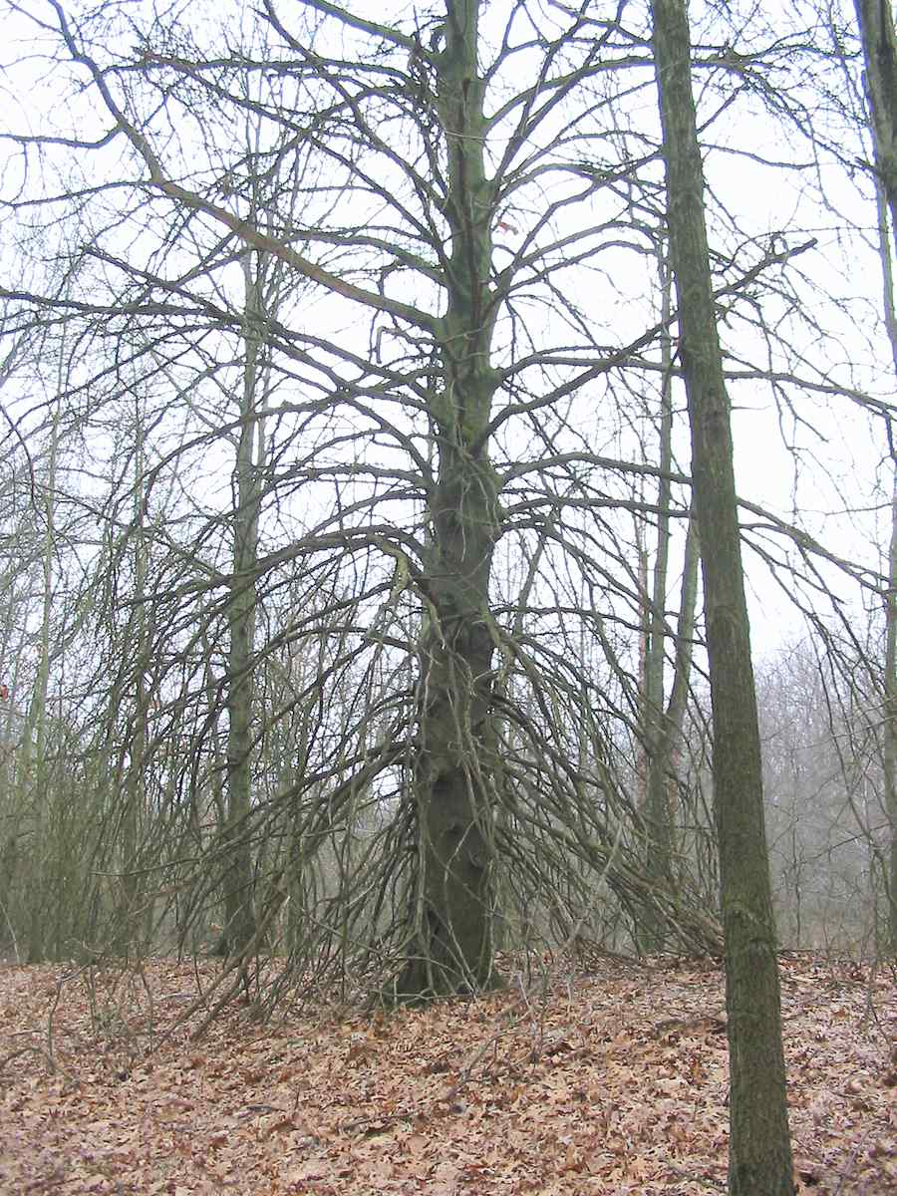
Why do we see this progression?
Answer: Ecological Succession

Slide 8
Key Definitions
Succession (def) – Predictable (directional) change in the composition (species abundance distribution) of an ecological community over time (e.g., A → B→ C)
Primary succession (def) – Colonization of new substrate by vegetation (e.g., A → B)
Secondary succession (def) – Replacement of early successional vegetation by other species (particularly woody plants) (e.g., B → C)
Climax community (def) – A stable species abundance distribution, the end point of succession (i.e., state C)
Cyclic succession (def) – Periodic succession in plant communities
(e.g., A → B→ C→A); communities with cyclic succession do not have a climax
What explains the directionality of succession, ending in a climax community?

Slide 9
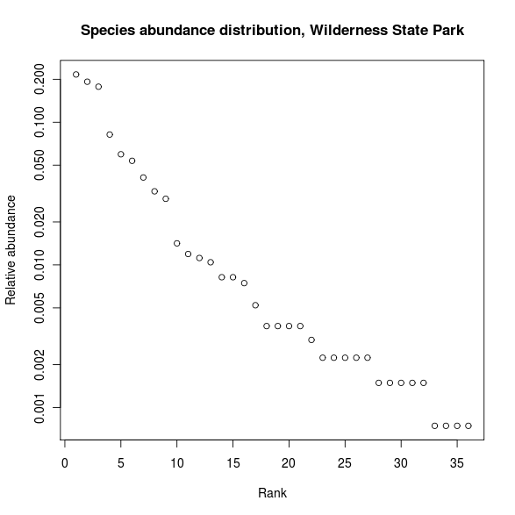
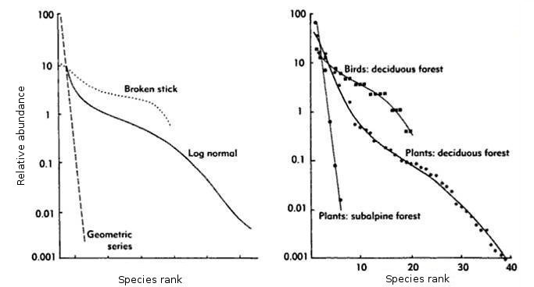
What is succession?
To answer this question we need another concept – the species abundance distribution
Species evenness (def.) – Relative distribution of species in a community; the opposite of concentration
Logarithmic
scale
Whittaker (1970)
Magurran (1988)

Slide 10
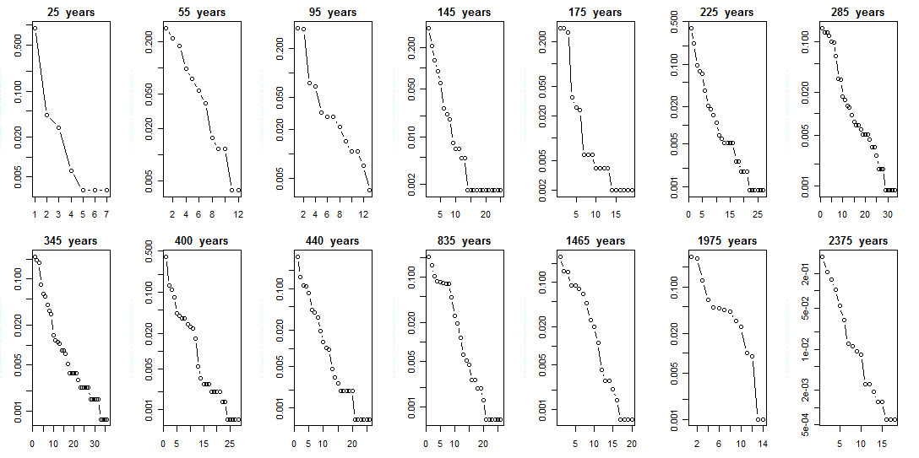
Evenness Across a Successional Gradient at Wilderness State Park
How does evenness change across this successional gradient?
How does species richness change across this successional gradient?

Slide 11
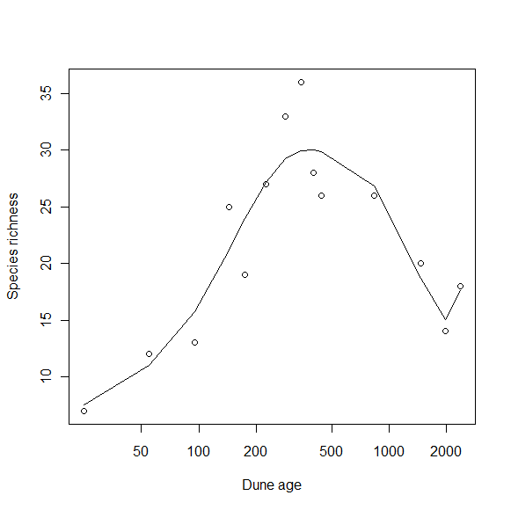
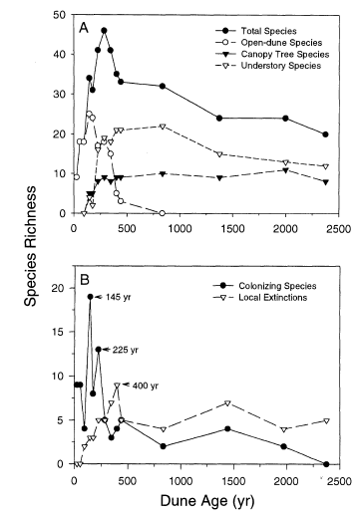
Species Richness Across a Successional Gradient at Wilderness State Park
Why does species richness peak at intermediate dune age?
What is the mechanism for this replacement process?

Slide 12
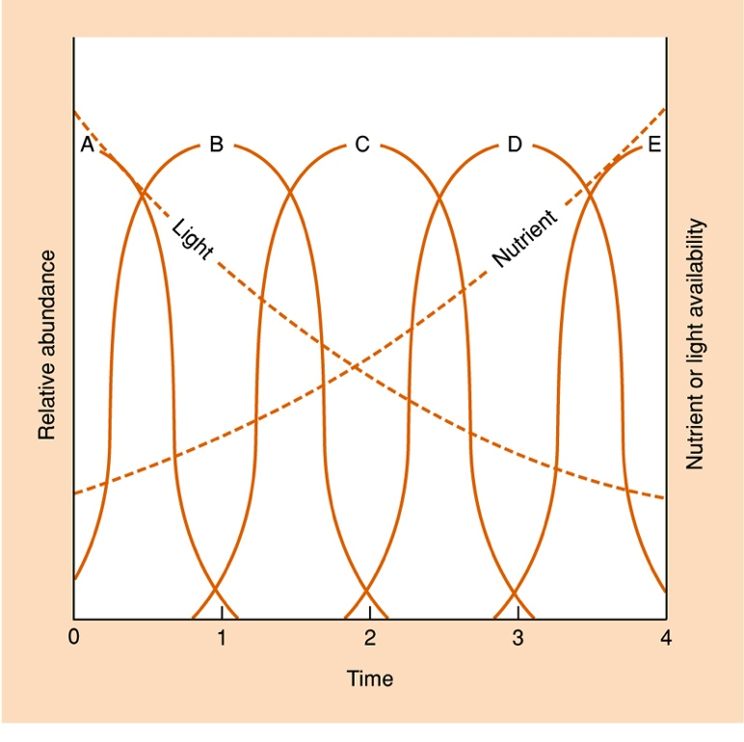
Tilman’s resource-ratio hypothesis
Plants differ in their requirements for limiting resources (soil nutrient & light)
Resources are negatively correlated
Relative competitive abilities change with resources
Successive dominance of different species predicted
Adapted from Tilman (1988)

Slide 13
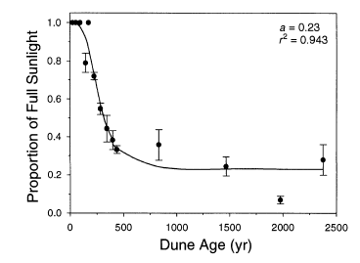
Light competition in the understory

Slide 14
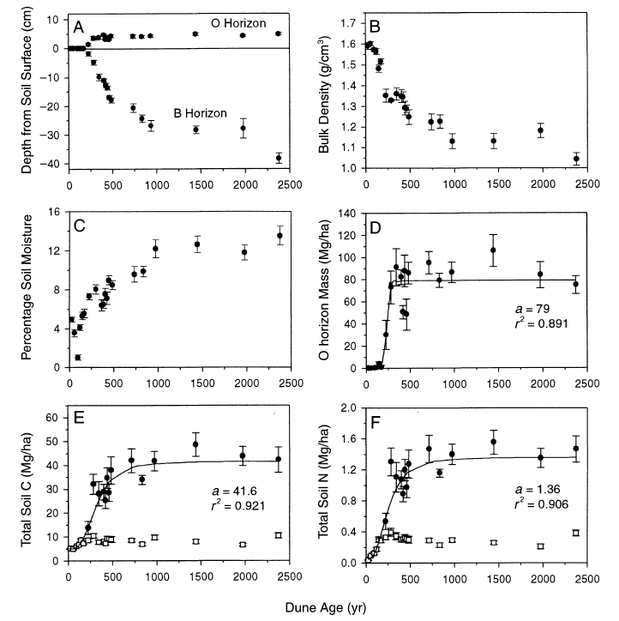
Succession and Ecosystem Processes

Slide 15
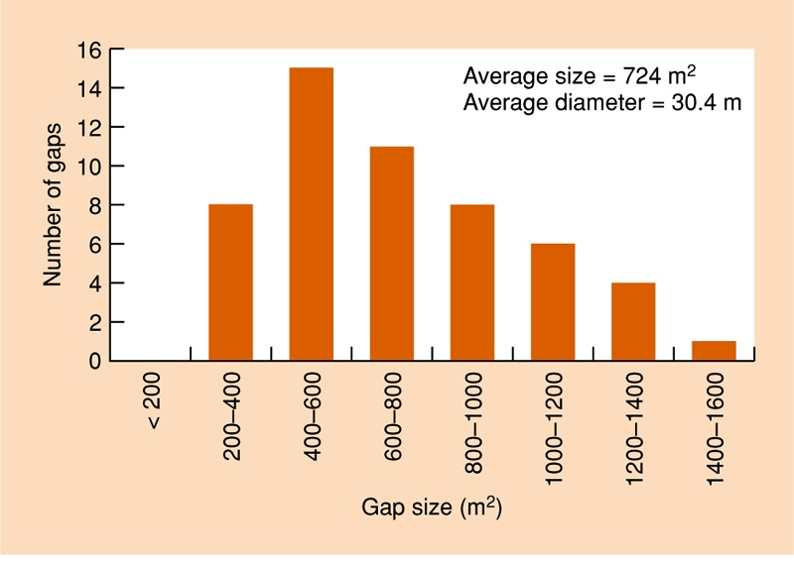

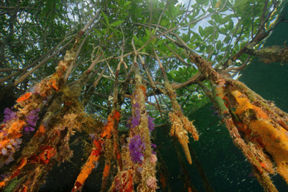
Disturbances create new opportunities
Frequency distribution of gaps created by lightning in tropical mangrove forest in the Dominican Republic
Sherman et al. 2000

Slide 16
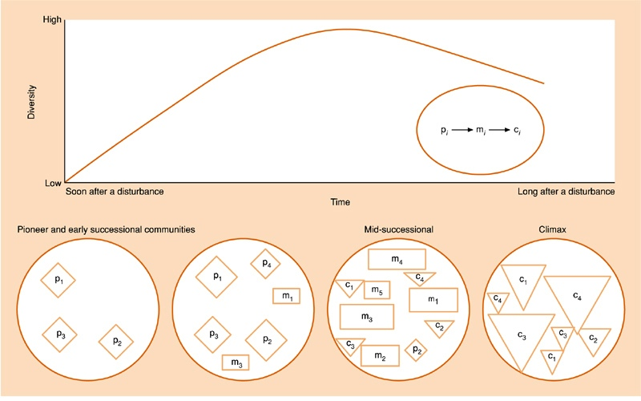
Hypothetical progression following disturbance

Slide 17
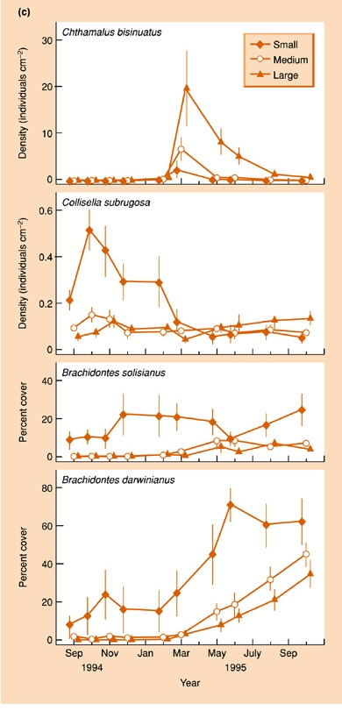
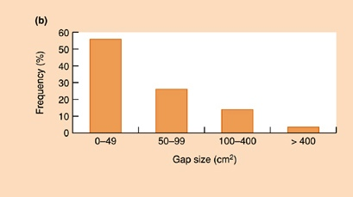
Experiments on mini-successions – effect of gap size
Tanaka and Magalhaes (2002) found that gap size in mussel beds affected successions
Small gaps initially harbored sea snails, and later, mussel species
Larger gaps showed slower colonization in general – first by barnacles, later by mussels

Slide 18
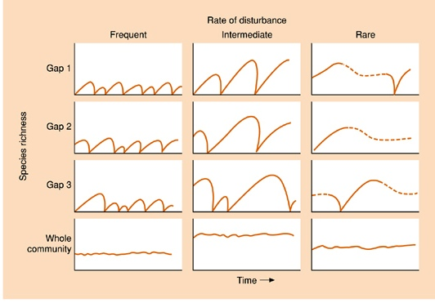
Intermediate disturbance
With frequent disturbance, all species (typically pioneer) are suffering
With rare disturbance, competitive exclusion (----) leads to climax community
Consequently, species richness (at community level) is maximized at intermediate disturbance
Proposed by Grime (1973), Horn (1975), Connell (1978)

Slide 19
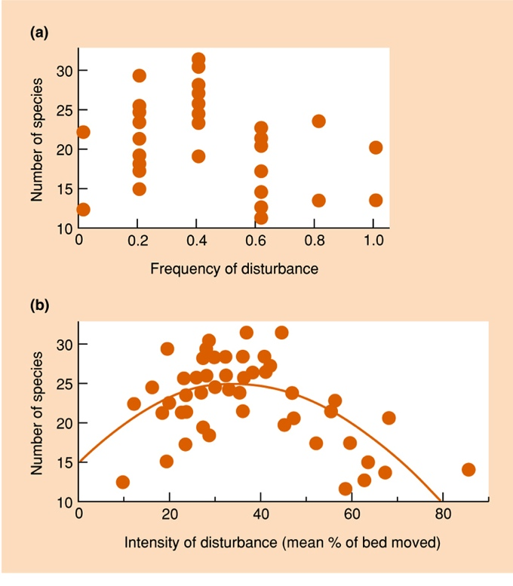
Support for intermediate disturbance hypothesis
Invertebrate species richness vs (a) frequency of disturbance (b) intensity of disturbance in NZ streams. Disturbance involves river bed movements during times of high discharge. (a) frequency of events causing >40% bed movement (b) mean % bed movement at site. Intensity and frequency are strongly correlated.
Townsend et al. 1997

Slide 20
Summary
Primary and secondary succession
Species abundance distribution – a graphical summary of diversity
Climax community defined as a community with a stable species abundance distribution; the climax community is the endpoint of succession
Succession and diversity
  Climax as a stable state
  Competitive replacement
Disturbances create new opportunities for succession
  Species richness maximized at intermediate disturbance frequency

Slide 21
Quiz: replace [1]-[4] with words from relevant list to recreate the 1st sentence of today’s reading
“Succession refers to a [1], [2] change in [3] structure over [4]”
1
2
3
4
Directional
Stochastic
Unpredictable
Random
Predictable
Directional
Stochastic
Unpredictable
Random
Predictable
Genetic
Spatial
Niche
Community
Physical
Space
Time
Ecosystems
Compensation
Biomes

Slide 22
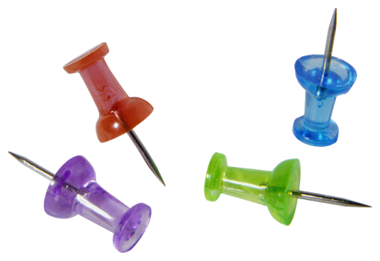
Latitudinal Diversity Gradients:
Key concepts
Latitudinal diversity gradient
Mid-domain effect
Evolutionary hypotheses
Abiotic hypotheses
Biotic hypotheses

Slide 23
What is diversity, and is it even important?
Diversity: the number and variety of organisms in a specified geographic area
Sources of diversity = unresolved problem
Controversial relationship between species diversity and community attributes
Variation in species diversity is complex
  Basis for some of the fundamental unsolved problems in community ecology

Slide 24
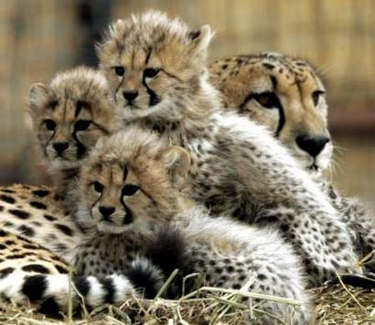
Global diversity
An example: species diversity in mammals
Schipper et al 2008 Science

Slide 25
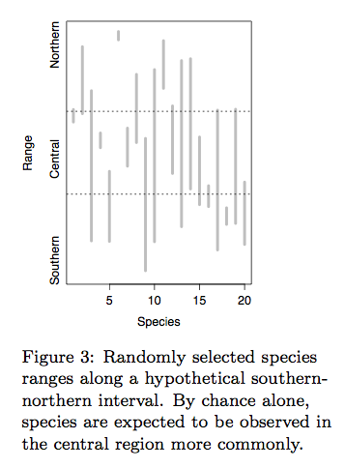
Mid-domain effect
Even if species latitudinal ranges are random, we still expect to see more species if we ‘walked’ an equatorial transect (vs. a a more temperate one)
A useful null model to
compare with

Slide 26
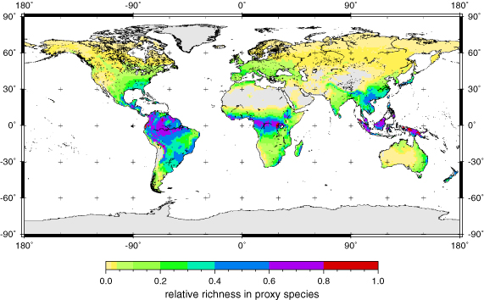
Several hypotheses have been proposed to explain latitudinal gradients in species diversity.
Evolutionary time
Ecological time
Climatic stability
Climatic predictability
Spatial heterogeneity
Productivity
Stability of primary production
Competition
Disturbance
Predation
These hypotheses are not mutually exclusive, and different factors may be interacting.

Slide 27
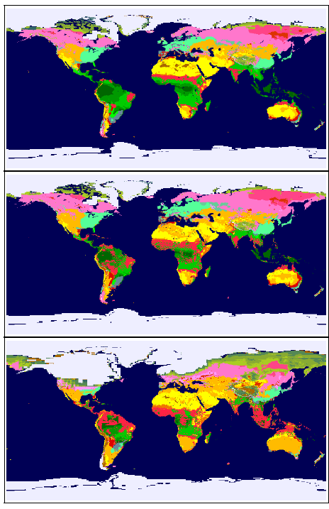
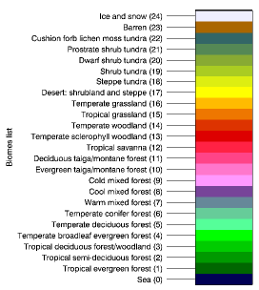
The age of tropical habitats have allowed for more speciation over time.
Evolutionary time
Ecological time
Climatic stability
Climatic predictability
Spatial heterogeneity
Productivity
Stability of primary production
Competition
Disturbance
Predation
Modern Day
6,000 yr BP
21,000 yr BP

Slide 28
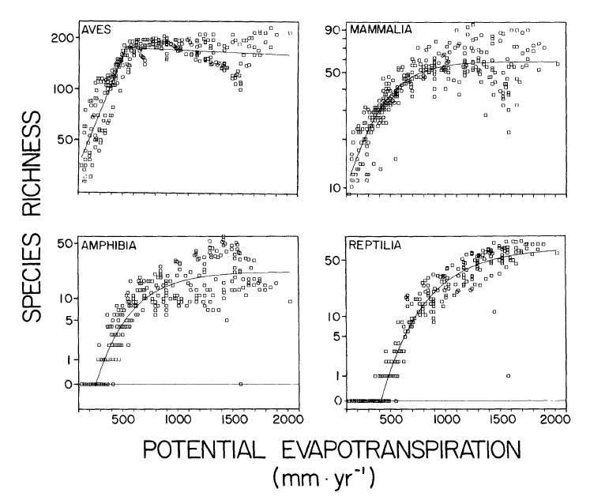
Tropical environments are more predictable, which allows for greater specialization of resources.
Evolutionary time
Ecological time
Climatic stability
Climatic predictability
Spatial heterogeneity
Productivity
Stability of primary production
Competition
Disturbance
Predation
Currie (1991)

Slide 29
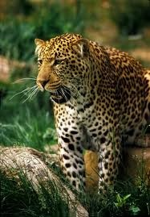
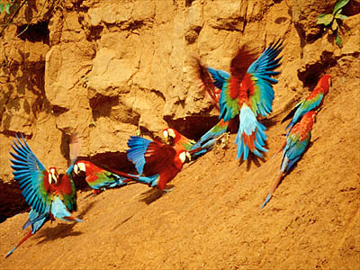
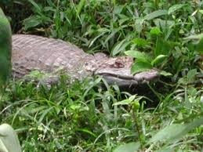
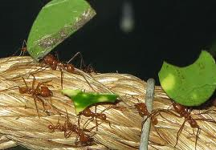
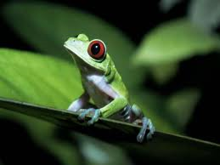
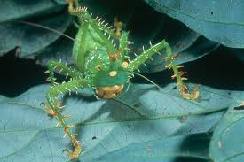
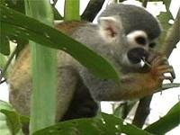
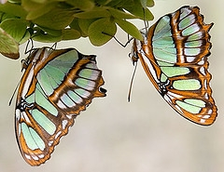
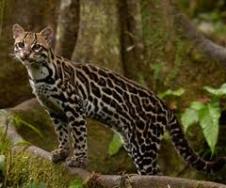
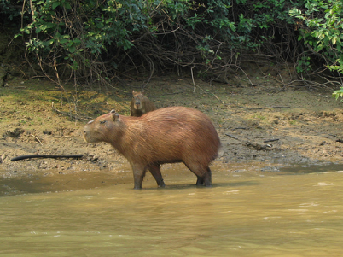
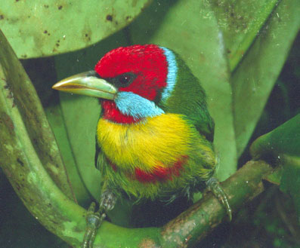

Greater competition and predation in the tropics allow more species to coexist.
Evolutionary time
Ecological time
Climatic stability
Climatic predictability
Spatial heterogeneity
Productivity
Stability of primary production
Competition
Disturbance
Predation

Slide 30



Disturbance is intermediate in the tropics compared with temperate regions, allowing for greater species diversity.
Evolutionary time
Ecological time
Climatic stability
Climatic predictability
Spatial heterogeneity
Productivity
Stability of primary production
Competition
Disturbance
Predation

Slide 31


The tropics contain a more extensive spatial matrix, which promotes higher species coexistence.
Evolutionary time
Ecological time
Climatic stability
Climatic predictability
Spatial heterogeneity
Productivity
Stability of primary production
Competition
Disturbance
Predation

Slide 32

Niche conservatism
If tropics are more species rich, they may not ‘supply’ species elsewhere, since some species will be maladapted to temperate environments

Slide 33
Summary
Latitudinal diversity gradient
  Mid-domain effect
  Evolutionary effects
  Abiotic processes
  Biotic processes

